Slide 1
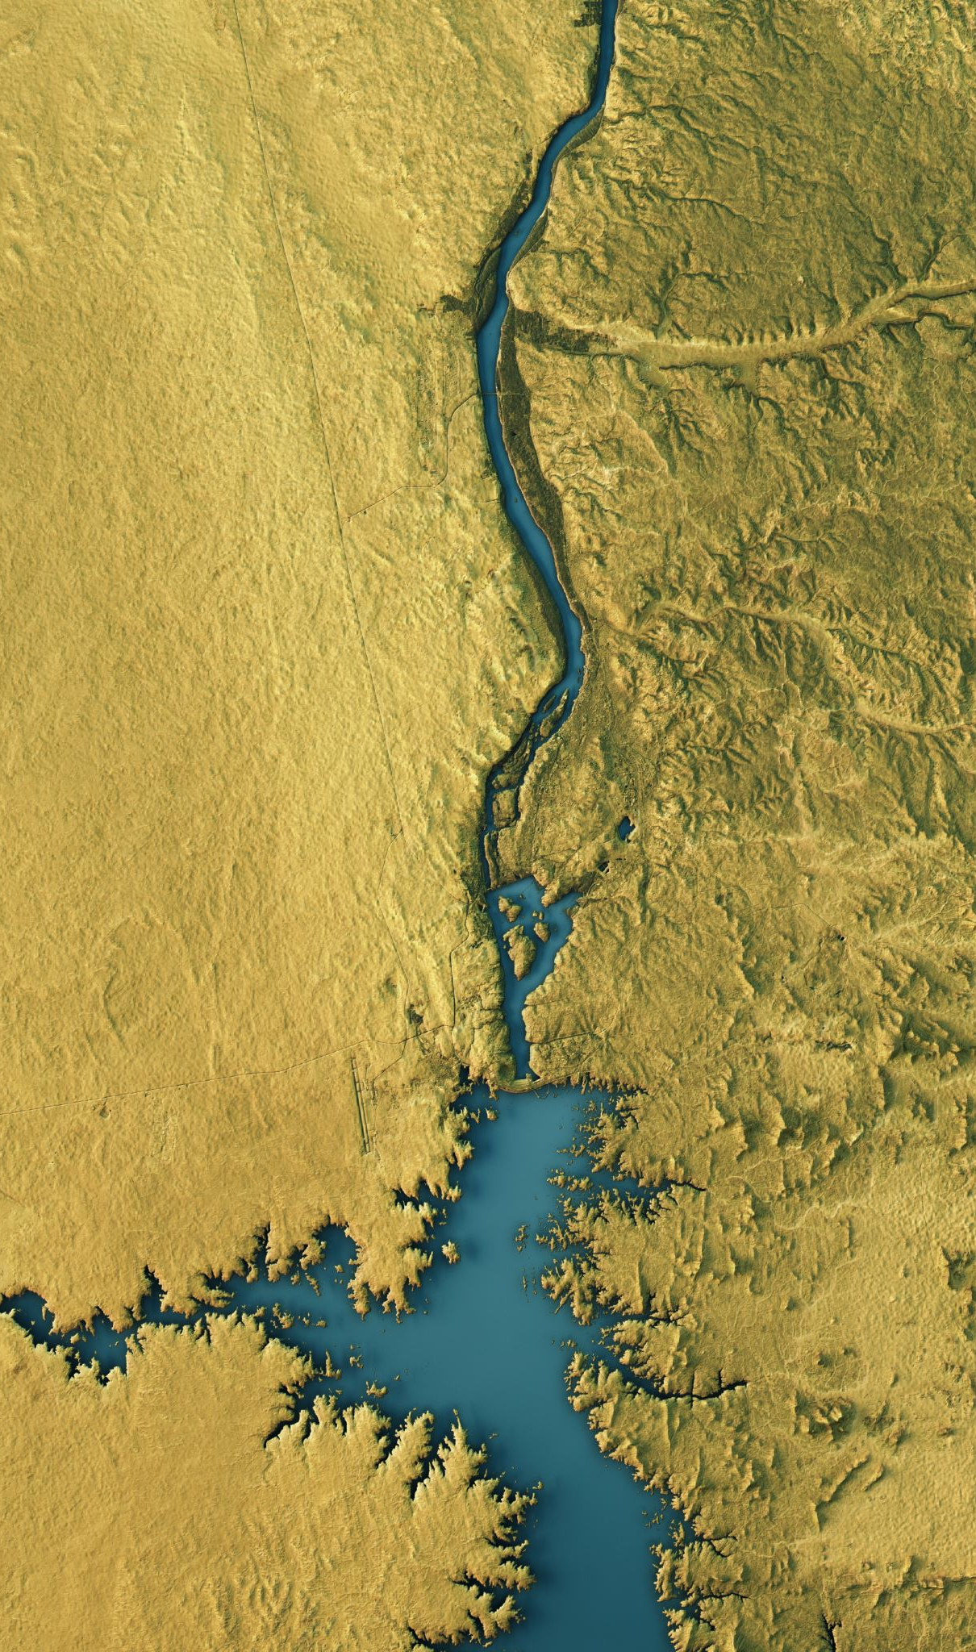
Landforms & Landmasses 2
Formation

Slide 2
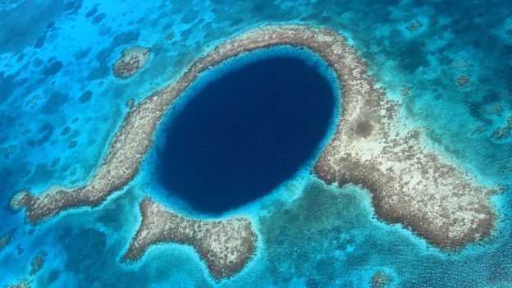
How are Landforms Created?
https://online.clickview.com.au/libraries/videos/7336963/the-formation-of-landforms

Slide 4
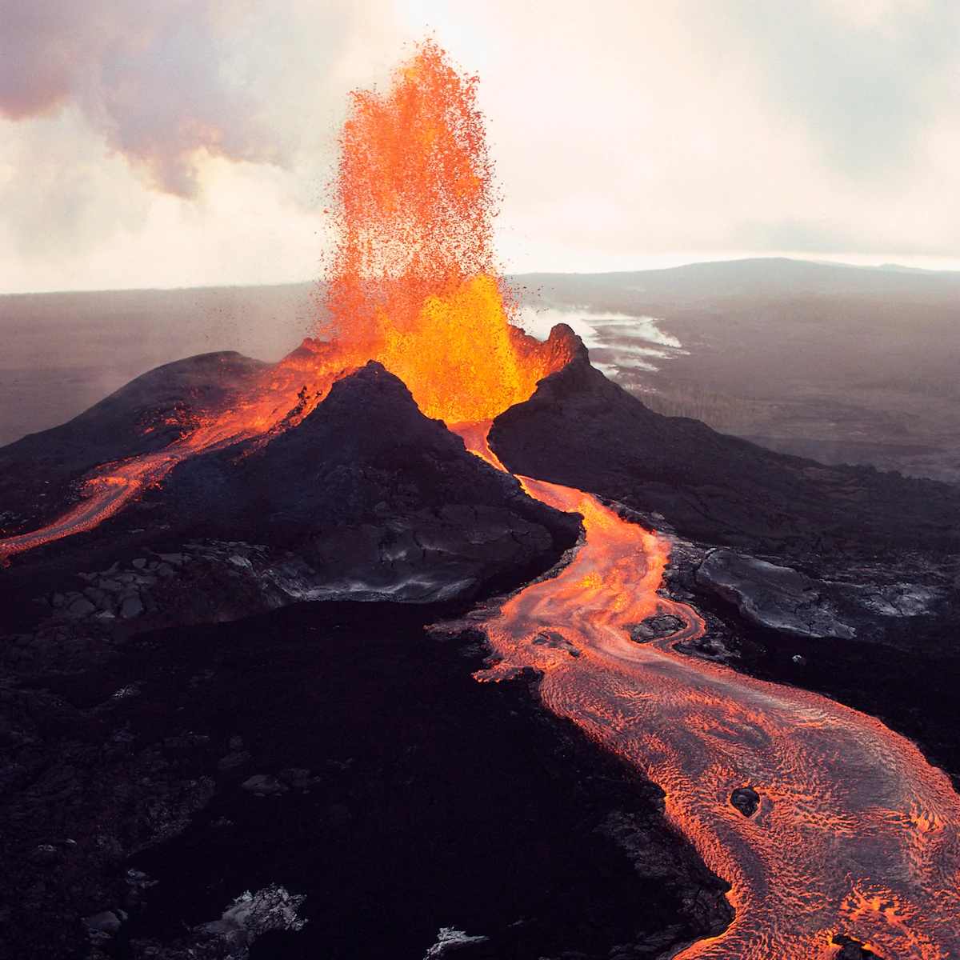
Internal
Plate tectonics
https://online.clickview.com.au/libraries/videos/21148006/tectonics-our-earth-and-its-movements
Volcanoes
https://online.clickview.com.au/exchange/videos/39605880/volcanoes

Slide 5
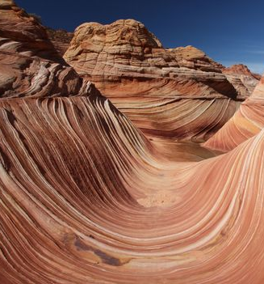
External
Weathering
https://online.clickview.com.au/libraries/series/34598510/miniclips-earth-s-changing-surface/videos/34591272/erosion
Erosion
https://online.clickview.com.au/libraries/series/34598510/miniclips-earth-s-changing-surface/videos/34590945/weathering

Slide 6
External Processes

Slide 7
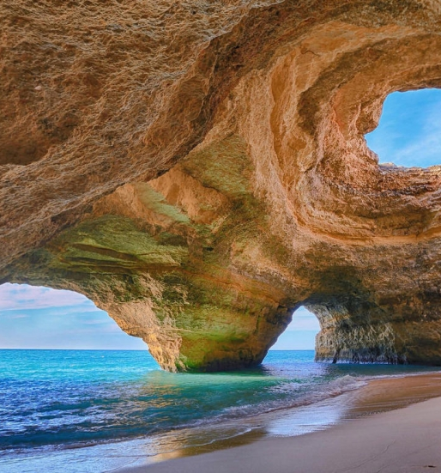
Some tricky examples
Caves
https://www.youtube.com/watch?v=EX0q5I3-HZI
Geysers
https://www.youtube.com/watch?v=_gyhvqbIaOE
Oases
https://www.youtube.com/watch?v=nuJ6QTZdvxM

