Slide 1
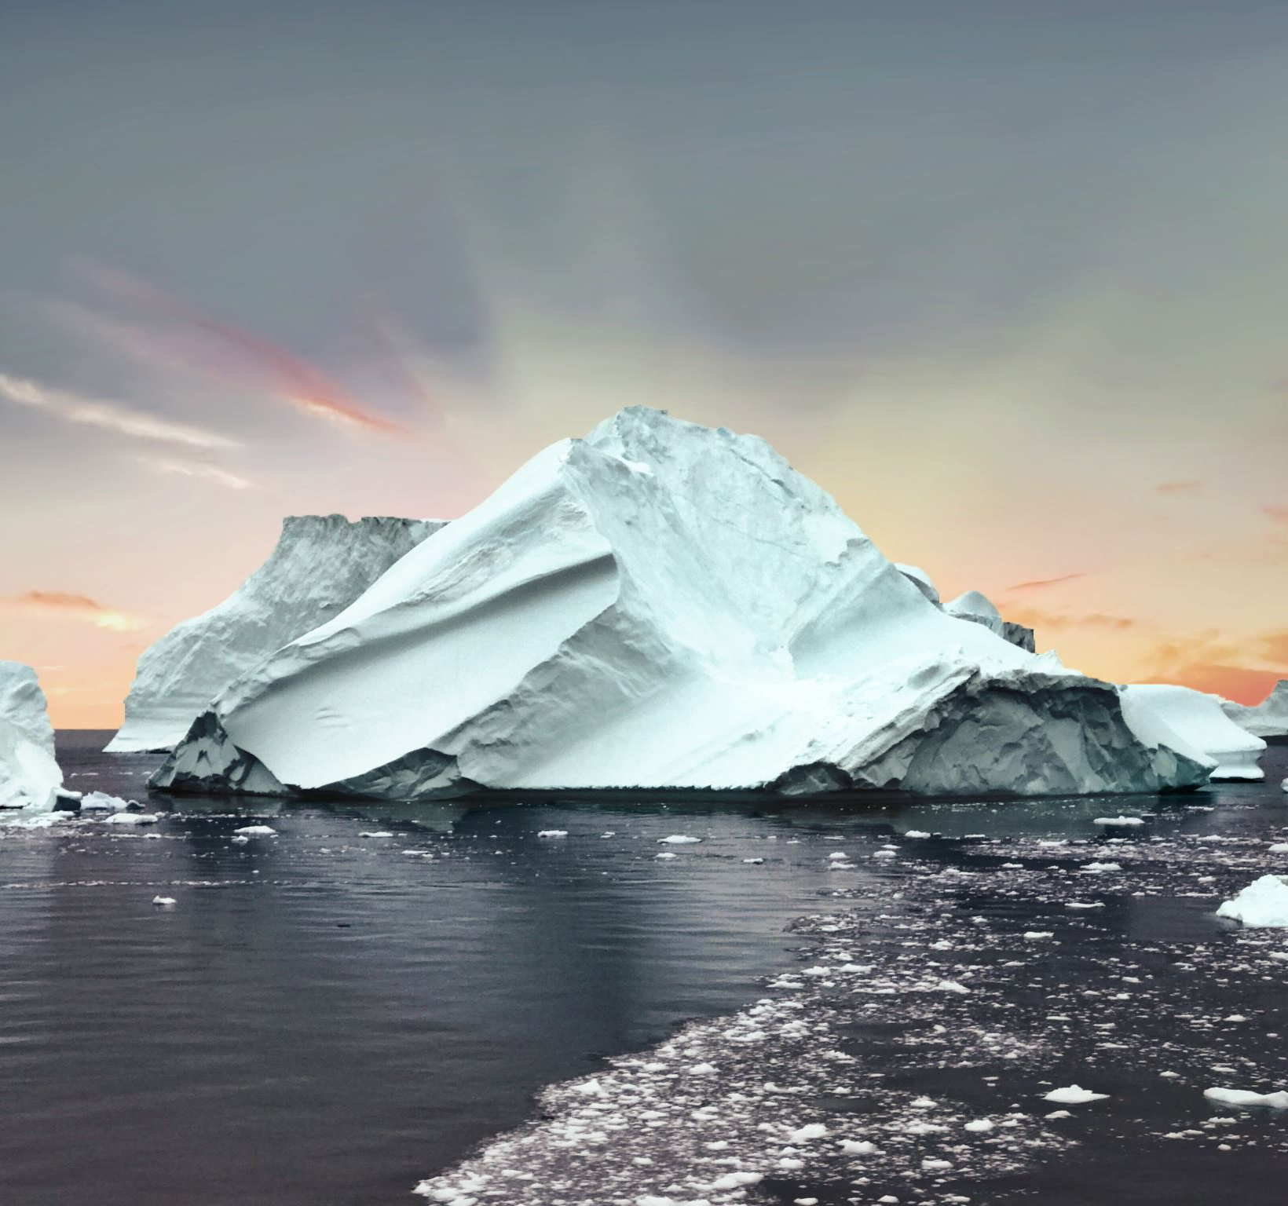
Globalisation
Travel & tourism

Slide 2
‘See’ factors
Society
(Education, health, safety, opportunity)
Economy
(money, jobs, trade, business)
Environment
(air, water, land, plants, animals)
These three factors are helpful for considering the effect something has on the world e.g. globalisation
Considers different ways that globalisation affects people and places.
Impact can be positive or negative

Slide 3
Positive see factors of globalisation
Social
Easier for people to stay in contact with family interstate/overseas
Economic
Increase in global trade means more jobs and careers
Environment
Travel and tourism raise awareness of environmental concerns in other countries

Slide 4
Negative see factors of globalisation
Social
‘Westernisation' and the loss of cultural identity.
Economic
Poorer nations are unable to adapt to new technologies and are being disadvantaged.
Environment
More resources and infrastructure take a toll on the environment – disposal of E-waste is becoming a global concern.

Slide 5
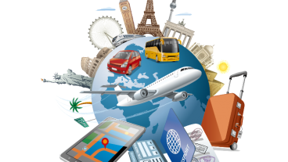
Tourism & Travel Interconnections
International & domestic tourism contribute $34 billion to the Australian economy each year.
Tourism is one of the biggest income sources for many countries.
Where people chose to travel depends on many factors e.g. purpose of travel, activities planned, cost
Have you travelled in the last five years? If so, how many times and where?
Was it domestic or international?
What was your reason for travelling? Why was that destination selected?

Slide 6
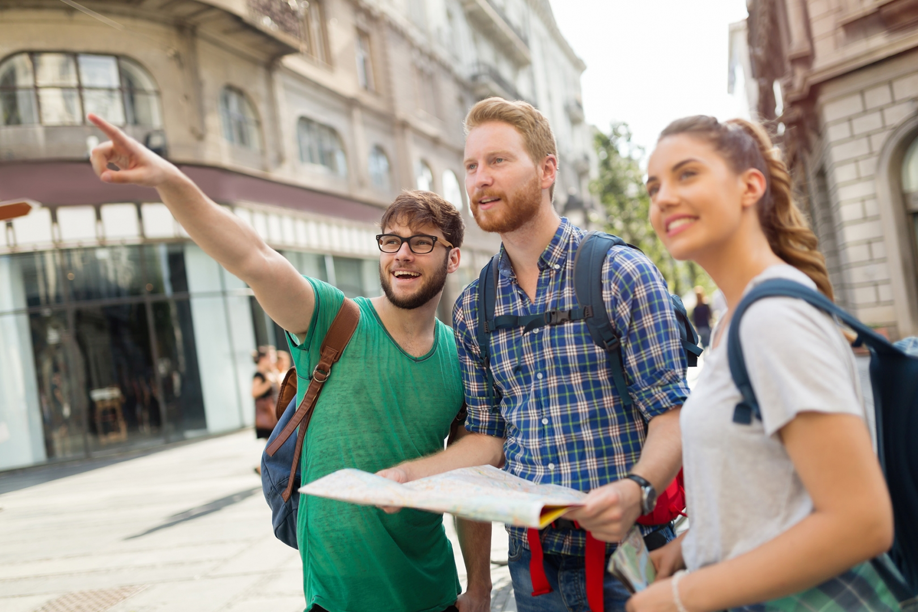
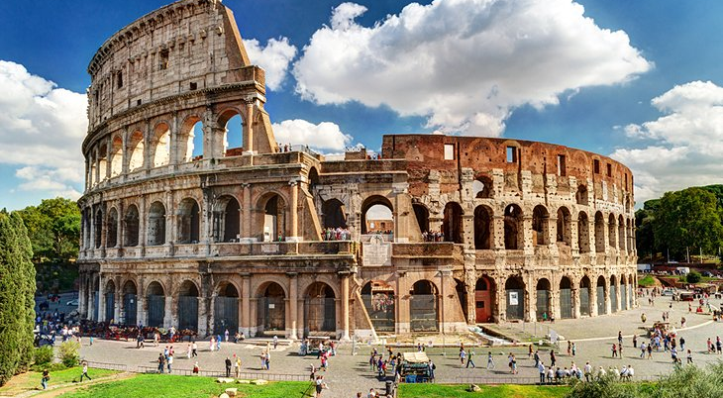
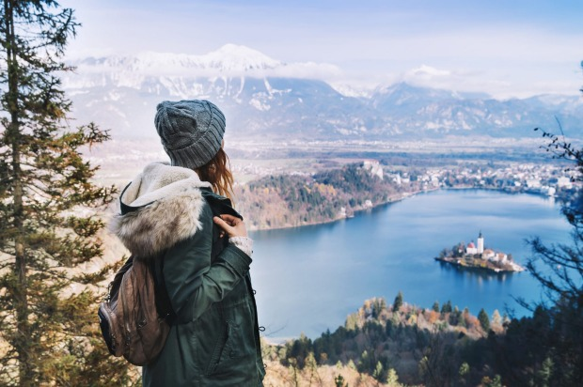
Types of tourism
Recreational Tourism: travelling to have a good time, relax or to enjoy the attractions of a particular place.
Historical Tourism: travelling to learn more about a particular place or events that have occurred there in the past, visit the places where it happened.
Wilderness Tourism: travelling to enjoy the challenge of places that are untouched by humans e.g. Antarctica, the Amazon, the Himalayas.

Slide 7
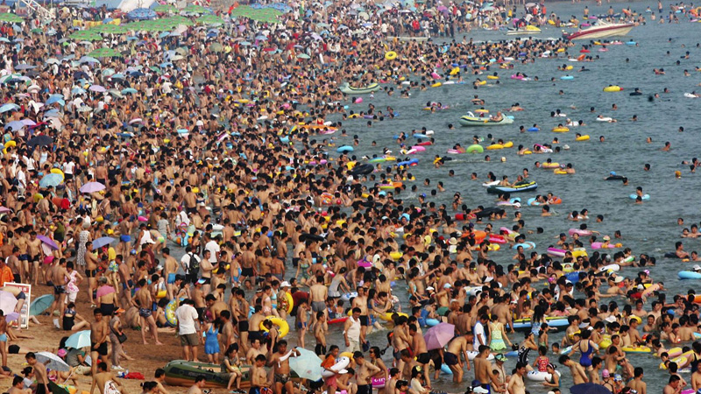
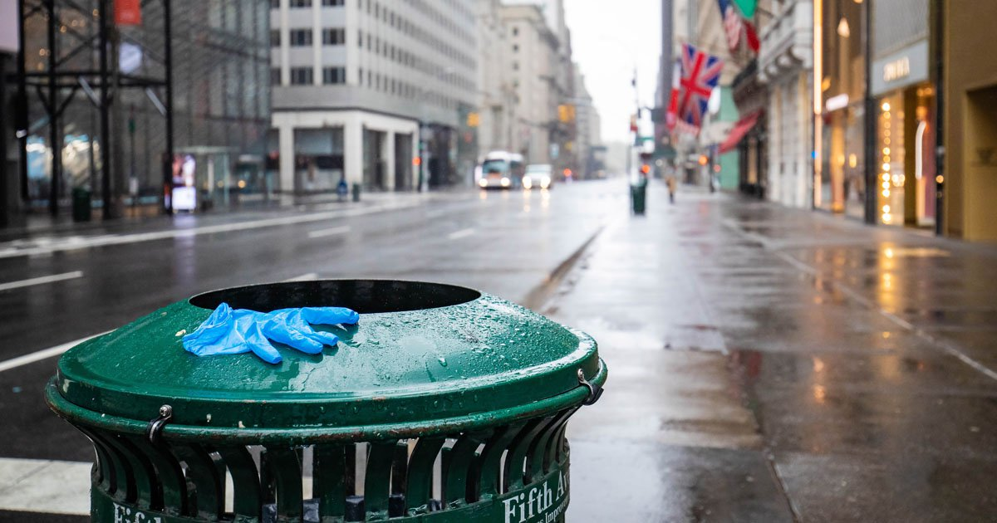
Tourism is constantly changing
Pre 2020
More people were travelling more often
Overcrowding
Countries exploiting locations for profit
After 2020
Dramatic decrease in international travel
Huge economic loss for countries who rely on tourism as their main industry

Slide 8
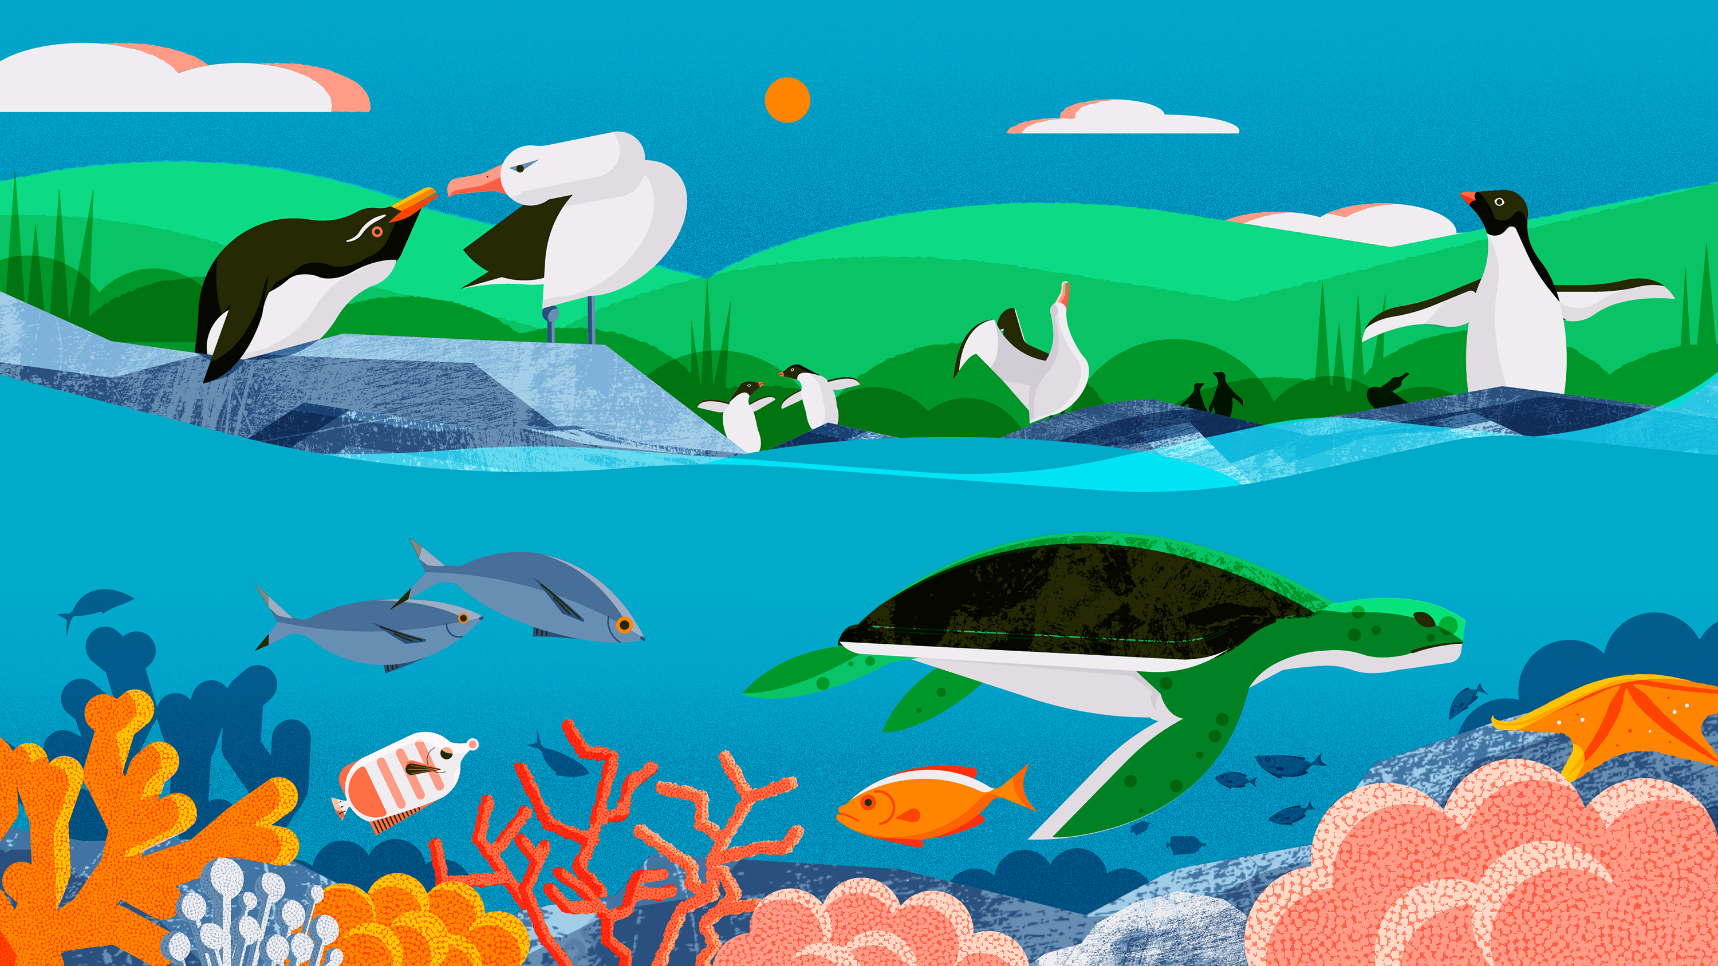
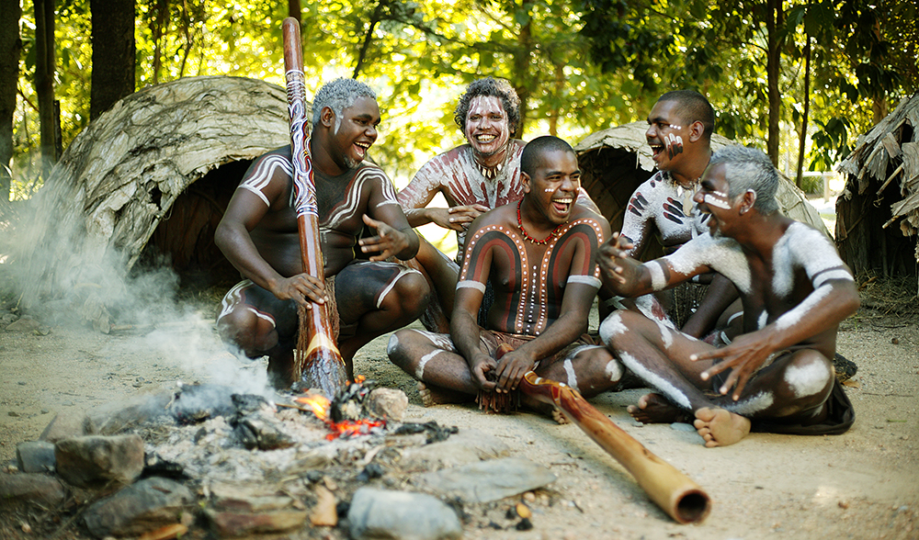
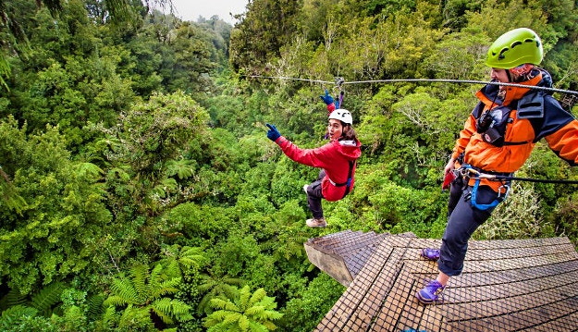
Trends in tourism (pre-covid)
The internet has allowed people to become more aware of their impact on locations before they travel there. This has led to an increase in Ecotourism – choosing locations and experiences that are environmentally friendly.
More demand for ‘authentic’ cultural or indigenous experiences, rather than places that have been created to cater specifically to tourists.
Adventure tourism e.g. mountaineering, rafting or rock-climbing is becoming more popular. The experience can more important than the place.

Slide 9
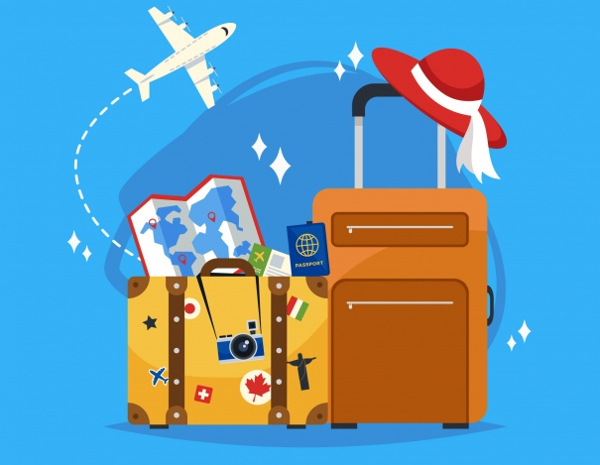
Trends in tourism (pre-covid)
More booking on the internet than using a travel agent.
Growth in the number of tourists from Asia.
More people participating in medical tourism (some surgeries or treatments are cheaper or better in other countries)
Increased tourism by people with disabilities – more accessibility awareness, better facilities
Think Pair Share: What do you think will change now? Predict the next trends in tourism, taking into account COVID-19

Slide 10
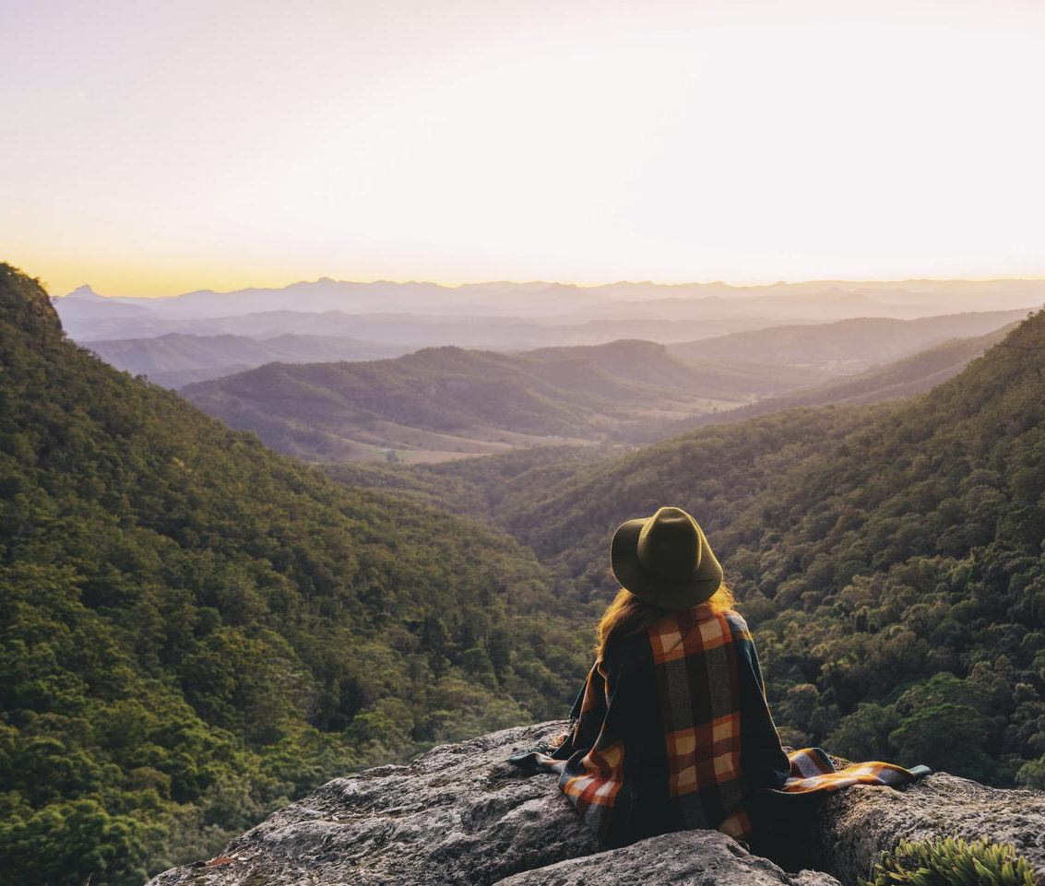
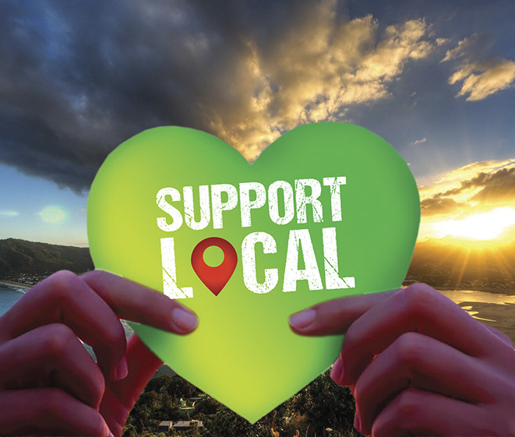
The future of tourism
Increase in local tourism (within your own state/country rather than overseas)
Shorter trips but spending more money
Hygiene & safety a much bigger concern
Avoiding public transport
Increased appeal of ‘wilderness’ tourism (open spaces, few people, outdoors) over cities
Less travelling in groups

Slide 11
Impacts of tourism ‘see’ factors
Society
(Education, health, safety, opportunity)
Economy
(money, jobs, trade, business)
Environment
(air, water, land, plants, animals)
Think Pair Share:
What are the impacts of tourism (positive AND negative) on
Society
Environment
Economy

Slide 12
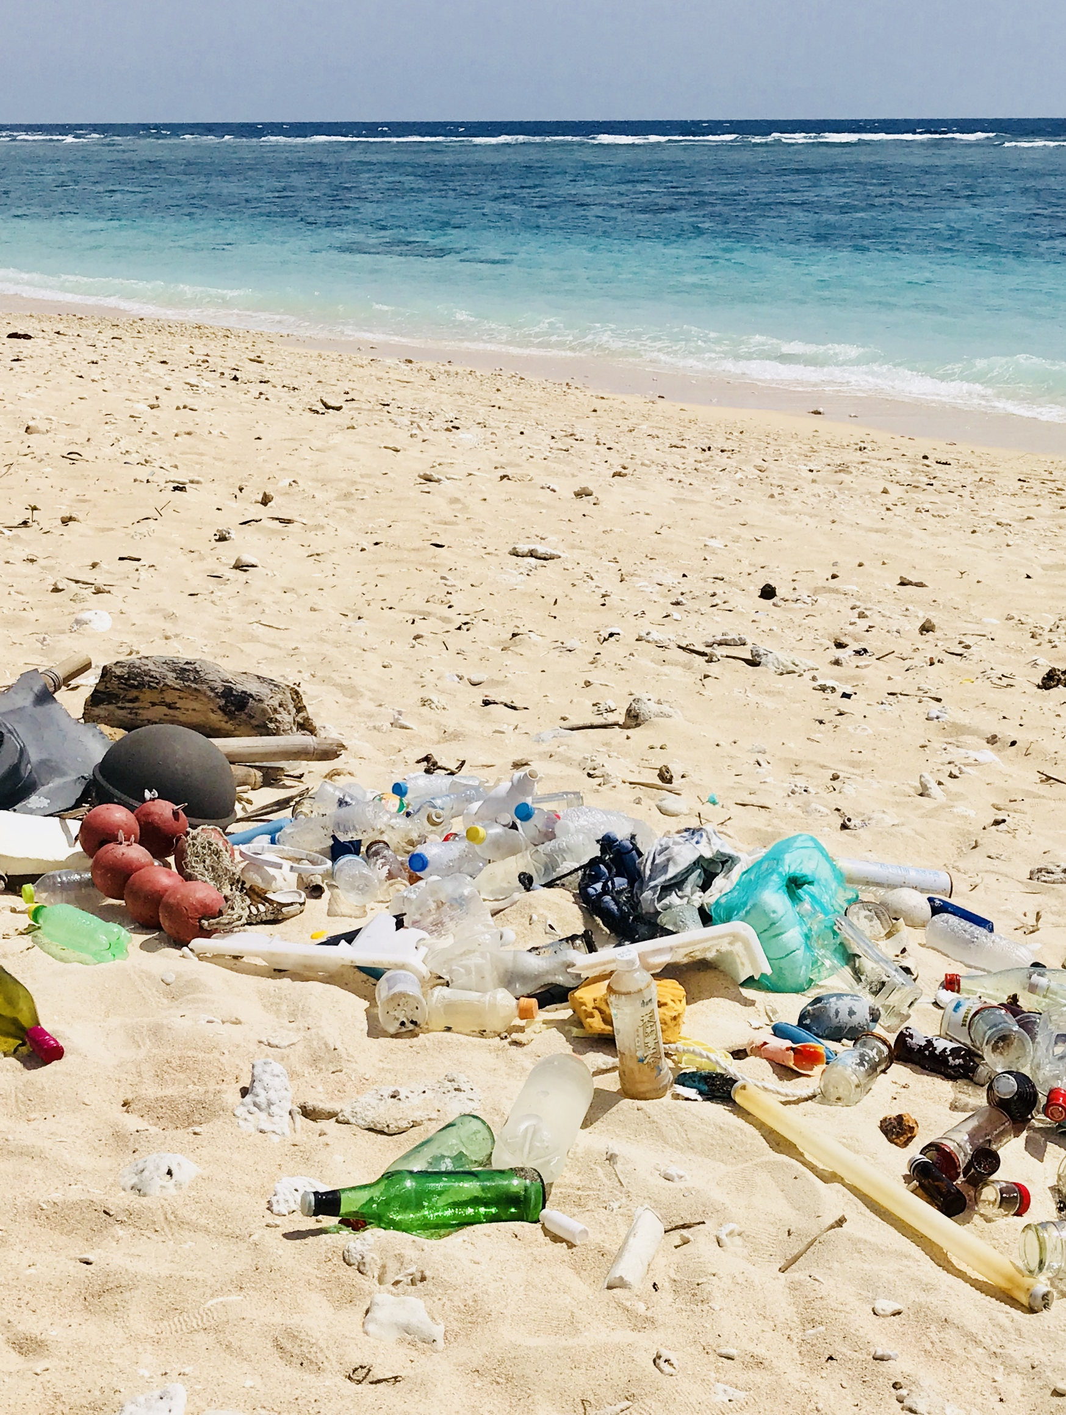
See impacts of tourism
Social
Culture and way of life – local customs & traditions altered to suit tourists.
Use money to develop areas for tourists instead of infrastructure the local population need.
Environmental
Heavy transport on popular routes can damage roads & water bodies – pollution.
Over-consumption of food and water resources in crowded areas.
Damage to wilderness areas.
Economic
Brings money into the economy & provides jobs for locals
Benefits big companies (e.g. airlines, hotels) – often TNCs are not based in that country

