Slide 1
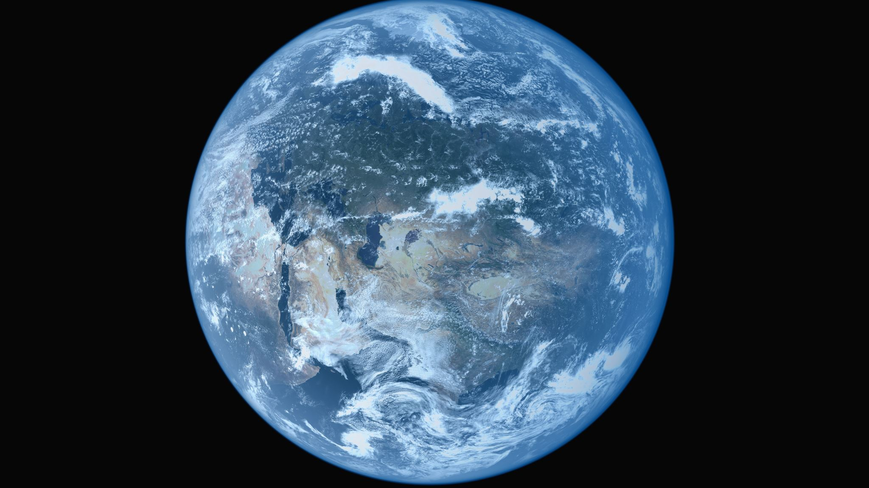
Globalisation
Changing global relationships

Slide 2
What is Globalisation?
A process caused by advancing technology
The way that communication and trade occurs worldwide, and that way that has changed
Involves the relationship between countries, companies, resources and money
Some countries have wealth and power while others lack basic necessities
Companies have grown so big they are more powerful than nations

Slide 3
“The World is Getting Smaller”
The time it takes for people and information to travel around the world has rapidly decreased
24 hours
5900 hours
636 hours

Slide 4
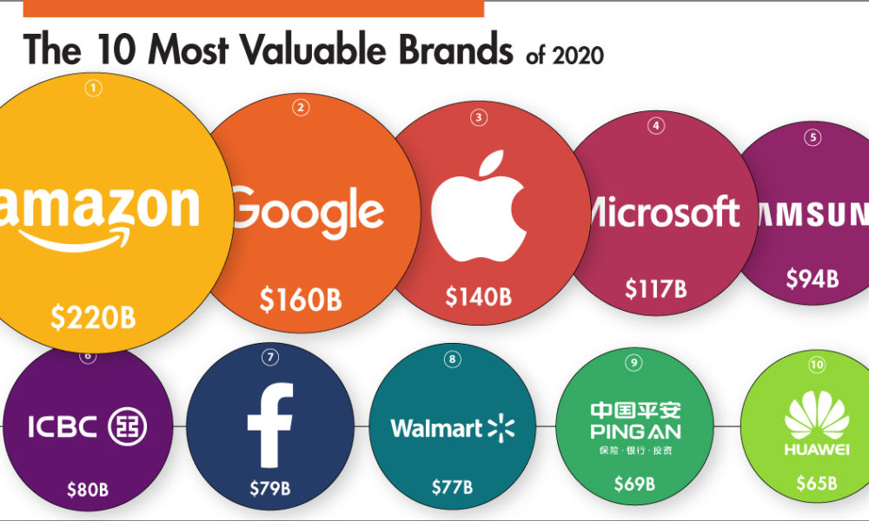
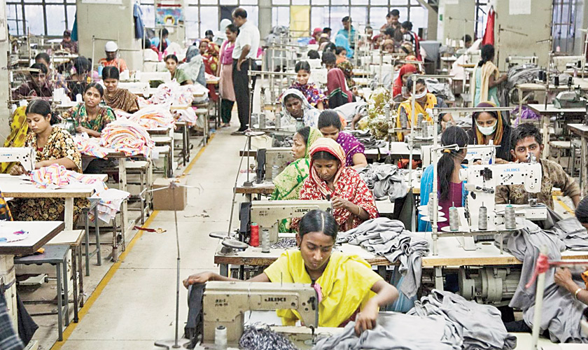
Creates Winners & Losers
Winners: TNCs (Trans National Corporations) – big companies with global impact, making large profits
Losers: Poor countries producing cheap goods for sale in wealthy countries, exploited workers, child labour

Slide 5
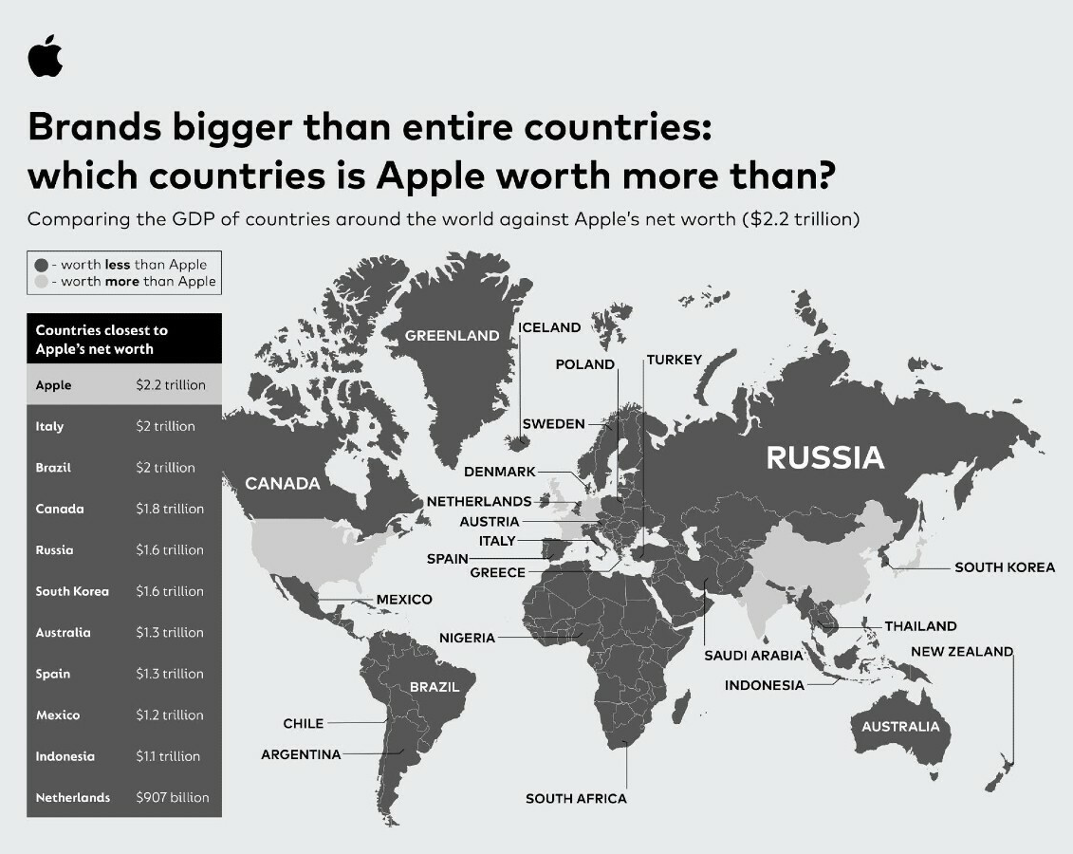
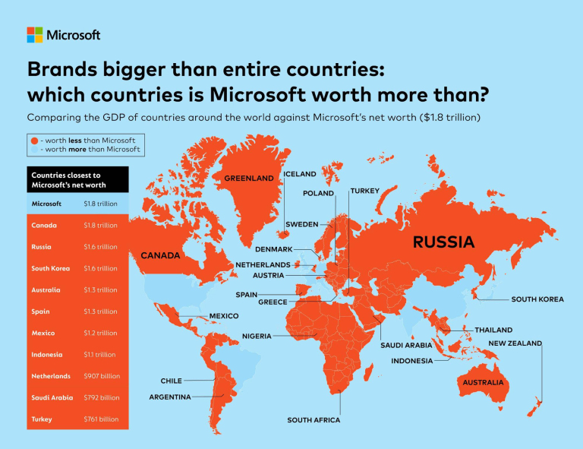

Slide 6
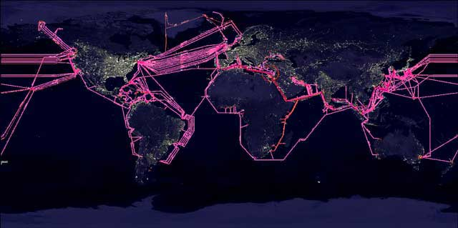
Advances in Communication Technology
Massive network of fibre-optic cables between continents on the sea floor

Slide 8
Satellites
There are 5,774 satellites orbiting the earth
Only 2,666 are currently active
Approximately 27,000 pieces of debris larger than a softball also orbit the earth

Slide 10
Adopting new technology
Radio – 1895
Time to 50 million users – 40 years
Computers – 1981
Time to 50 million users – 15 years
Internet – 1995
Time to 50 million users – 5 years
Why do you think it’s getting so much quicker?

