Slide 1
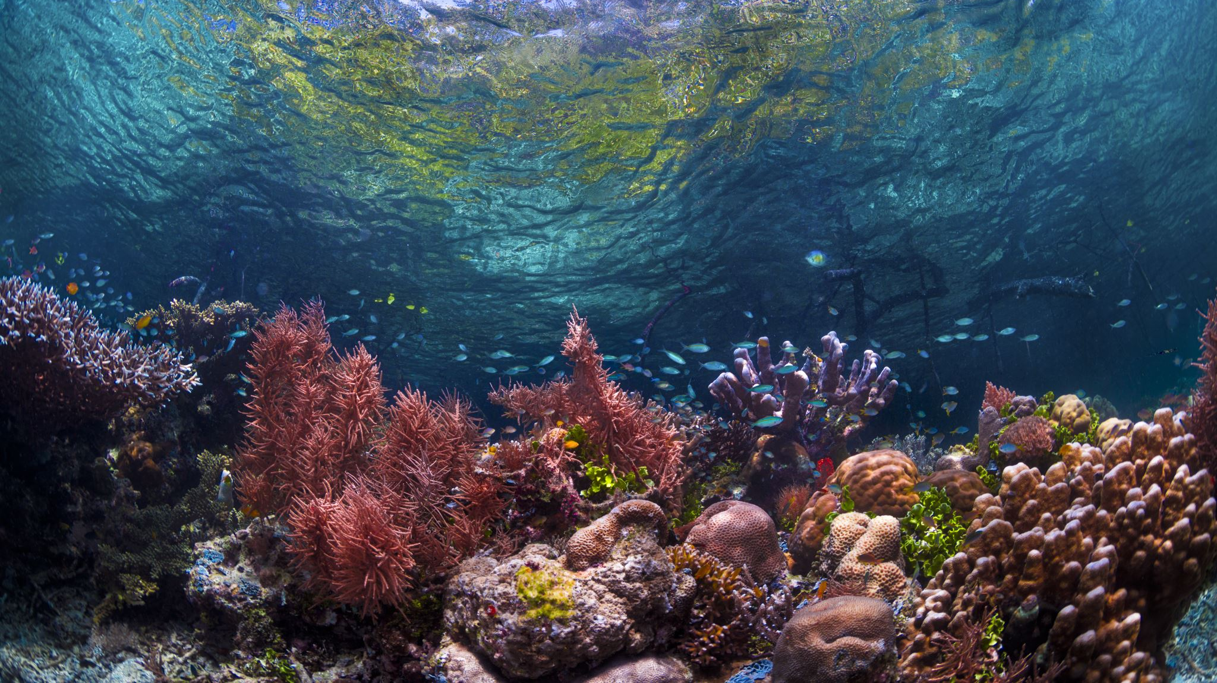
Ecosystems

Slide 2
Earth’s
4 Spheres
Lithosphere
The solid part of the earth's crust, consisting of rocks and soil.
Hydrosphere
All of earth's water bodies, including lakes, rivers, streams, oceans, groundwater and ice caps
Atmosphere
The layer of gases surrounding the earth
Biosphere
All living things including plants and animals

Slide 3
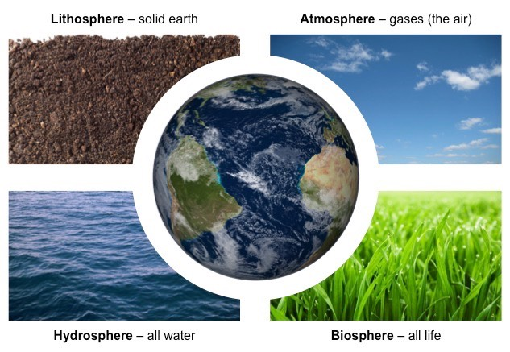

Slide 4
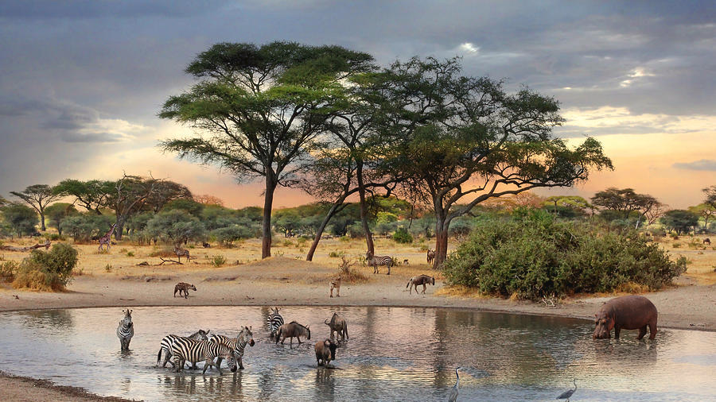
Atmosphere
Biosphere
Lithosphere
Hydrosphere

Slide 5
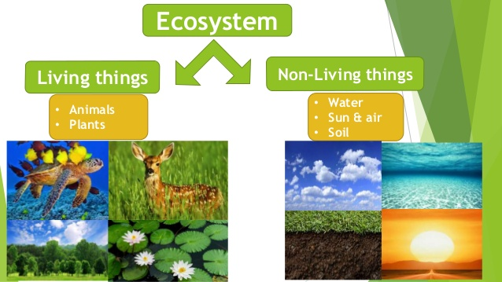
Ecosystems
Unique collections of living organisms (plants and animals) which have adapted to their surrounding non-living environment (climate, rocks, soils and water)
Develop as a result of the interaction between the 4 spheres
Can be as large as the Sahara Desert or as small as a fishpond
Influenced by humans – few left in natural state

Slide 6
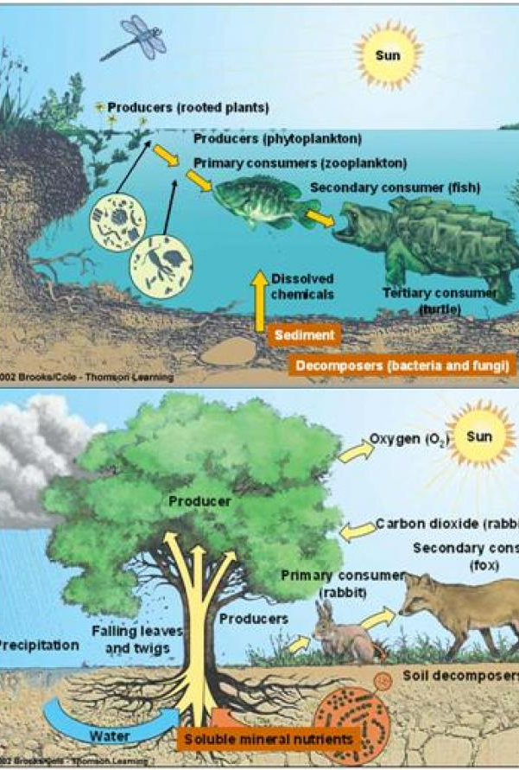
Connected and Self-sustaining
Components are closely related
  Affect each other
  Are affected by each other
Interrelationship causes each ecosystem to develop its own unique characteristics.

Slide 7
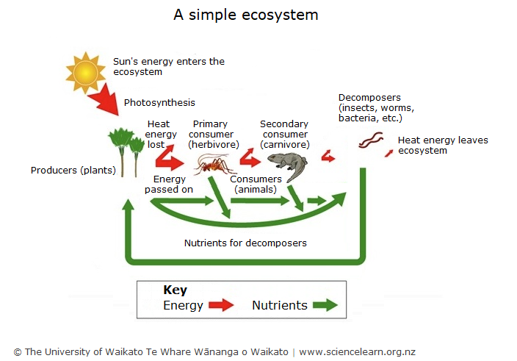
Simple Model of an Ecosystem

Slide 8
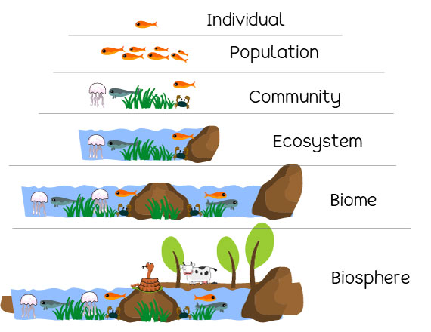
Difference between biomes & ecosystems
Both consist of distinctive plant and animal species which have adapted to their surrounding environment
Different scale.
  Ecosystems vary in size
  Biomes are always very large areas
Biome – more about the plants & climate that identify them
Ecosystem – more about the interactions between the different elements

Slide 9
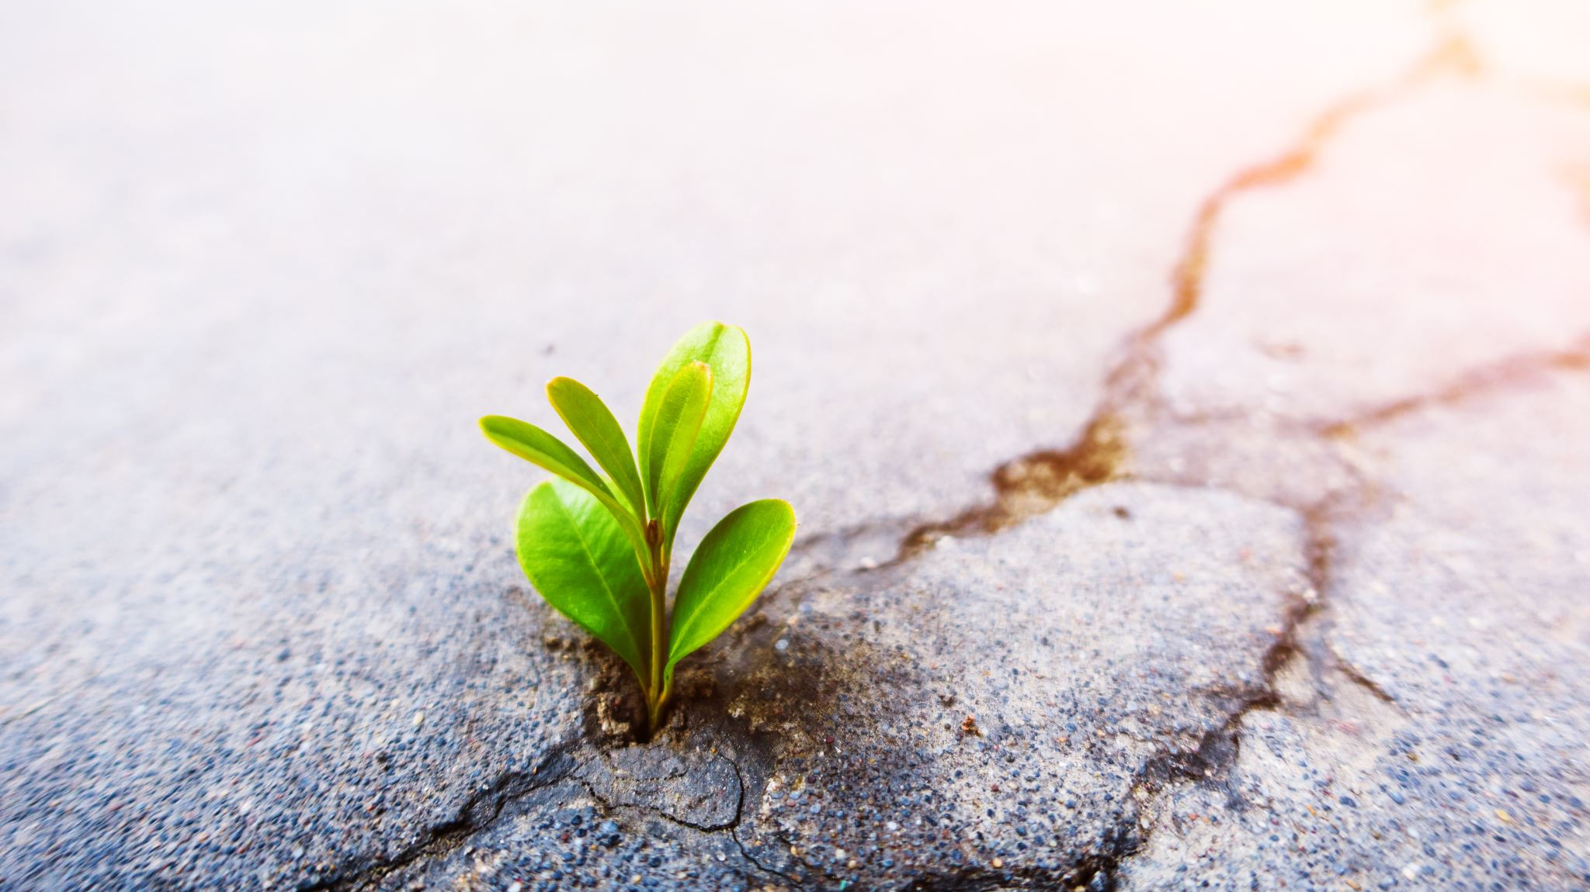
Climate & Ecosystems

Slide 10
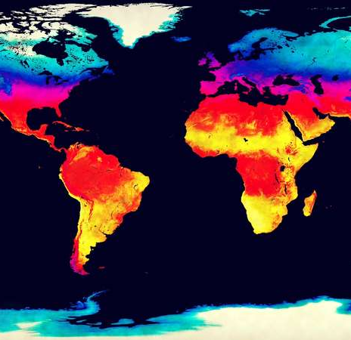
Climate
Climate is the biggest factor that influences ecosystems
Temperature + rainfall changes the type of vegetation produced.
Warmer climates with higher rainfall will be the most productive
  Taller and more closely spaced trees
  Greater biodiversity
  Year-round growing conditions
Areas with the coldest climates and lowest rainfall figures often have little vegetation or animal life
  E.g. Desert, Arctic tundra

Slide 11
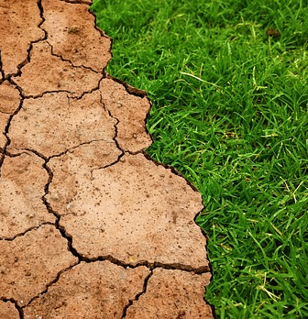
Climate & soil
Very high rainfall (precipitation exceeds evaporation)
  Soil weathered (washed away/dissolved) to a greater depth
  Larger amounts of dissolved nutrients carried down to the subsoil beyond the reach of plants
  Lower soil fertility
Very low rainfall (evaporation exceeds precipitation)
  Water moves upward through the soil
  Dissolved salts are deposited near the surface
  Lower soil fertility
Seasonal rainfall (wet & dry seasons)
  Leaching of nutrients balanced by upward movement of minerals
  Higher soil fertility

Slide 12
