Slide 1
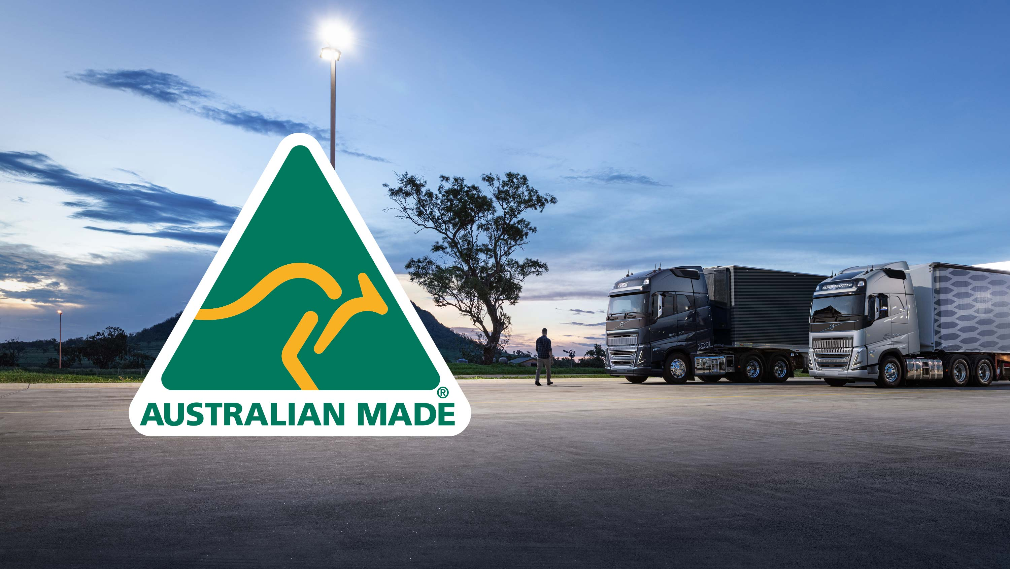
Australia: Food & Fibre Production

Slide 2
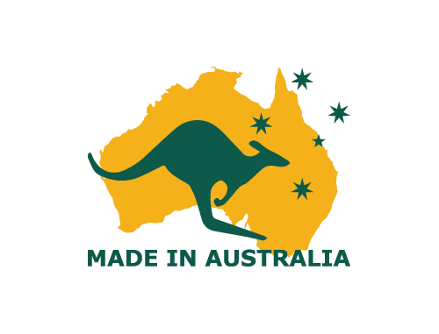
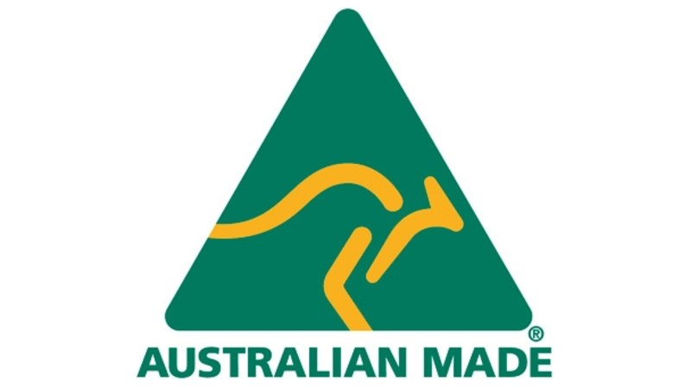
Think, Pair, Share
What do you think are the top three FOOD & FIBRE resources that Australia produces?
(Not including minerals, gas, timber, iron ore etc)

Slide 3
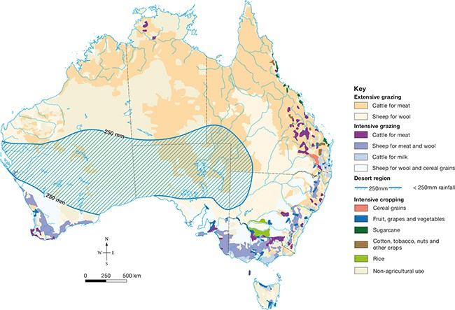
Top 3
Cattle/beef ($9.485 billion)
Wool ($4.159 billion)
Wheat ($3.676 billion)

Slide 4
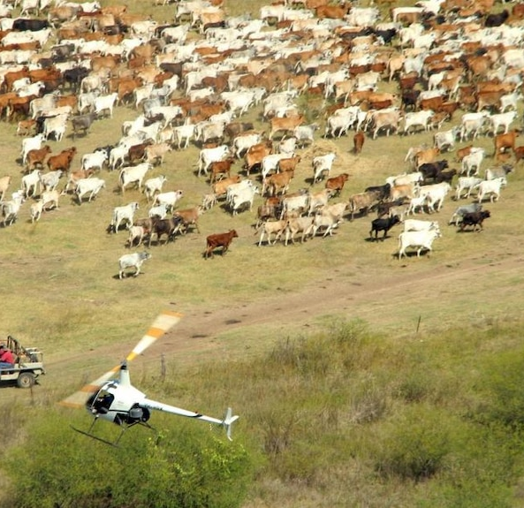
Sheep & Cattle Grazing
Australia’s 90 million sheep and 14 million cattle are found mainly in Queensland and New South Wales
Requires semi-arid and desert grassland biomes
Farms are large in scale, covering hundreds of square kilometres.
Modern grazing farms have very few employees, and often use helicopters and motor vehicles for mustering
Meat and wool products go to both local and overseas markets for high economic returns

Slide 5
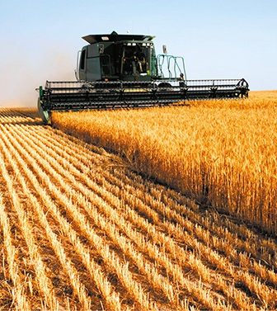
Wheat Farming
About 25,000 wheat farms in Australia. Large scale - average size is 910 hectares (9km²).
Grassland, mallee or savanna biomes (cleared for planting crops.) Needs warm summers and cool winters, approximately 500 mm rain per year.
Soils can be improved by fertilisers and crop yields increased by using disease-resistant, fast-growing seed varieties.
Use large machinery for ploughing, planting and harvesting.
Farm produce is sold to large corporations on local and international markets.

Slide 6
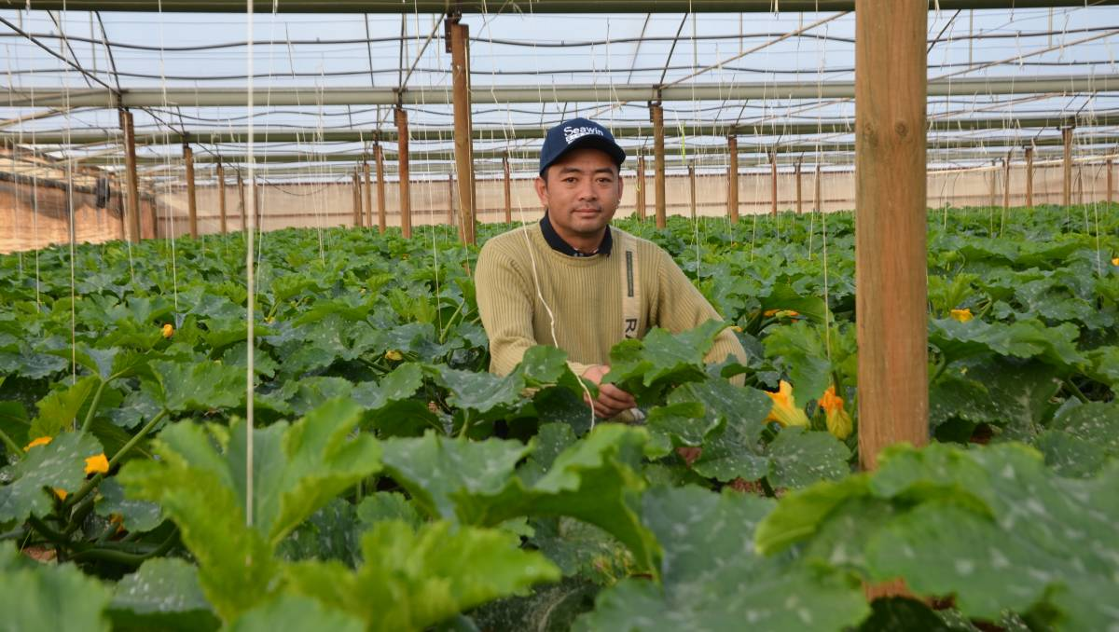
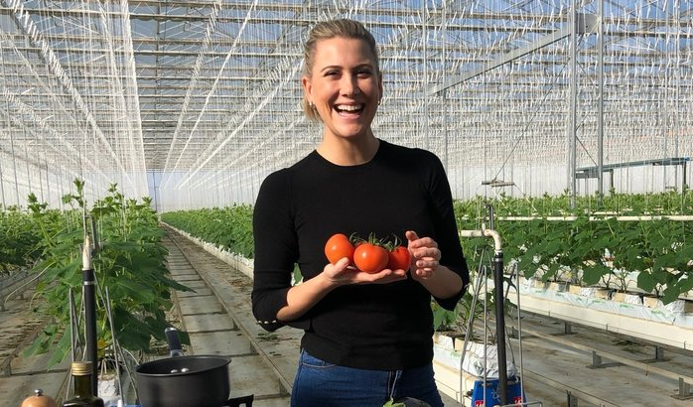
Intensive Farming
Intensive farms are close to urban centres.
They produce things like milk, fruit, vegetables and flowers.
These items are perishable, sometimes bulky, and expensive to transport
This type of farming is capital and labour intensive because the cost of land near the city is high and many workers are required for harvesting.

Slide 7
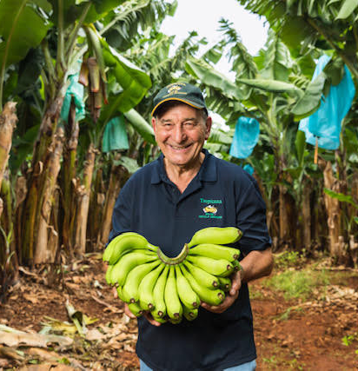
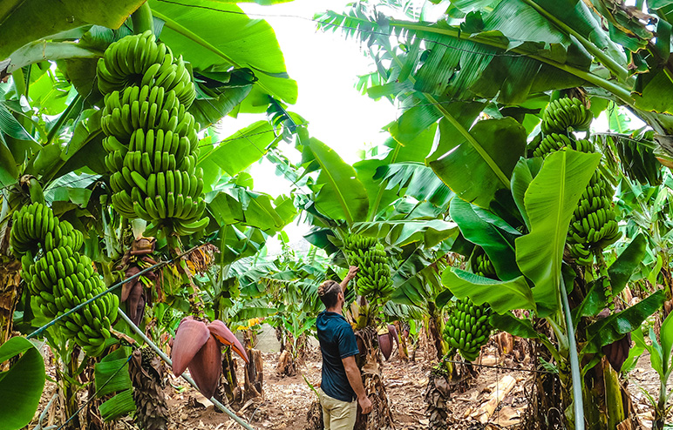
Plantation Farming
Plantations produce a wide range of produce such as coffee, sugar cane, cocoa, bananas, rubber, tobacco and palm oil
This type of crop grows mainly in tropical biomes with high rainfall & warm temperatures.
Requires large-scale clearing to allow for farming
Farm sizes can be 50 hectares or more in size. Many are family owned
Cash returns are high, and markets are both local and global

