Slide 1
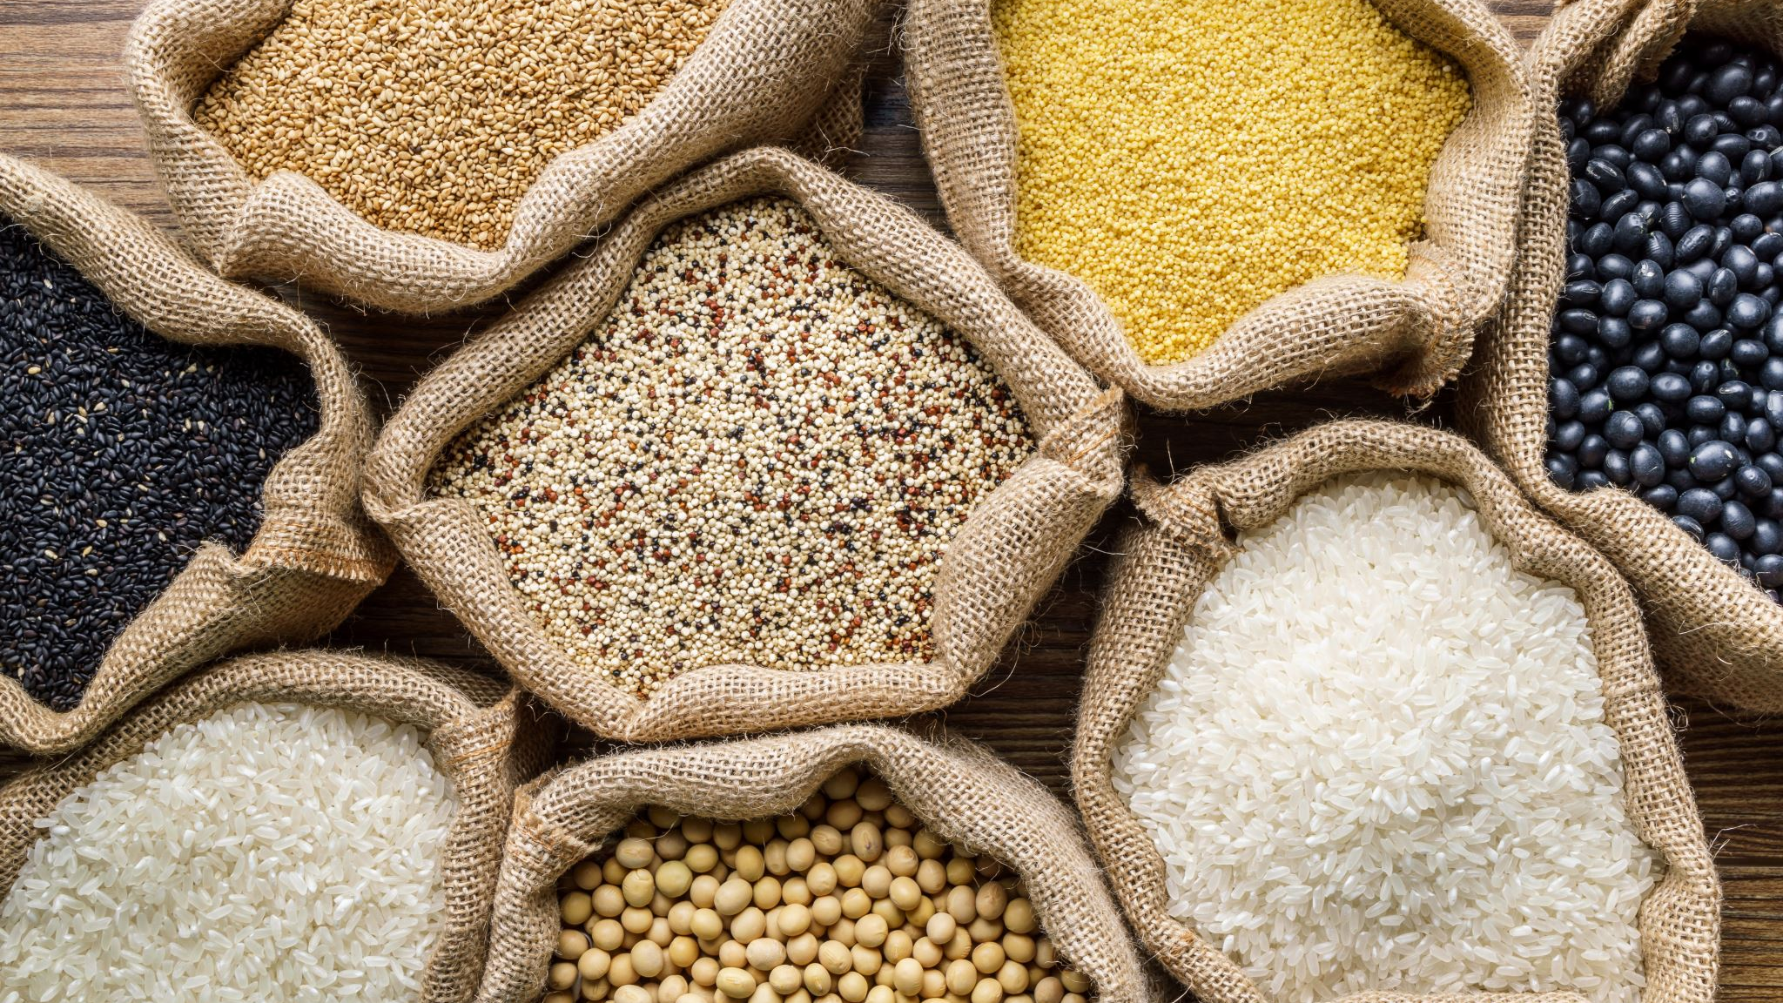
Food Security

Slide 2
Food Security
Food security = all people, at all times, have access to enough food to meet their needs.
Individual or family: can grow their own food, have enough money to buy it, or can barter/swap for it.
Country: is able to grow enough food to feed population AND/OR can afford to import it.
Not all countries in the world are able to achieve this

Slide 3
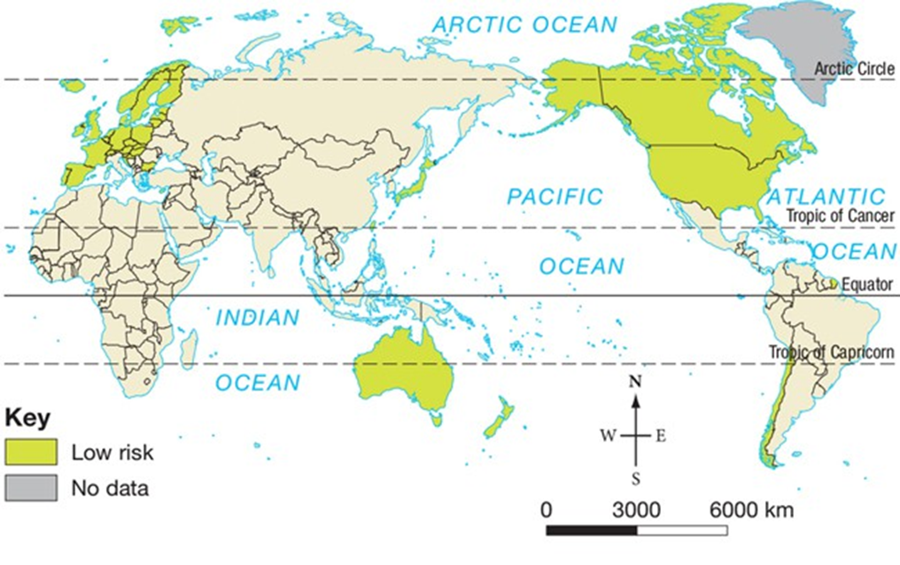
Global Risk of Food Insecurity
Australia, most of Europe, America, Canada & Japan have low risk
Most of Central & South America, Africa, Asia, Middle East, Russia & India have increased risk

Slide 4
Australia – high food security
Very few Australians go to bed hungry
Most can confidently say that there will be food at their next mealtime
Plentiful supply – Australia produces roughly 3x as much as it consumes, exports the rest
However despite our plentiful resources, food insecurity is still experienced by some

Slide 5
Australia – exports & imports
90% of our food grown in Australia
10% imported (processed/out of season, e.g. oranges)
Some of our biggest food exports are cereals, oil seeds (canola), meat, sugar & dairy
Global trade important part of food security - can’t produce everything in one place year-round

Slide 6
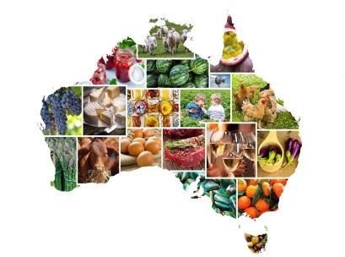
Not Our Problem?
As a country, Australia does not have a problem feeding its population
BUT as a country we have an interest in the food security of developing nations.
As a major food producer, Australia faces future challenges.
Declining growth in agricultural productivity
Threat of climate change
Increasing competition for land and water

Slide 7
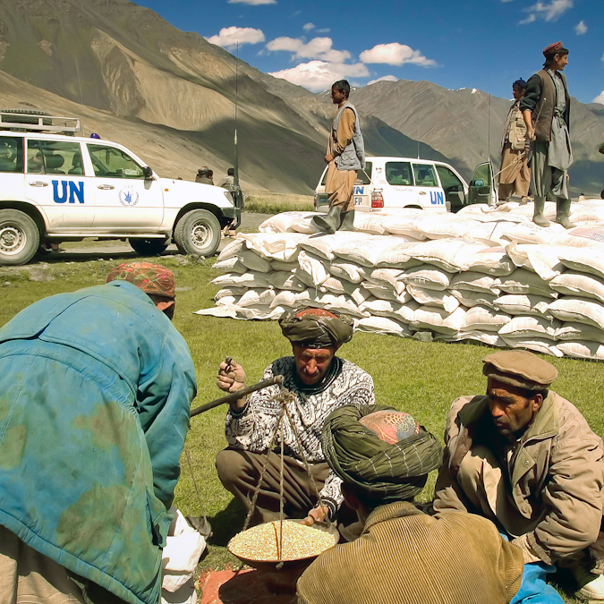
Food Aid
The World Food Programme (WFP) is a voluntary arm of the United Nations.
WHO? 90 million people, over 89 countries. Wealthier, more developed nations give to less developed nations
WHAT? Food, money, goods
WHEN? After disasters and conflicts
WHY? For the specific purpose of helping those who need it
People who need food aid include people who:
Cannot buy food even if it is available (poverty cycle)
Have fled violence or civil conflict
Have been devastated by natural disasters.

Slide 8
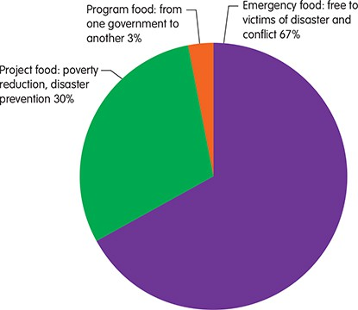
Types of Food Aid
Emergency Food aid: given free to people after natural disasters such as cyclones, floods and earthquakes.
Project Food aid: required over lengthy periods, typically after civil war or prolonged drought. Geared towards future disaster prevention.
Program food aid: organised between national governments.

Slide 9
Who gives food aid?
Country | Aggregate in US$ 2009–2013
USA | 6 395 877 480
Canada | 1 255 078 828
Japan | 1 040 737 420
United Kingdom | 772 851 965
Germany | 607 952 096
Australia | 471 800 026
Spain | 378 842 371
Sweden | 356 160 663
Netherlands | 354 610 101
Switzerland | 241 012 452

Slide 10
Who receives food aid?
Recipient | Metric tonnes (2010) | % | Metric tonnes (2011) | %
Ethiopia | 1139 | 26 | 605 | 22
Pakistan | 990 | 23 | 379 | 14
Kenya | 198 | 5 | 233 | 9
Sudan | 471 | 11 | 203 | 7
Somalia | 69 | 2 | 165 | 6
Occupied Palestinian Territory | 92 | 2 | 151 | 6
Afghanistan | 77 | 2 | 110 | 4
Chad | 104 | 2 | 77 | 3
Yemen | 78 | 2 | 73 | 3
Libya | – | – | 61 | 2

Slide 14
