Slide 1
Biomass and Biopower

Slide 2
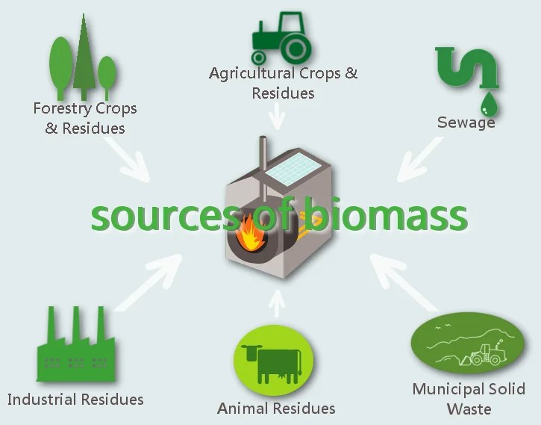
What is Biomass?
Fuel developed from organic materials.
A renewable and sustainable source of energy
Can be made from:
Scrap lumber & forest debris
Non-edible parts of crops e.g. husks, stalks
Animal manure & sewage
Some types of industrial or municipal waste

Slide 4
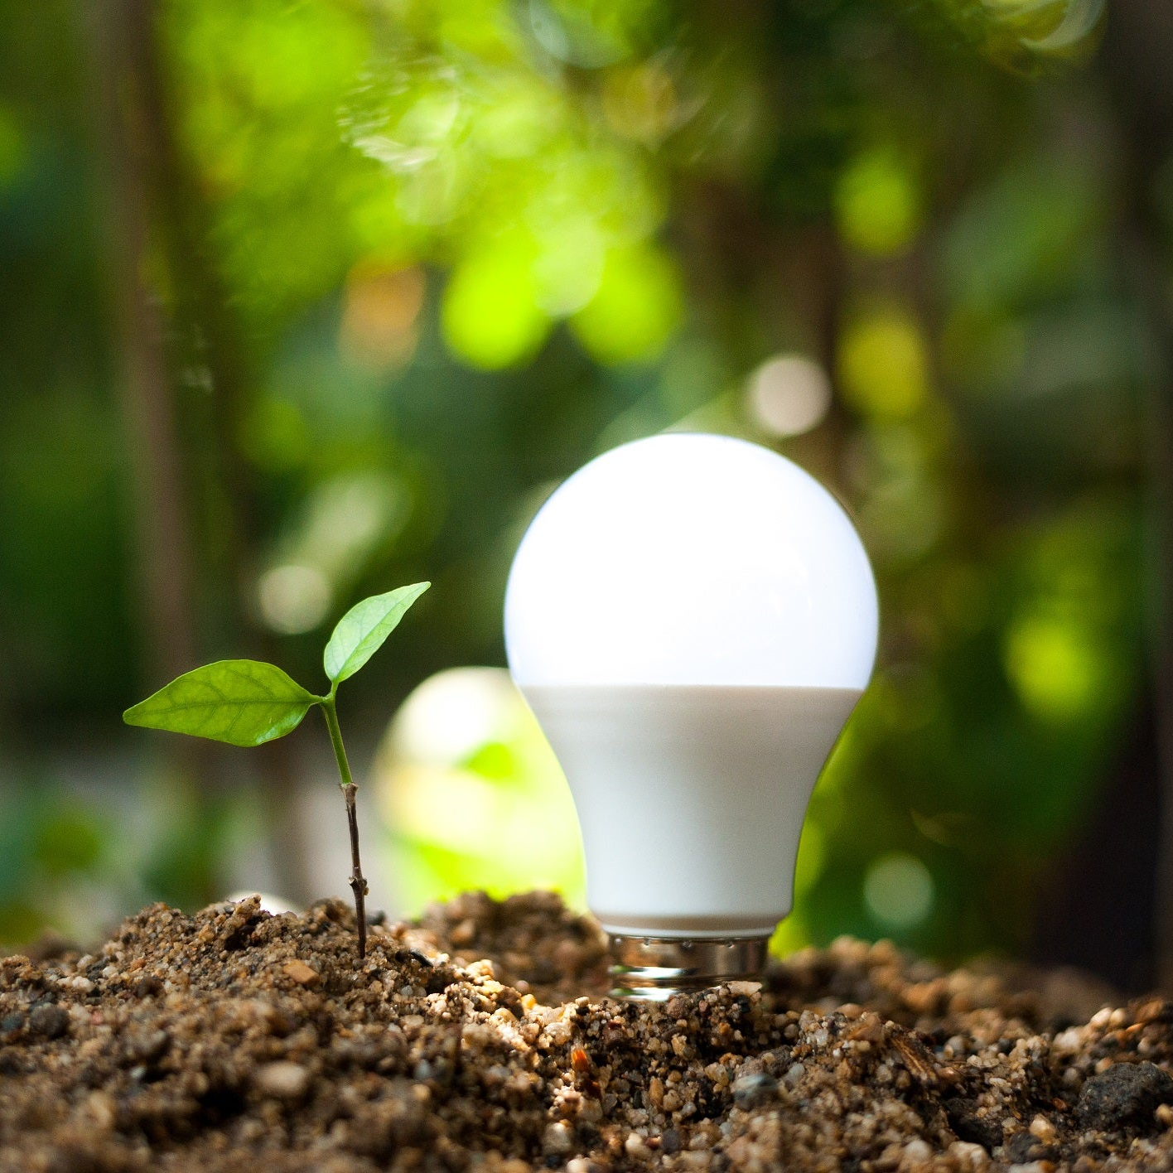
Renewable Energy Source
Biomass is a renewable source of fuel because it makes use of waste or leftovers from things that are already being produced in large quantities
If the waste wasn’t used, it would be dumped in landfill, burned, or left as fodder for forest fires.

Slide 5
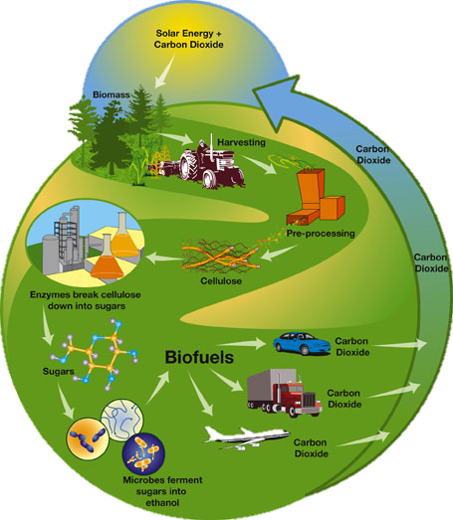
Biopower
Biomass can be converted to bioenergy using a range of technologies depending on the type of raw material, the scale (size) of the project, and the form of energy to be produced.
Direct combustion (burning)
Gasification (using heat, steam & oxygen to convert to hydrogen)
Anaerobic digestion (uses microbes in an oxygen-empty tank to break down into biogas & biofertilizer)
Pyrolysis (thermal decomposition)
Transesterification (chemical process that converts fats to biodiesel)
Fermentation (microorganisms convert biomass to ethanol and carbon dioxide)

Slide 6
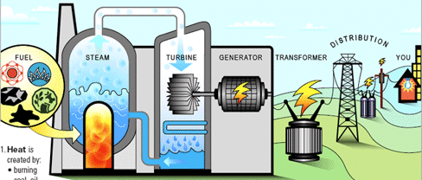
Direct Combustion
Most common method.
Biomass is burned in a boiler, heating water to make steam
Steam turns a turbine, turbine is connected to generator

Slide 7
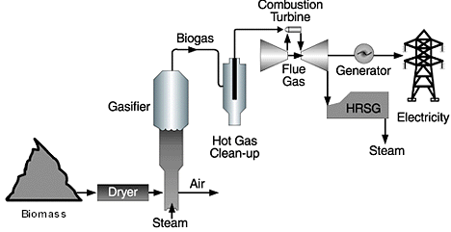
Gasification
Solid biomass can be converted into a fuel gas in a gasifier.
Sand (at about 800°C) surrounds the biomass and creates a very hot, oxygen-starved environment.
These conditions break apart wood or other biomass and create an energy-rich, flammable gas.
The biogas can be cofired with wood (or other fuel) in a steam boiler or used to operate a standard gas turbine.

Slide 8
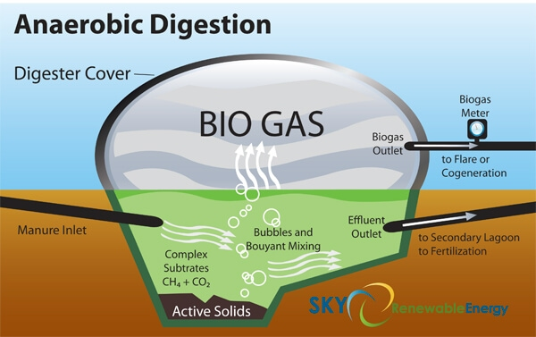
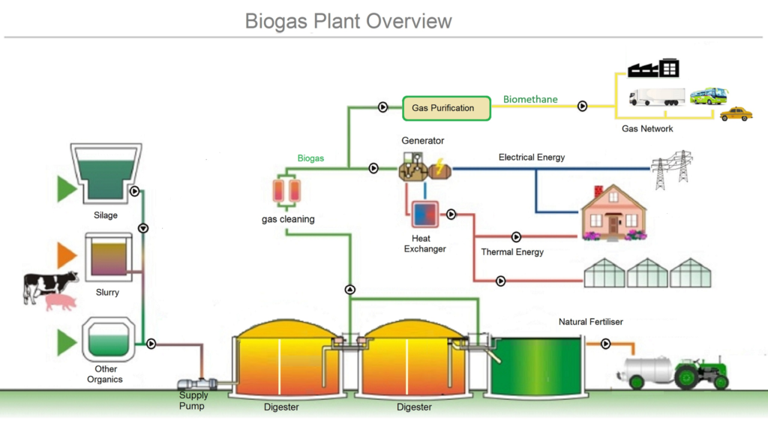
Anerobic Digestion
Biogas can also be created by ‘digesting’ food or animal wastes in a sealed oxygen-free environment.
Different types of bacteria work to break down complex chemicals into progressively simpler molecules.
The final product is a biogas containing methane and carbon dioxide
This gas requires some processing before it can be used as fuel

Slide 9
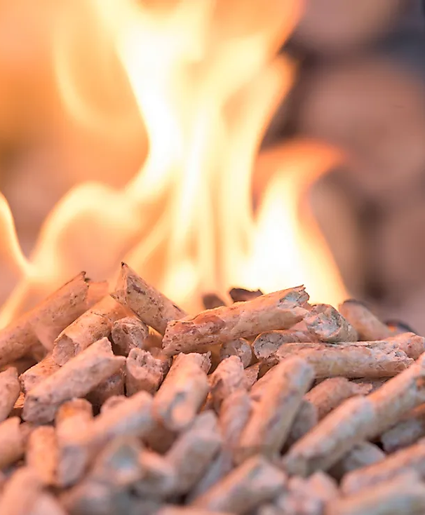
Biopower: Challenges and Drawbacks
Transport & storage: Biomass raw materials are organic & break down. Transporting or storing raw materials for long periods of time can prove difficult or expensive. Resources are scattered, and it’s not always possible to put the processing facility close to the source.
High initial costs: Biomass treatment technologies have high initial costs and require very large-scale plants with high input to be efficient. Smaller scale farmers or fuel companies often can’t afford to choose this option.
Lack of investment: Because of high initial cost and some other factors, biofuel is seen as a high market risk. Investors very rarely take the initiative to invest in the industry or research ways to make the process more efficient. Governments favour fossil fuels and often subsidize domestic fuel prices.

Slide 10
Biopower: Challenges and Drawbacks
Some environmental impact: clearing waste organic matter can deplete nutrients from soil and contribute to loss of biodiversity. Biopower processing & storing plants often require a lot of space.
Regulation: As biomass fuels are a fairly new technology, many countries do not regulate or control how it is produced. There are often no penalties for using unethical or unsafe practices.
Not as efficient: Some biofuels (e.g. ethanol) are relatively inefficient compared to petrol and may need to be fortified with fossil fuels to increase its efficiency.

Slide 11
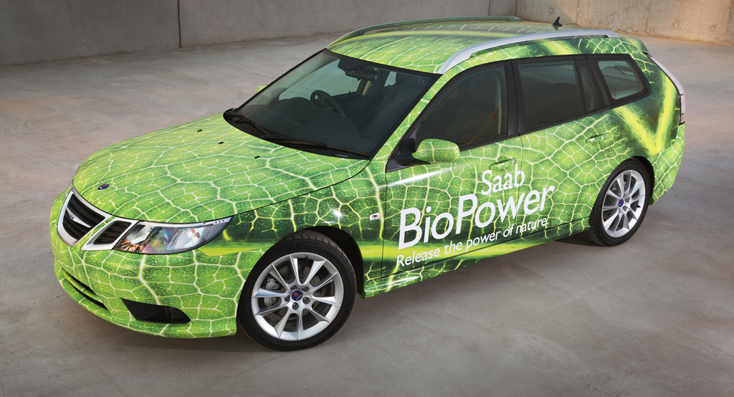
Biopower: Benefits
Renewable: the type of products used to create biofuels can be regrown within a few years (unlike fossil fuels which take millennia to form)
Prevents landfill: By using waste material for fuel, we prevent it from burdening our landfills or being left to decay.
Carbon neutral: Biopower reduces CO² emissions by 15 million tons a year. Biomass fuels only release the same amount of carbon into the atmosphere as was absorbed by plants in the course of their life cycle.

Slide 12
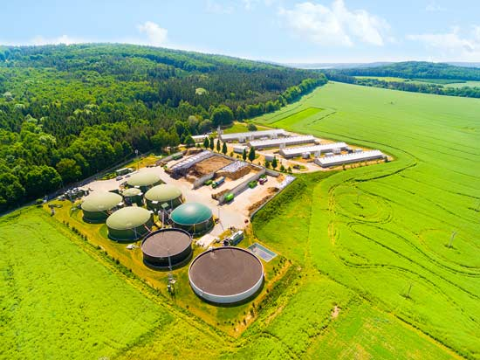
Biopower: Benefits
Reduces reliance on fossil fuels: Not only is there is a limited supply of fossil fuels, but they release large amounts of carbon dioxide into the atmosphere and their removal, transportation and production pollutes the environment.
No need for land clearing: It is not CURRENTLY economically viable to clear forests to create biofuel. This may change if demand increases due to depleted fossil fuels.
Reliable: unlike solar or wind power which can change depending on the season, waste is consistently being produced. As long as there is garbage and sewage, there is biomass.

