Slide 1
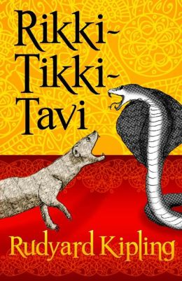
Techniques Used in Rikki Tikki Tavi

Slide 2
In-depth description
The author goes into a lot of detail about the characters and the setting.
Tells you what something looks like – size, shape, colour.
Tells you what sound it makes.
Tells you how it behaves or acts.
Compares it to other things.

Slide 3
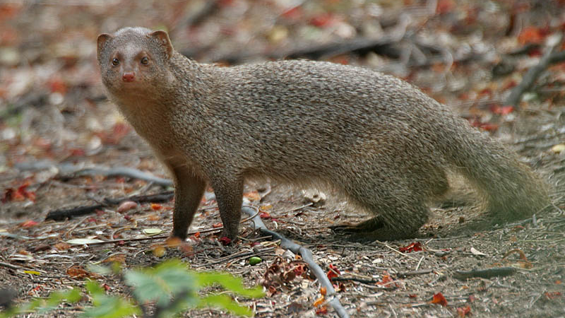
Example 1
He was a mongoose, rather like a little cat in his fur and his tail, but quite like a weasel in his head and his habits. His eyes and the end of his restless nose were pink. He could scratch himself anywhere he pleased with any leg, front or back, that he chose to use. He could fluff up his tail till it looked like a bottle brush, and his war cry as he scuttled through the long grass was: "Rikk-tikk-tikki-tikki-tchk!"

Slide 4
Example 2
Then Rikki-tikki went out into the garden to see what was to be seen. It was a large garden, only half cultivated, with bushes, as big as summer-houses, of Marshal Niel roses, lime and orange trees, clumps of bamboos, and thickets of high grass.

Slide 5
Shorter descriptive passages
Also, short descriptions scattered through the story, between the action sequences.
Why so much description?
Trying to help you form a picture in your mind.

Slide 6
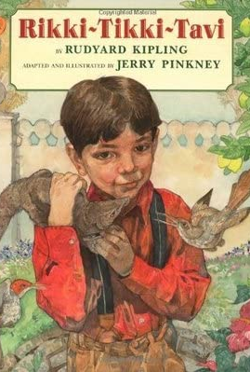
Example 1
They gave him a little piece of raw meat. Rikki-tikki liked it immensely, and when it was finished he went out into the veranda and sat in the sunshine and fluffed up his fur to make it dry to the roots.

Slide 7
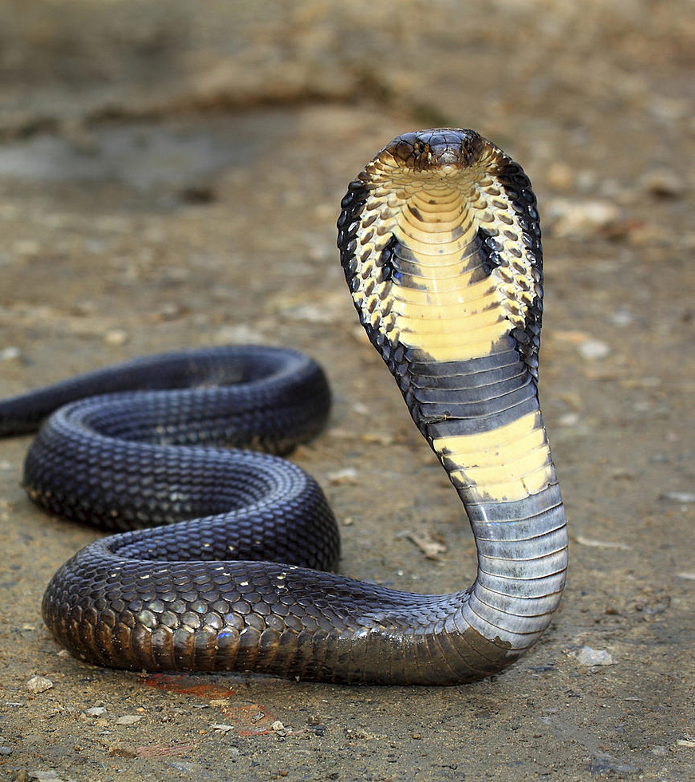
Example 2
Then inch by inch out of the grass rose up the head and spread hood of Nag, the big black cobra, and he was five feet long from tongue to tail.
When he had lifted one-third of himself clear of the ground, he stayed balancing to and fro exactly as a dandelion tuft balances in the wind, and he looked at Rikki-tikki with the wicked snake's eyes that never change their expression, whatever the snake may be thinking of.

Slide 8
Dialogue
Direct speech from the main characters and supporting characters.
The way they speak often gives clues about their personality.

Slide 9
Example 1
"Those who kill snakes get killed by snakes," said Chuchundra, more sorrowfully than ever. "And how am I to be sure that Nag won't mistake me for you some dark night?"
"There's not the least danger," said Rikki-tikki. "But Nag is in the garden, and I know you don't go there."
"My cousin Chua, the rat, told me--" said Chuchundra, and then he stopped.
"Told you what?"
"H'sh! Nag is everywhere, Rikki-tikki. You should have talked to Chua in the garden."
"I didn't--so you must tell me. Quick, Chuchundra, or I'll bite you!"
Chuchundra sat down and cried till the tears rolled off his whiskers. "I am a very poor man," he sobbed.

Slide 10
Example 2
"Who is Nag?" said he. "I am Nag. The great God Brahm put his mark upon all our people, when the first cobra spread his hood to keep the sun off Brahm as he slept. Look, and be afraid!"

Slide 11
Character’s actions
Description of characters’ actions, what they do and how they behave.
Telling you HOW they do things, clues about them.
Tailor birds: cowered down in the nest
Snakes: savage blow, horrid cold hiss, wicked head.
Mongoose: amused at all the fuss, enjoying himself, speaks scornfully
Muskrat: creeping around
Mother: white and fainting, hugged him crying

Slide 12
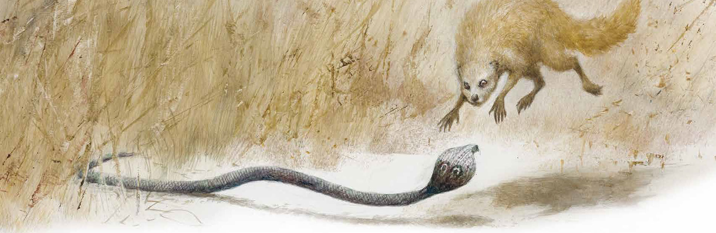
Example 1
Rikki-tikki jumped up in the air as high as he could go, and just under him whizzed by the head of Nagaina, Nag's wicked wife. She had crept up behind him as he was talking, to make an end of him. He heard her savage hiss as the stroke missed. He came down almost across her back, and if he had been an old mongoose he would have known that then was the time to break her back with one bite; but he was afraid of the terrible lashing return stroke of the cobra. He bit, indeed, but did not bite long enough, and he jumped clear of the whisking tail, leaving Nagaina torn and angry.

Slide 13
Example 2
Darzee said, "It is all over with Rikki-tikki! We must sing his death song. Valiant Rikki-tikki is dead! For Nagaina will surely kill him underground."
So he sang a very mournful song that he made up on the spur of the minute, and just as he got to the most touching part, the grass quivered again.

Slide 14
Narrator’s comments
Comments from the ‘voice’ that is telling the story.
In Rikki Tikki Tavi the narrator is omniscient (all-knowing).
Can read the thoughts of ALL the characters and tell you what they’re thinking or feeling.
Also tells you factual information about the animals.

Slide 15
Example 1
He was afraid for the minute, but it is impossible for a mongoose to stay frightened for any length of time, and though he had never met a live cobra before, his mother had fed him on dead ones, and he knew that all a grown mongoose's business in life was to fight and eat snakes.
Nag knew that too and, at the bottom of his cold heart, he was afraid.

Slide 16
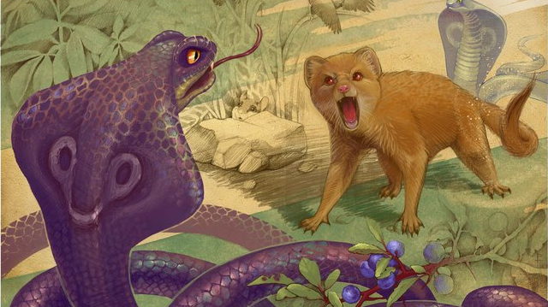
Example 2
Rikki-tikki felt his eyes growing red and hot (when a mongoose's eyes grow red, he is angry), and he sat back on his tail and hind legs like a little kangaroo, and looked all round him, and chattered with rage. But Nag and Nagaina had disappeared into the grass. When a snake misses its stroke, it never says anything or gives any sign of what it means to do next.

Slide 17
Similes and Metaphors
Simile – using ‘like’ or ‘as’ to compare
Metaphor – comparing by saying one thing IS the other

Slide 18
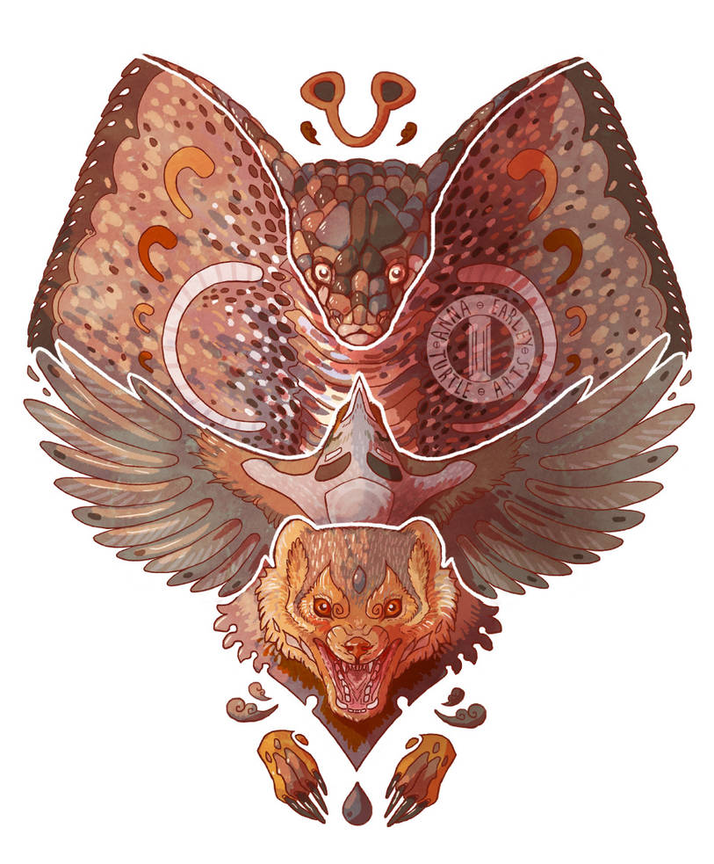
Examples
He sat stone still
Be careful, I am death
She flew like an arrow down the path.
Swaying to and fro, exactly like a dandelion tuft balances in the wind

Slide 19
Foreshadowing
Something early in the story gives you a clue or suggestion about the main conflict.
This is a sophisticated technique - tricky to weave in without being too obvious.

Slide 20
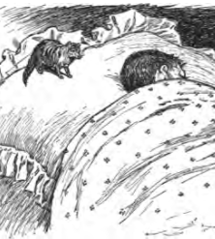
Example
"He'll do no such thing," said the father.
"Teddy's safer with that little beast than if he had a bloodhound to watch him. If a snake came into the nursery now…"

