Slide 1
Year 8 Vocab
Term 1, List 1

Slide 2
Tangible
Part of Speech: Adjective
Meaning: Able to be touched or felt.
The excitement in the air was almost tangible.
You can’t blame him without any tangible proof.

Slide 3
Stamina
Part of speech: Noun
Meaning: strength or endurance (mental or physical). The ability to keep going for a long time under tough conditions.
Phil did not have the stamina to finish the marathon.

Slide 4
Affable
Part of speech: Adjective
Meaning: Friendly, good natured, easy to talk to.
Cats are not always as affable and loving as dogs.

Slide 5
Imperative
Part of speech: adjective
Meaning: Extremely important or vital.
Water is imperative for survival.
It is imperative that you put your name on your test.

Slide 6
Condone
Part of speech: Verb
Meaning: To ignore or accept something bad.
We do not condone vandalism at this school.

Slide 7
Disarm
Part of speech: Verb
Meaning: to remove weapons or alarms, OR to remove anger and suspicion.
The rebel group will never agree to disarm their troops.
The politician’s charm and sense of humour disarmed the crowd.

Slide 8
Elude
Part of speech: Verb
Meaning: To escape or avoid, often with skill.
The suspect continues to elude police.
I can picture his face, but his name eludes me.

Slide 9
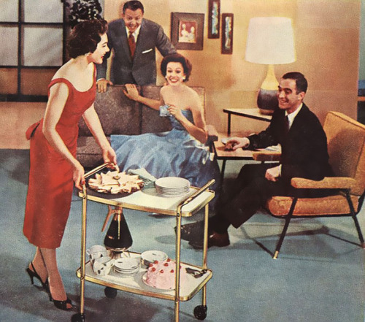
Solicitous
Part of speech: adjective
Meaning: showing care or attention; full of concern or fear
Penny was a very solicitous hostess, hovering over the guests offering snacks.

Slide 10
Zeal
Part of speech: noun
Definition: Great enthusiasm or eagerness.
In his zeal to finish quickly, he didn’t do a good job.
The police officer had a zeal for justice.

Slide 11
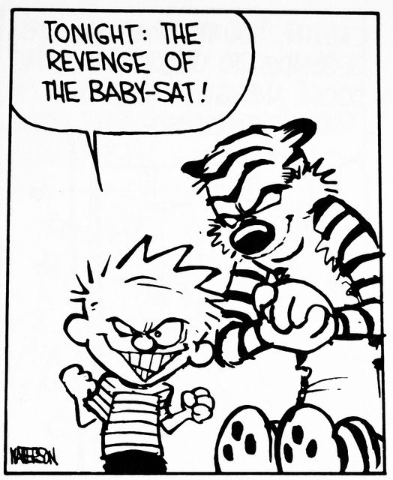
Deplorable
Part of speech: Adjective
Meaning: Completely unacceptable; shockingly bad.
Calvin’s deplorable behaviour makes it hard for his parents to find a babysitter.

