Slide 1
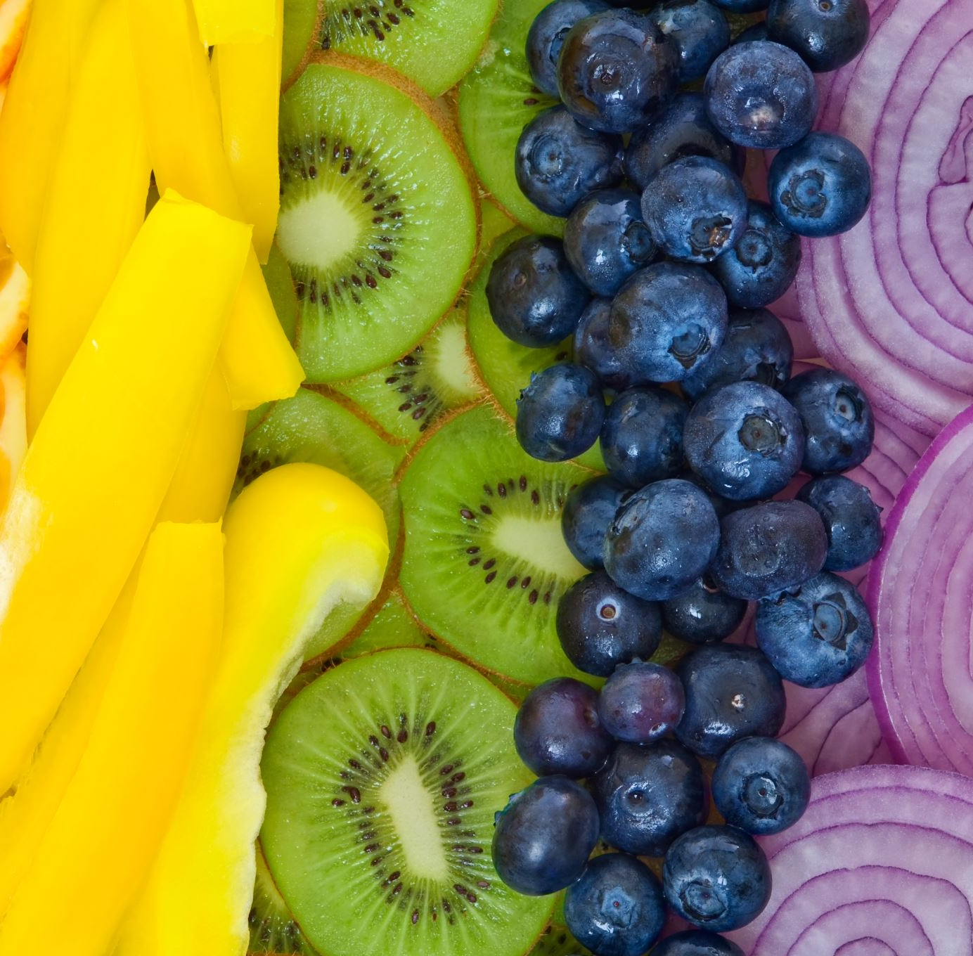
Year 8 Vocab
Term 1 Week 2

Slide 2
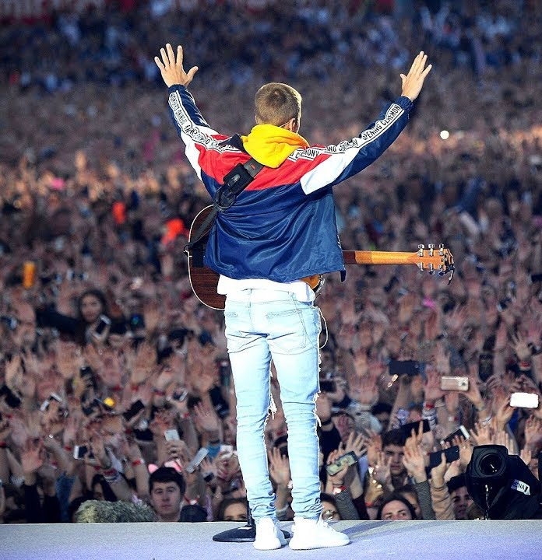
Adulation
Part of speech: noun
Meaning: excessive praise or admiration; worship
The crowd screamed in adulation as the pop star walked onto the stage.

Slide 3
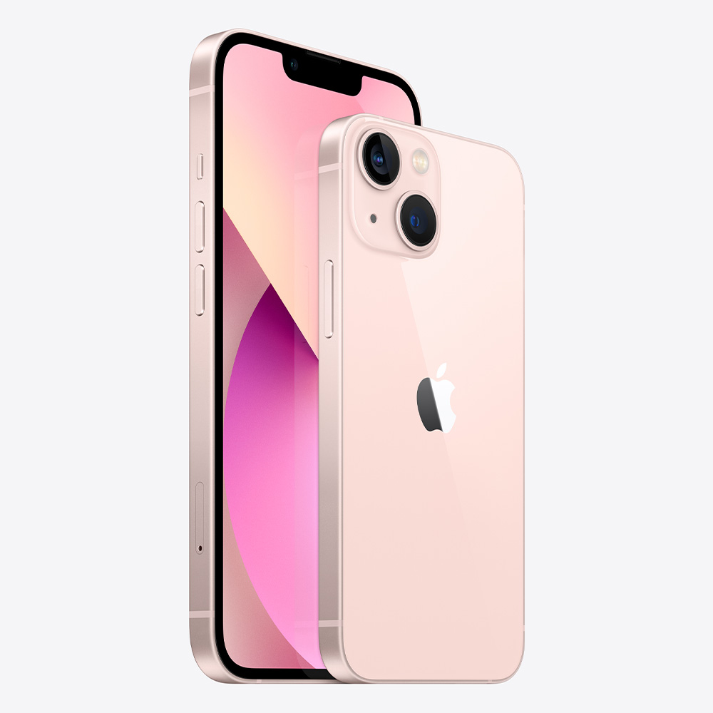
Exorbitant
Part of speech: adjective
Meaning: much too high; unreasonable price or amount
People are happy to pay exorbitant prices if they are loyal to a brand.

Slide 4
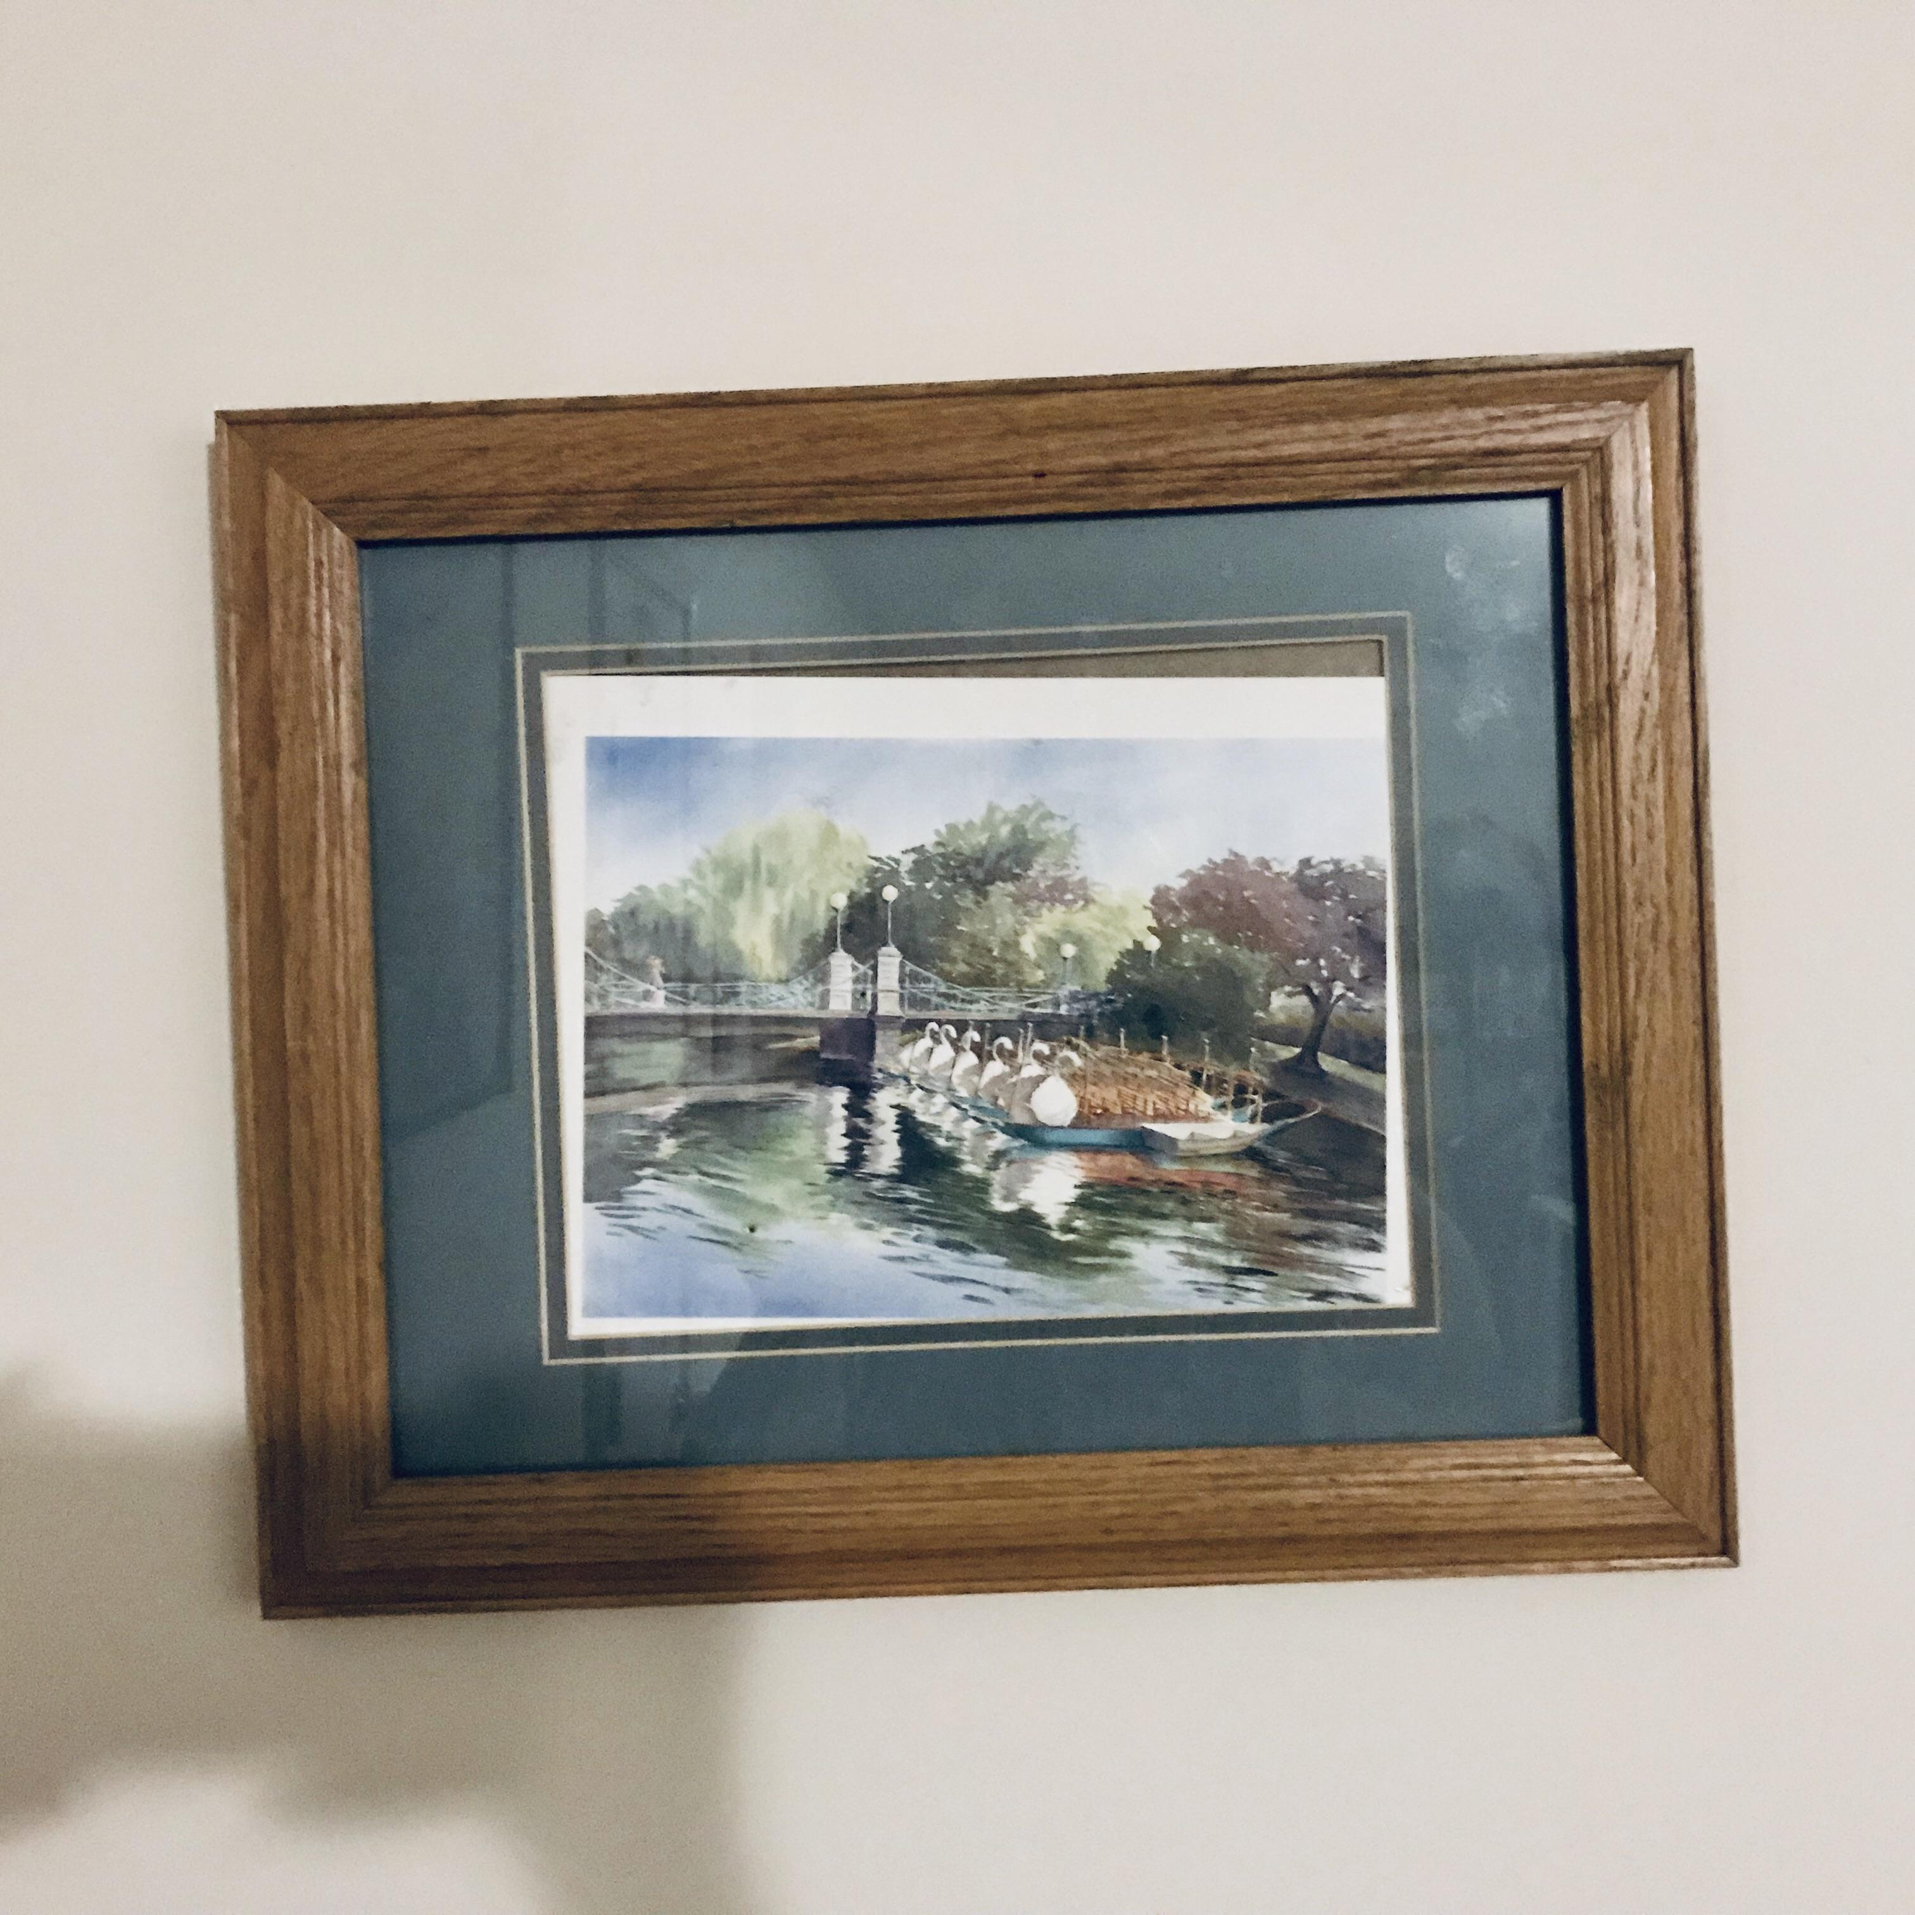
Askew
Part of speech: adjective
Meaning: crooked
The picture frame was slightly askew.

Slide 5
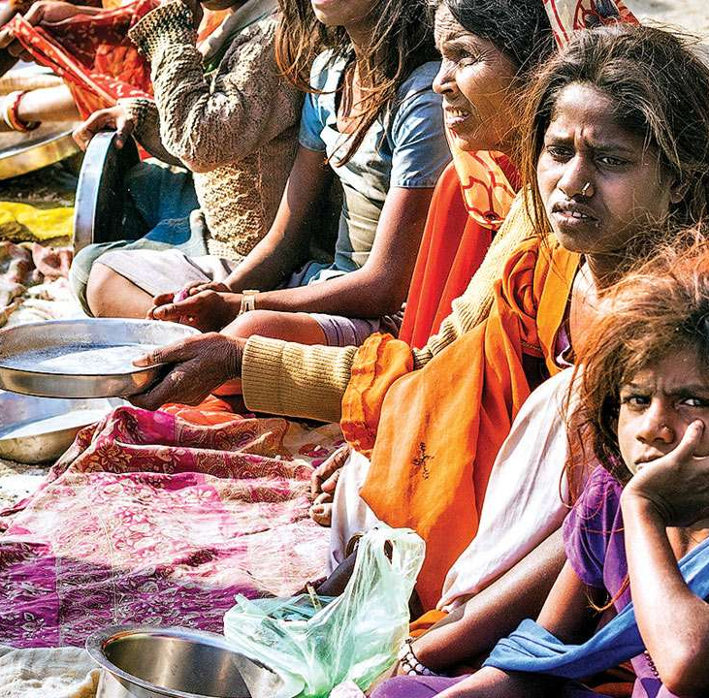
Pauper
Part of speech: noun
Meaning: someone who is very poor
Despite his luxurious lifestyle, he died a pauper.
In India, many paupers beg on the street for money or food scraps.

Slide 6
Prospect
Part of speech: noun
Meaning: A possibility that something will happen.
Kate’s heart fluttered at the prospect of seeing Adam again.

Slide 7
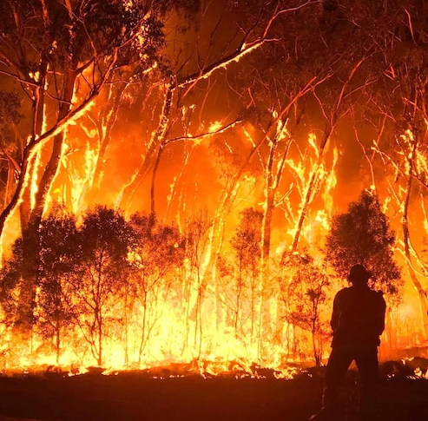
Ruinous
Part of speech: adjective
Meaning: disastrous; destructive
The bushfires had a ruinous effect on the environment.

Slide 8
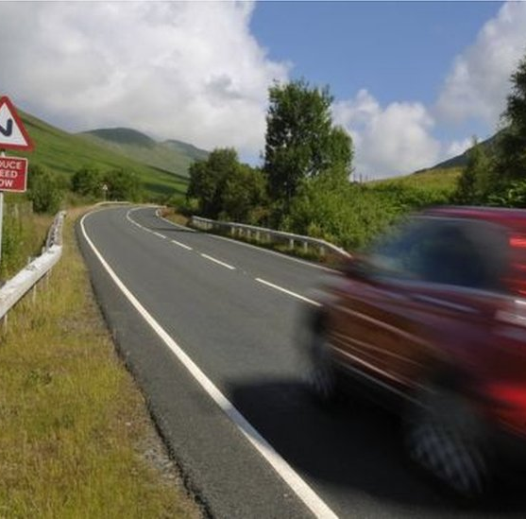
Careen
Part of speech: verb
Meaning: to move forwards in a sudden uncontrolled way
The car careened off the road and into a ditch.
The fireworks made the dog careen down the hall in fright.

Slide 9
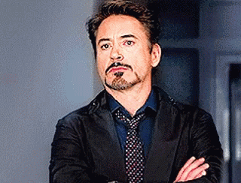
Vexation
Part of speech: noun
Meaning: irritation, worry, or annoyance
Tony didn’t say anything but his face clearly showed his vexation.
All this vexation about his estate is likely to send him to an early grave!

Slide 10
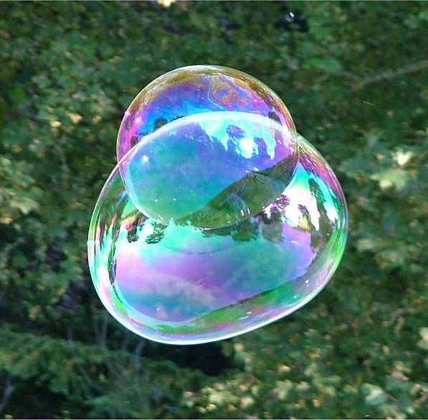
Iridescent
Part of speech: adjective
Meaning: shining with shifting rainbow colours
The kids were fascinated by the iridescent bubbles.

Slide 11
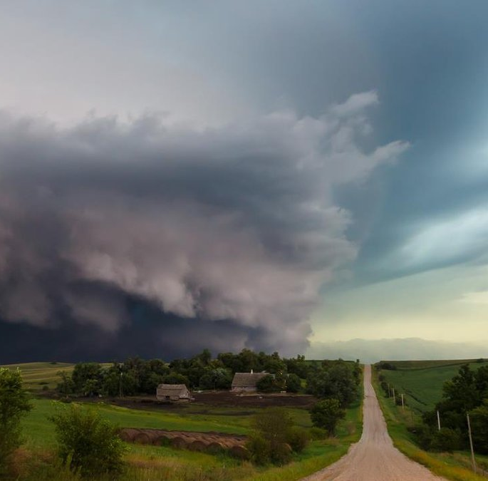
Imminent
Part of speech: adjective
Meaning: about to happen
The looming black clouds suggested that a storm was imminent.

