Slide 1
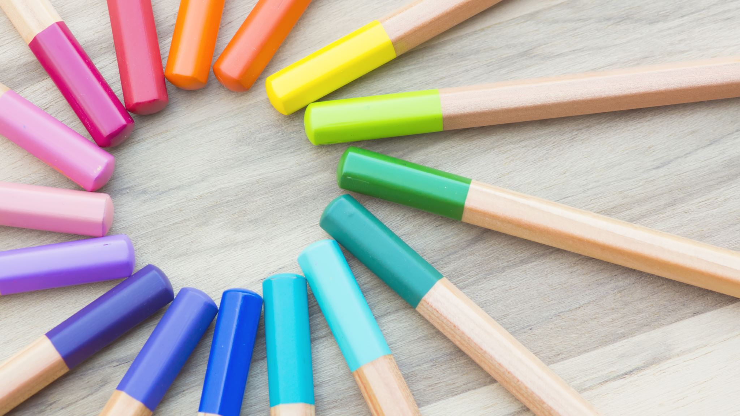
Year 8 vocab
Term 1, Week 4

Slide 2
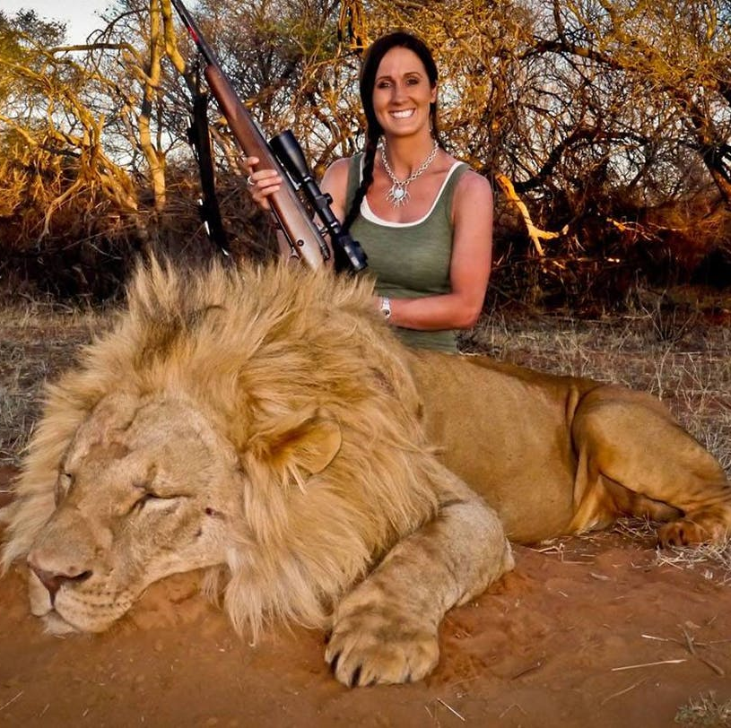
reprehensible
Part of speech: adjective
Meaning: deserving blame or criticism
Hunting animals for fun is absolutely reprehensible.

Slide 3
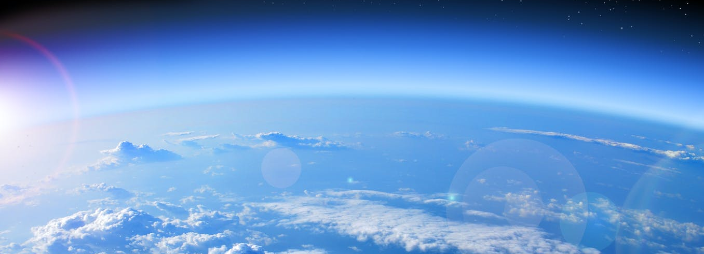
envelop
Part of speech: verb
Meaning: to wrap up, cover, or surround completely
Darkness seemed to envelop us as we sneaked through the garden.
The atmosphere envelops the globe.

Slide 4
spasm
Part of speech: noun
Meaning: a sudden involuntary muscle twitch or cramp; a shudder
He felt a spasm of panic sweeping over him.
Pete had to stop playing because of a leg spasm.

Slide 5
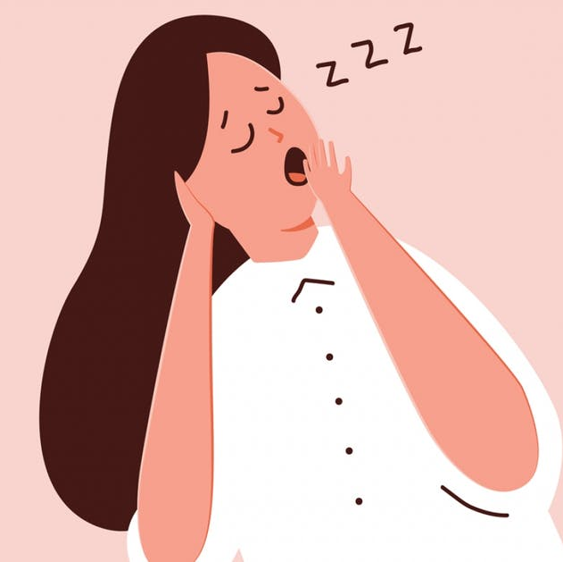
pantomime
Part of speech: verb
Meaning: to act something out without using words (often in a funny or exaggerated way)
When I finally arrived, he made a pantomime of checking his watch in disbelief.
During the speech, she caught my eye and pantomimed falling asleep.

Slide 6
fanatic
Part of speech: noun
Meaning: someone who is obsessively interested in something – an extreme fan
John is such a fitness fanatic that any time he has a spare moment he starts doing push-ups.
That girl is a Hello Kitty fanatic.

Slide 7
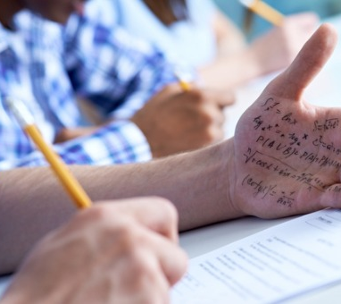
remorse
Part of speech: noun
Meaning: deep and painful regret from doing something wrong
Adam was filled with remorse after cheating on his test.

Slide 8
lodge
Part of speech: verb
Meaning: to get stuck; to stay
A bullet had become lodged near his spine.
Is there anywhere I could lodge in the village for the night?

Slide 9
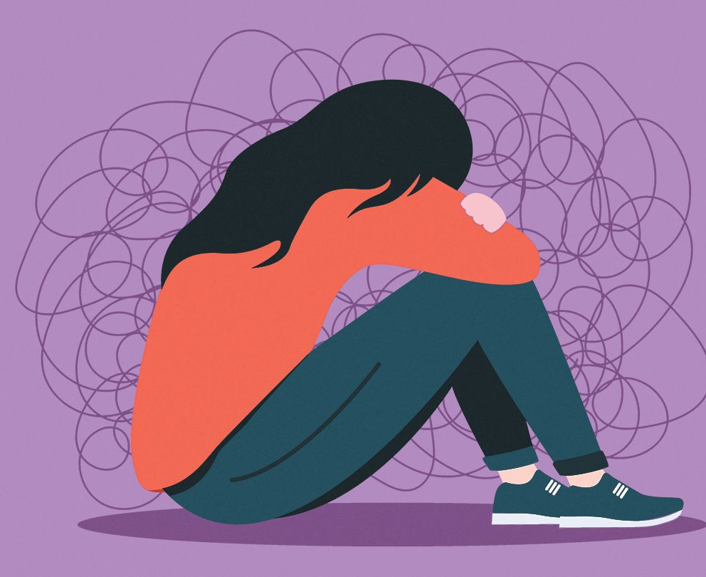
depressed
Part of speech: adjective
Meaning: unhappy, down, lacking hope
She became severely depressed after losing her job.

Slide 10
juncture
Part of speech: noun
Meaning: an important point in time, a turning point
The battle had reached a critical juncture.
At this juncture, it looks like they might get a divorce.

Slide 11
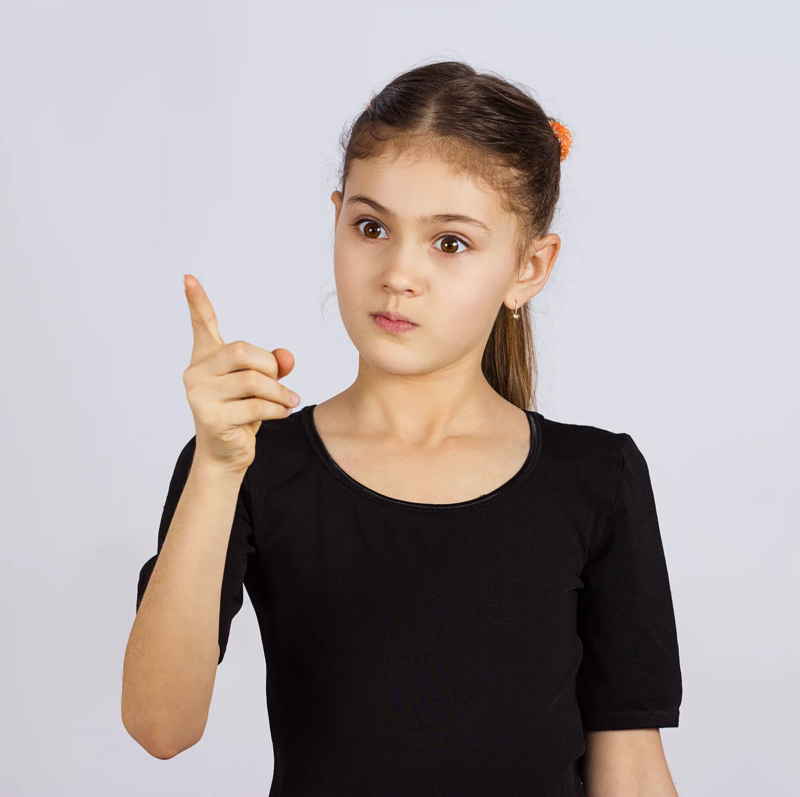
imperious
Part of speech: adjective
Meaning: haughty; bossy and demanding; expecting to be obeyed
After his promotion he became very imperious, telling people what to do.
She sent him away with an imperious wave of her hand.

