Slide 1
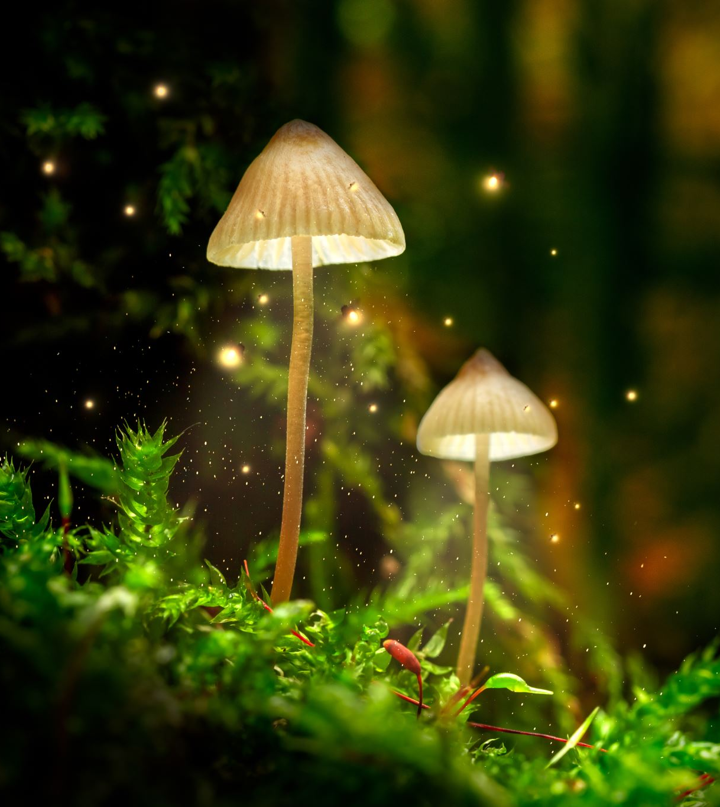
Year 8 Vocab
Term 1, Week 5

Slide 2
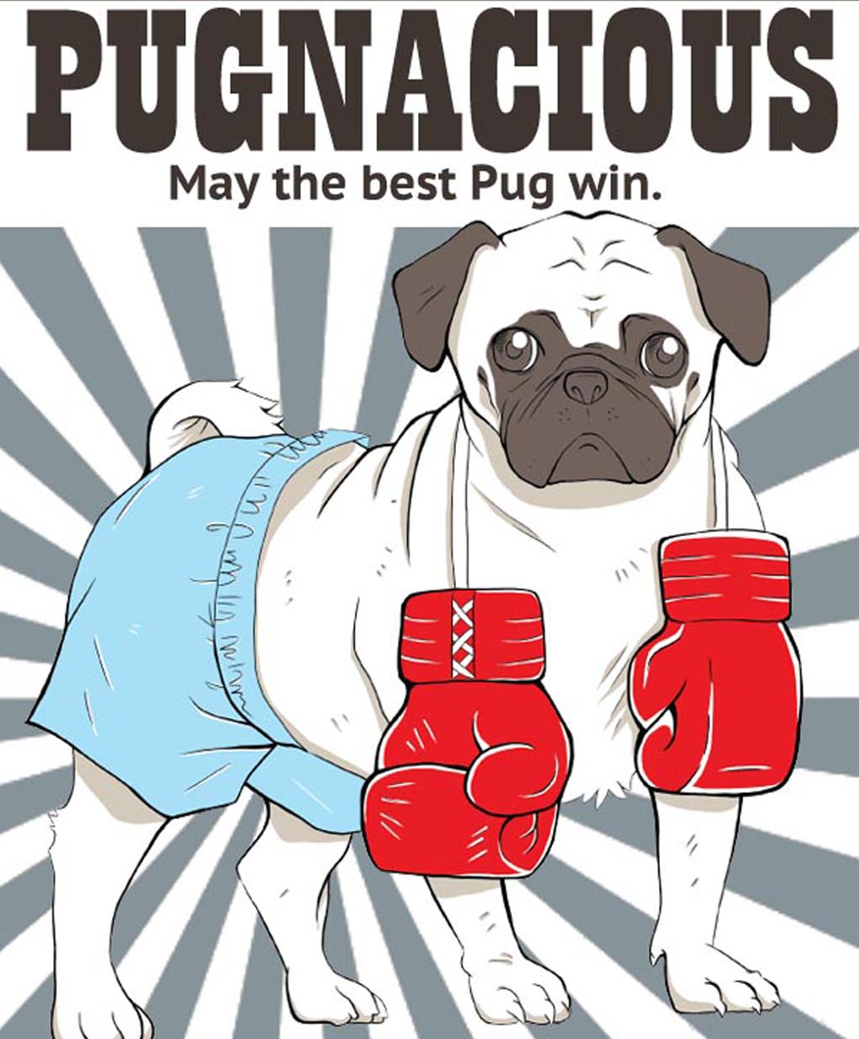
Pugnacious
Part of speech: adjective
Meaning: aggressive, looking for a fight.
My dog is so pugnacious, he tries to fight with every other dog he meets.
Your pugnacious attitude won’t help you keep your job.

Slide 3
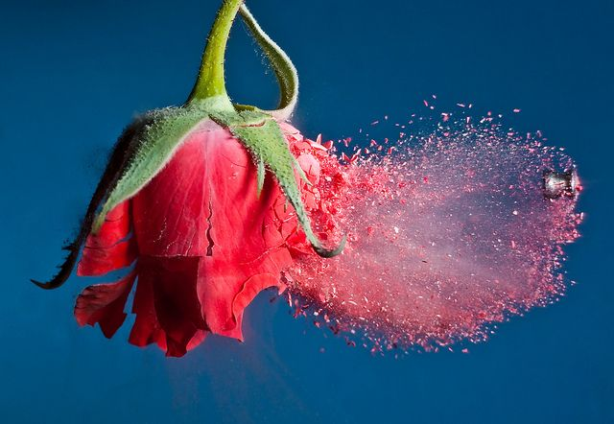
Brittle
Part of speech: adjective
Meaning: fragile, easily broken
The rose became brittle when it was dipped in liquid nitrogen.

Slide 4
Subdue
Part of speech: verb
Meaning: to hold back, quieten, or bring under control
Police managed to subdue the angry mob.
He forced himself to subdue his fears.

Slide 5
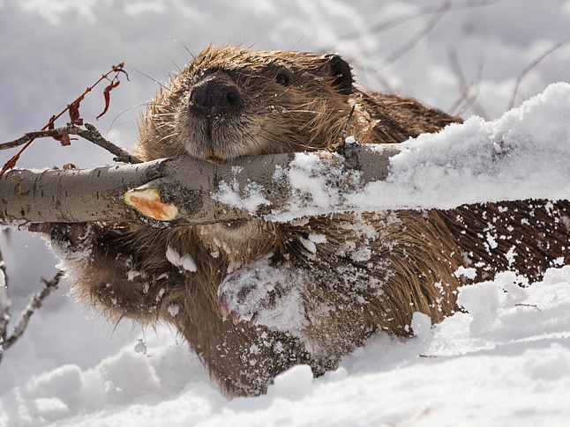
Gnaw
Part of speech: verb
Meaning: to bite or chew away at something for a long time
Rodents must gnaw constantly to wear down their teeth, otherwise they will grow too long.
Anxiety gnawed at my stomach.

Slide 6
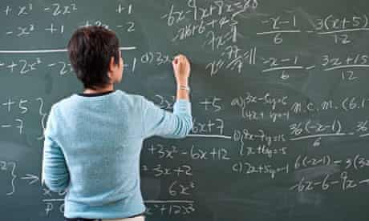
Bewildered
Part of speech: adjective
Meaning: confused
I felt bewildered when the maths teacher started talking about integers.

Slide 7
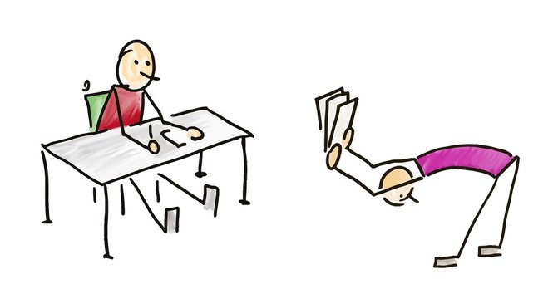
Fawn
Part of speech: verb
Meaning: to try to get someone’s approval by serving and flattering them
It makes me cringe to watch George fawn over his boss.

Slide 8
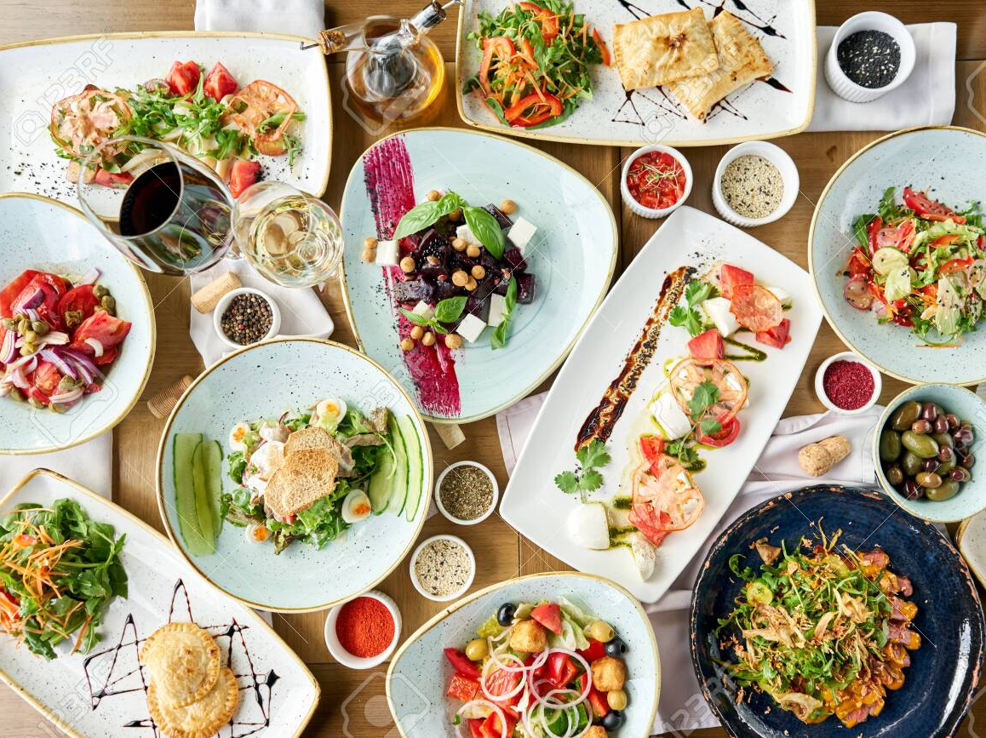
Eclectic
Part of speech: adjective
Meaning: including lots of very different elements, styles or methods
The restaurant’s menu was eclectic and included a variety of Asian, Italian and Mexican dishes.

Slide 9
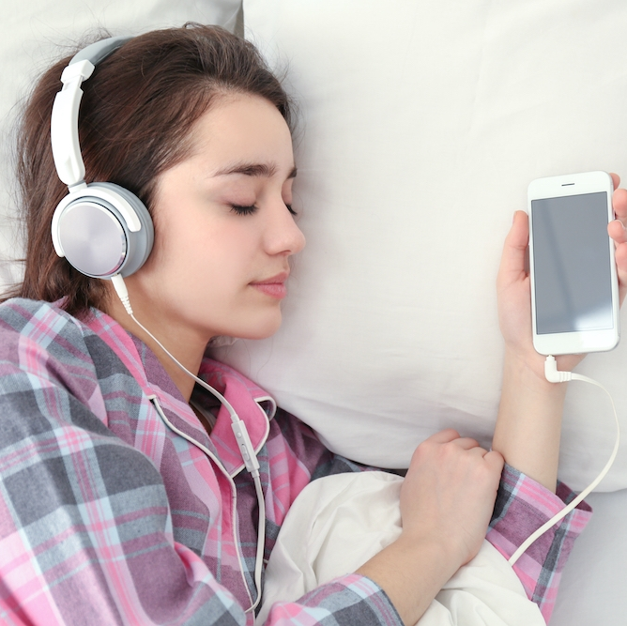
Monotone
Part of speech: adjective
Meaning: a sound or a voice that goes on and on without changing tone or pitch
He spoke in a boring monotone.
The monotone music put her straight to sleep.

Slide 10
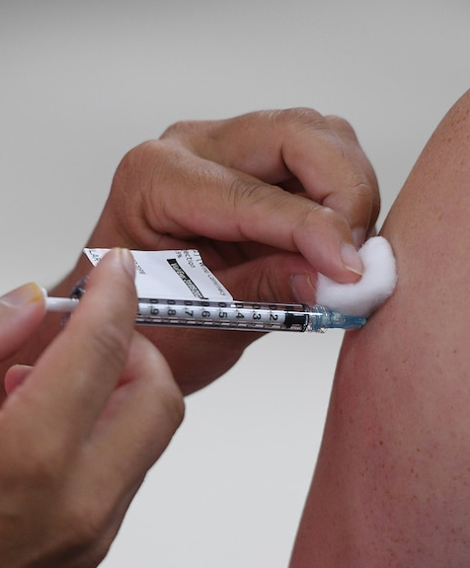
Immune
Part of speech: adjective
Meaning: not able to be affected by something; resistant; protected
Fred should not be immune to criticism just because he’s a policeman.
Getting a polio vaccine will make you immune to polio.

Slide 11
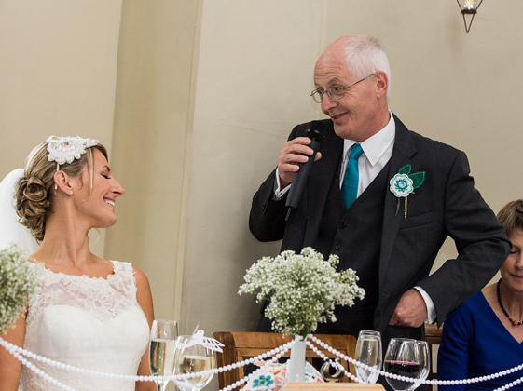
Jovial
Part of speech: adjective
Meaning: cheerful, jolly, friendly
There was a jovial atmosphere at the picnic.
The father of the bride was in a jovial mood, bantering with the bridesmaids and slapping the groom heartily on the back.

