Slide 1
Year 8 Vocab
Term 1, Week 6

Slide 2
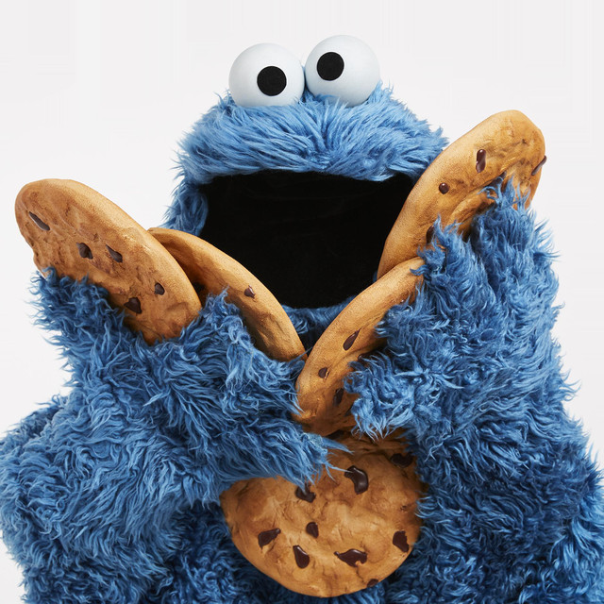
Voracious
Part of speech: adjective
Meaning: very eager or greedy for something, especially food
She is a voracious reader.
Which Sesame Street character has a voracious appetite for cookies?

Slide 3
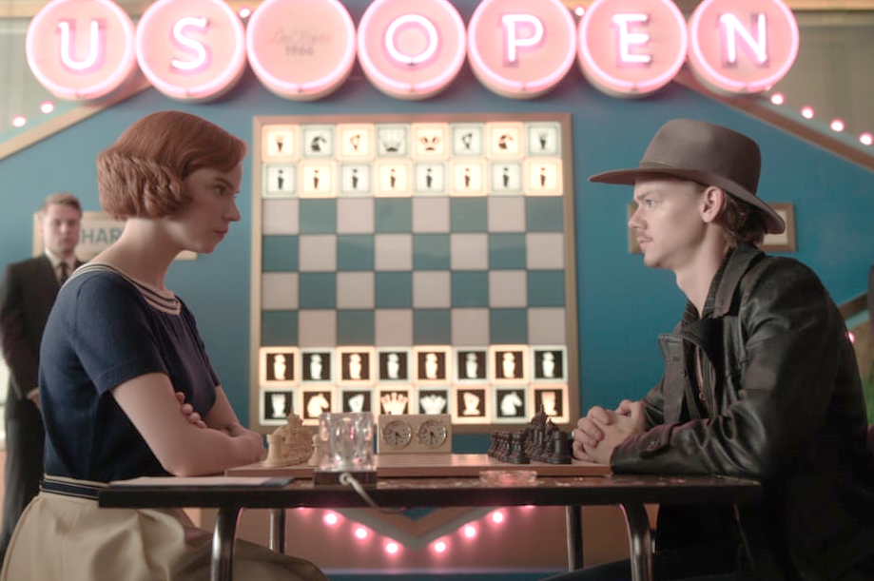
Foe
Part of speech: noun
Meaning: an enemy or opponent
We waited quietly to see if she was friend or foe.
My chess partner was a worthy foe but I defeated him in the end.

Slide 4
Estate
Part of speech: noun
Meaning: property and possessions
The governor owns a huge estate in the South of France.
In her will, she divided her estate between her four children.

Slide 5
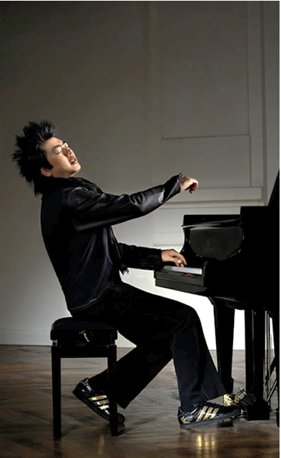
Virtuoso
Part of speech: noun
Meaning: a person who is highly skilled at something; an expert
Lang Lang is a piano virtuoso.
She is recognised everywhere as a virtuoso, perhaps the greatest painter of the 20th century.

Slide 6
Confound
Part of speech: verb
Meaning: to confuse or surprise
Computers, phones, and technology absolutely confound my Grandpa.
The success of the show confounded the critics.

Slide 7
Purge
Part of speech: verb
Meaning: to get rid of something unwanted; to cleanse or purify
Ben decided to purge his wardrobe of any clothes that were too small.
Diets that claim to purge toxins are unnecessary; your kidneys and liver already do this very well.

Slide 8
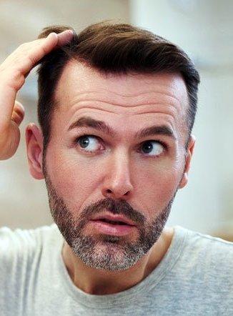
Recede
Part of speech: verb
Meaning: to move back or gradually diminish
The floodwaters had begun to recede.
Jim was horrified when his hairline receded.

Slide 9
Counsel
Part of speech: verb
Meaning: to give advice, usually from an expert or professional
Her job as careers officer is to counsel the students about which courses they need.
His lawyers counselled him to avoid answering too quickly.

Slide 10
Vacillate
Part of speech: verb
Meaning: to waver between two opinions or choices; to be indecisive
His tendency to vacillate makes him a poor leader.
For a long time she vacillated between teaching and journalism.

Slide 11
Undulate
Part of speech: verb
Meaning: to move smoothly up and down in a wave-like motion.
The surface of the liquid began to undulate slightly.
The trail undulated as we went up the hill.

