Slide 1
Idioms
Year 8 Vocab – Term 2 Week 1

Slide 2
What is an idiom?
A phrase or saying that over a long period of time has come to have a particular meaning. The meaning of the phrase is usually different to what the words mean literally or individually. The meaning is often based on a historical reference.
Examples:
To be “over the moon” means to be happy (why?)
To “see the light” means to see sense (why?)

Slide 3
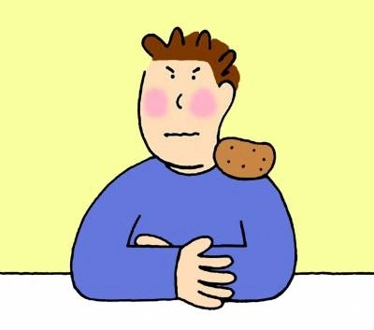
A chip on your shoulder
Meaning: to be angry, upset or ready to fight, especially over being treated unfairly.
Origin: In the 1800’s there was a game where one boy would put a chip of wood or stone on his shoulder. Then he would dare another to knock it off. If he did, a fight would follow.
“Wow, Jim has a real chip on his shoulder about not getting a part in the play.”
Shawn had a potato on his shoulder. A chip wasn’t enough.

Slide 4
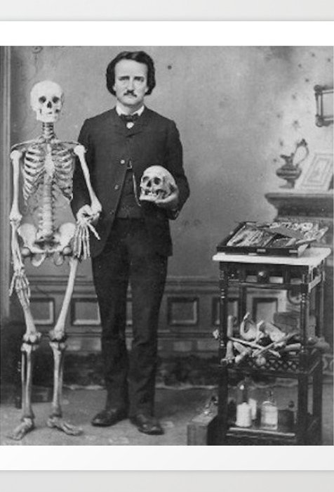
A skeleton in the closet
Meaning: a dark, shameful secret in someone’s past that will ruin their reputation if discovered
Origin: this saying may be a reference to the gothic horror stories of Edgar Allan Poe from the 1800s. Several were about murderers who tried to hide their victims in the walls or basement of their houses, but were discovered.
“He probably would have been elected if someone hadn’t found that skeleton in his closet.”

Slide 5
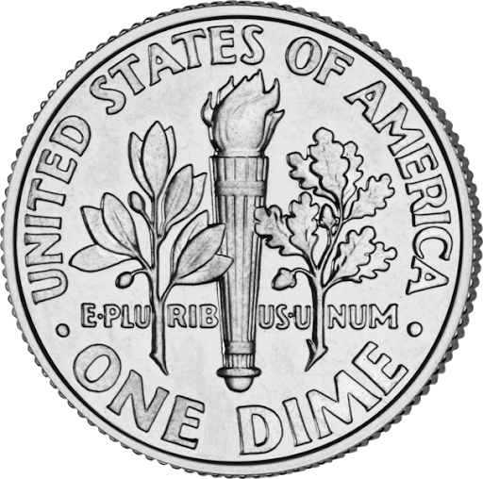
A dime a dozen
Meaning: very common and not very valuable
Origin: A dime in the USA is ten cents, and dozen means 12. Sets of cheap things were often sold ‘by the dozen’ – e.g. a dozen eggs, a dozen roses
“Those birds might be rare where you’re from, but around here they’re a dime a dozen.”

Slide 6
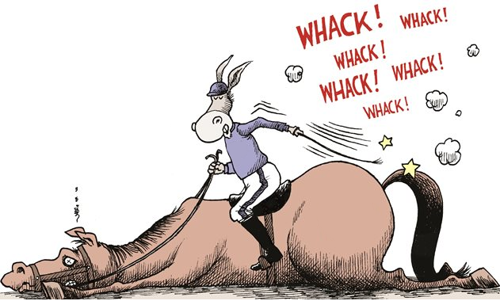
Beat a dead horse
Meaning: to keep fighting a battle that has been lost, or arguing about something that has been already decided. An effort that is futile or a waste of time.
Origin: In ancient Rome, Plautus wrote a play in which a man was beating the horse that was pulling his cart to get it to move. The horse was dead, so the beating had no effect.
“Mum said no, so stop asking – you’re beating a dead horse.”

Slide 7
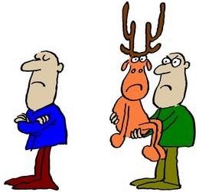
Pass the buck
Meaning: to pass the responsibility or blame to someone else
Origin: In 1800’s poker, a knife with a handle made of buck (deer) horn was passed to you if it was your turn to deal.
“You’ve got to make the decision yourself. You can’t pass the buck this time.”

