Slide 1
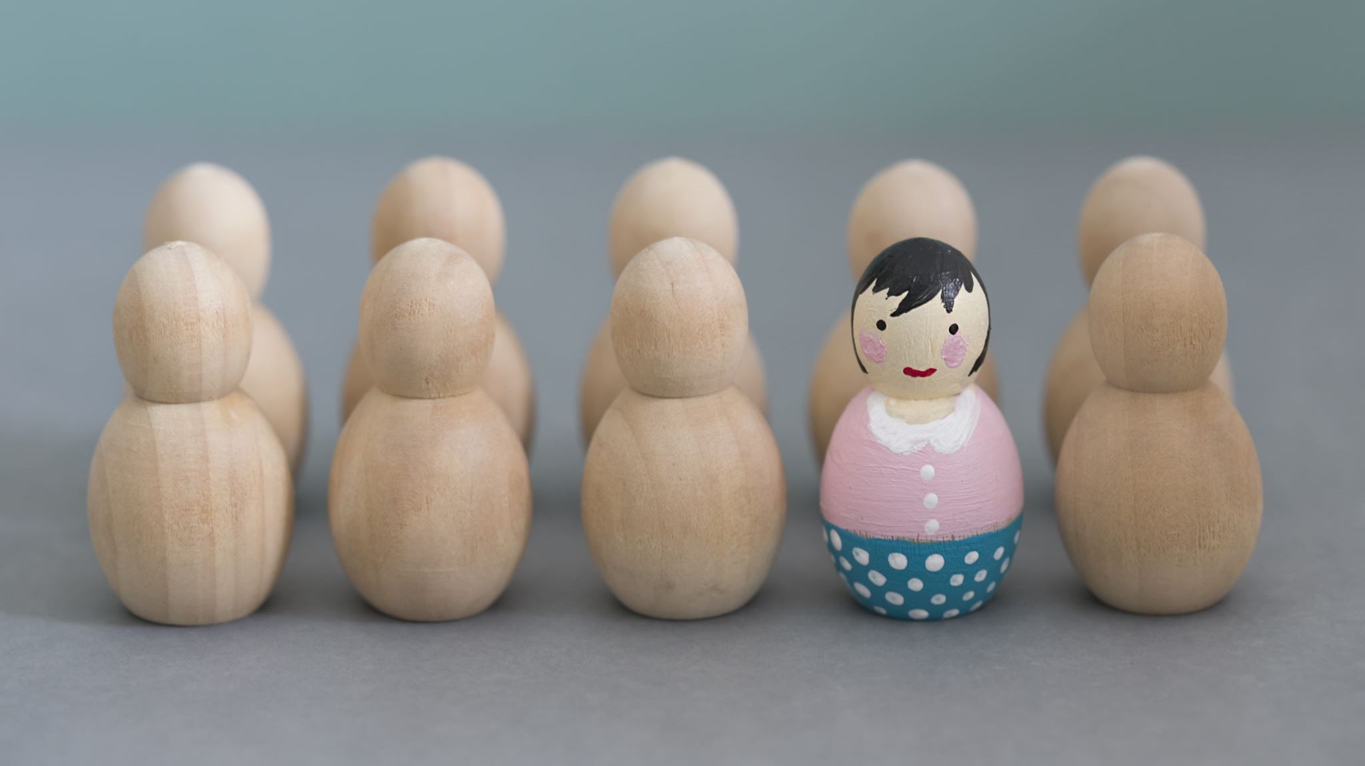
Idioms
Year 8 Vocab – Term 2, Week 2

Slide 2
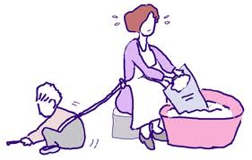
Tied to someone’s apron strings
“You can’t be tied to your mother’s apron strings your whole life.”
Meaning: to be dependent on someone or under their influence (particularly a wife or mother).
Origin: Most women in the past wore aprons to keep their dresses clean. Busy mothers would sometimes attach small children to their apron strings to prevent them wandering off while they worked.

Slide 3
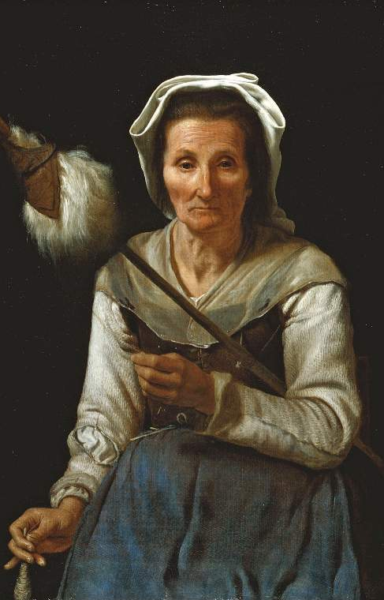
An old wives’ tale
“You can’t catch a cold from being cold. That’s just an old wives’ tale.”
Meaning: a superstition, belief, or practice that is not based on fact.
Origin: People used to go to the old women of the village for wise advice. These women had many superstitions like “walking under a ladder is bad luck” or “wear garlic to ward off evil.”

Slide 4
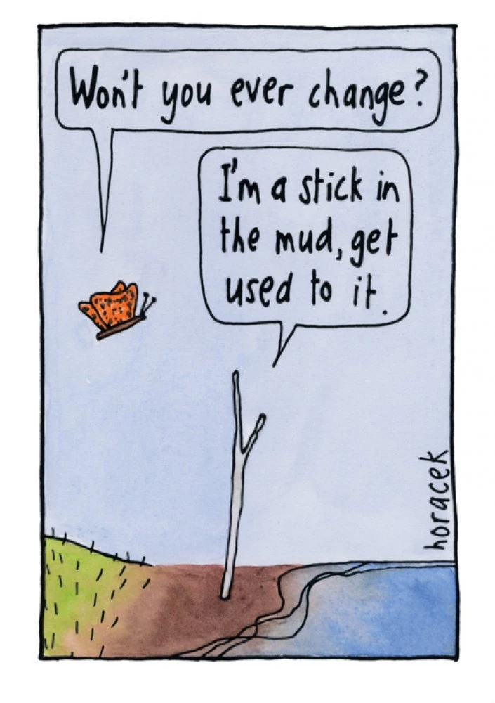
A stick-in-the-mud
“Dad is such a stick-in-the-mud; he refuses to get a new phone.”
Meaning: a person who likes old-fashioned ideas and avoids change.
Origin: People used to travel in wagons. A common problem was when the wagon got stuck in the mud and would not move. This is like a person who doesn’t want to change.

Slide 5
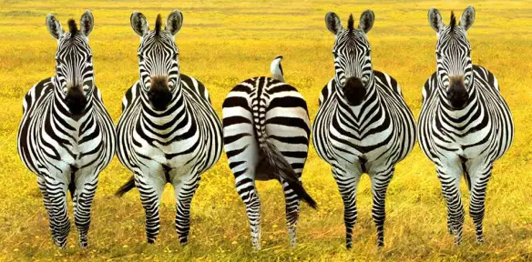
March to the beat of a different drum / their own drum
“You can tell by the way she dresses that she marches to the beat of her own drum.”
Meaning: to be an individual and have unique ideas. Not being like everyone else.
Origin: Henry David Thoreau, an American philosopher, used this phrase in his book Walden (1854). It refers to the way everyone in a marching band is led by the beat of the drummer.

Slide 6
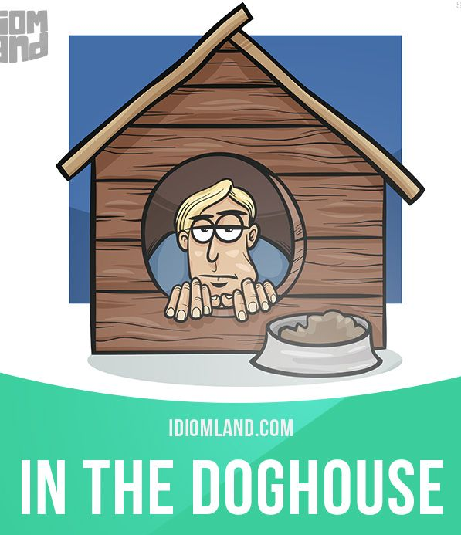
In the doghouse
“Dad forgot Mum’s birthday so now he’s in the doghouse.”
Meaning: feeling disgraced; facing punishment.
Origin: A bad dog is often sent out to his kennel as punishment. If person makes a mistake, they will face the displeasure of others and possible consequences (although probably not sitting in a literal doghouse).

