Slide 1
Idioms
Year 8 Vocab – Term 2, Week 3

Slide 2
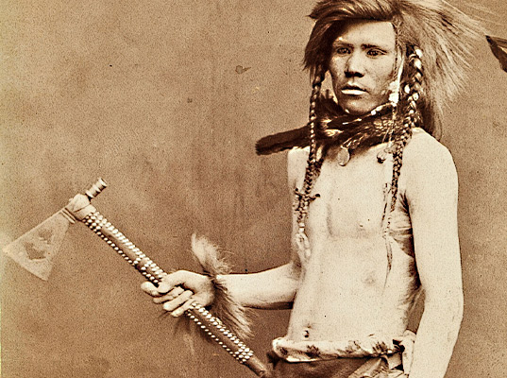
Bury the hatchet
“Harry and Ben have finally agreed to bury the hatchet and cooperate.”
Meaning: to settle an argument
Origin: Native Americans used to have a ceremony at the end of a war. To show it was over, they would bury their weapons in the dirt.

Slide 3
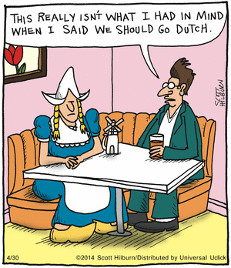
Dutch treat / Go Dutch
“Gina invited us to dinner at an expensive restaurant and then insisted we go Dutch.”
Meaning: each person pays for their own food or entertainment.
Origin: In the 17th Century there was rivalry between the British and the Dutch, who the Brits thought were stingy and tight-fisted (not generous). Instead of ‘treating’ your friends to a meal, a Dutch ‘treat’ means making them pay for their own food.

Slide 4
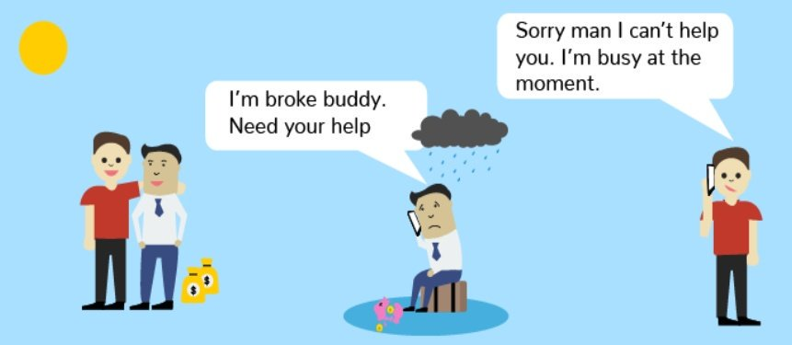
Fair-weather friend
“You can’t count on Penny when you’re in trouble, she’s such a fair-weather friend.”
Meaning: a person who is only friends with you when things are going well. They desert you when times are difficult.
Origin: Life usually feels better when the weather is sunny with blue skies. A friend who ditches you when times are bad, or “foul weather,” is not a very good friend.

Slide 5
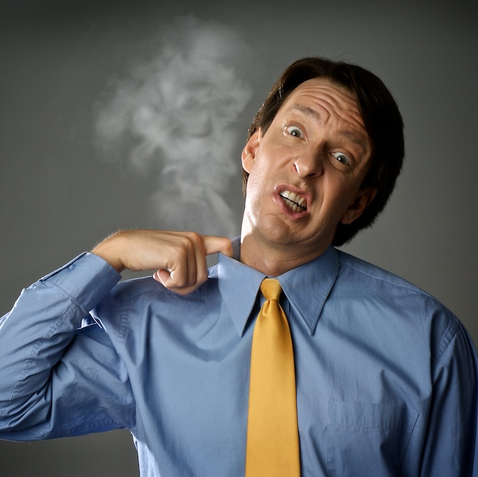
Hot under the collar
“I have to be home by 11 or my dad will get hot under the collar.”
Meaning: to be angry or embarrassed
Origin: When people get angry or upset their necks and faces sometimes turn red. The area under their collar is getting hot.

Slide 6
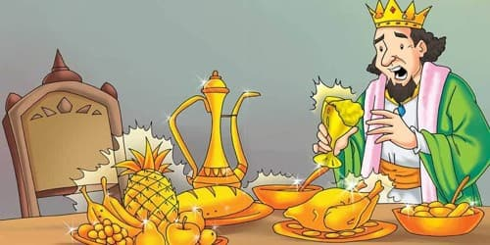
The Midas touch
“Darryl is making millions designing clothing. I think he must have the Midas touch.”
Meaning: the ability to make a lot of money at whatever you do.
Origin: In Greek Mythology, King Midas loved gold and wanted to be rich. The god Dionysus gave Midas a special power - everything he touched turned to gold. He was thrilled, until his food and his daughter turned to gold too.

