Slide 1
Idioms
Year 8 Vocab – Term 2, Week 5

Slide 2
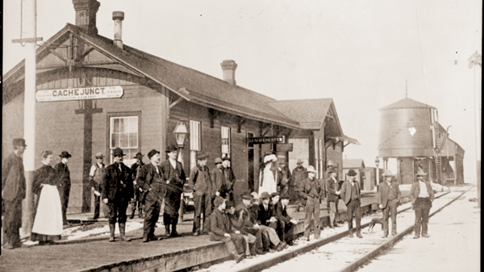
Wrong side of the tracks
“I can’t believe Grandma said that the girl I was dating was from the wrong side of the tracks. What a snob.”
Meaning: from a poor background or a lower-class area, from a less wealthy family or social class
Origin: Train tracks used to divide a town into rich and poor sections. The better-off neighborhood was usually on the side of the track where the train smoke wouldn’t blow. The wrong side of the tracks is the poorer side.

Slide 3
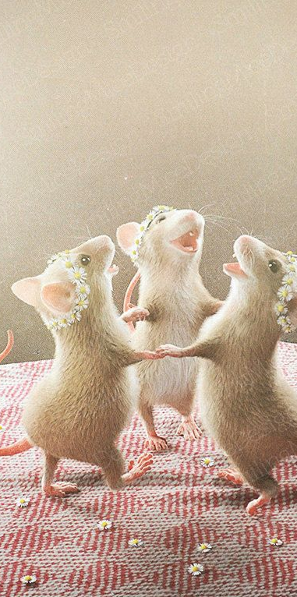
When the cat’s away, the mice will play
“When the teacher stepped out of the room, all the students started throwing paper airplanes. When the cat’s away, the mice will play.”
Meaning: when the person in charge is gone, people will take advantage of the freedom and do whatever they want.
Origin: When a cat is in the house, the mice are afraid and stay hidden. If the cat is gone, the mice feel safe and come out. The same thing happens with people!

Slide 4
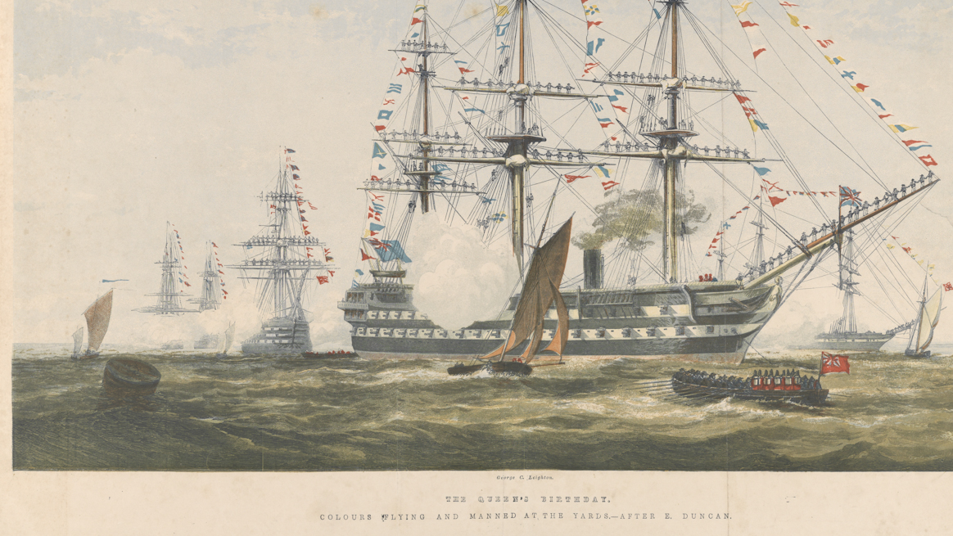
With flying colors
“I passed my English exam with flying colors after all that studying!”
Meaning: with ease and great success
Origin: A victorious naval ship would approach the dock with colorful flags flying off the mast. This signified a magnificent victory.

Slide 5
Water under the bridge
“Did you have a bad day yesterday? Well, keep moving forward. It’s just water under the bridge.”
Meaning: something in the past that can’t be changed
Origin: Wherever water is flowing, once it has flowed on, it cannot come back. The same thing happens with time. Once time has passed, we cannot get it back.

Slide 6
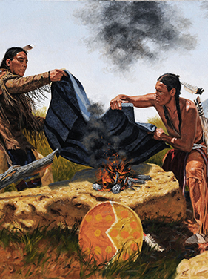
Wet blanket
“I hope Rafi doesn’t come to the beach with us - he is such a wet blanket.”
Meaning: a person who spoils the fun because they are depressing and negative
Origin: Native Americans used to put out their campfires by laying a wet blanket on the fire. Fire represents enthusiasm, and the wet blanket puts out the flames like a pessimist.

