Slide 1
Idioms
Year 8 Vocab – Term 2, Week 9

Slide 2
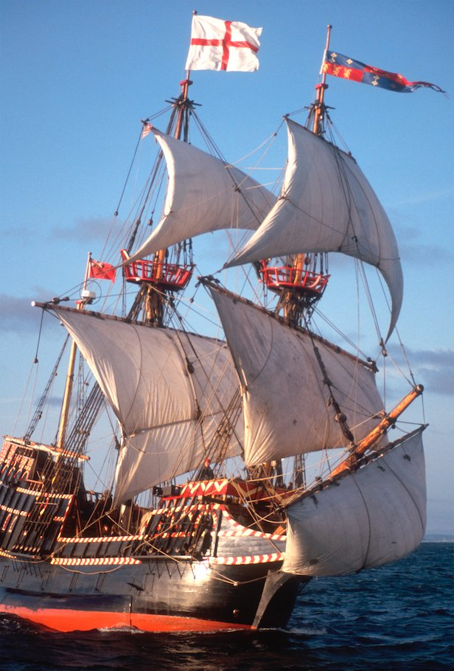
Show your true colors
“We thought Clive was a great guy until he showed his true colors and kicked his dog.”
Meaning: to reveal what you a really like
Origin: Ships used to display colorful flags to identify themselves. Sometimes a ship could fool an enemy by flying false flags. That would be “flying false colors.” Then, if a ship put up its real flags, it would show its true identity, or “true colors.”

Slide 3
Up the creek
“I’m really up the creek. I’ve lost my costume, and the play is tonight.”
Meaning: in serious trouble
Origin: The whole phrase is usually “up the creek without a paddle.” In this situation you’d be unable to steer or paddle ashore, and quite helpless.

Slide 4
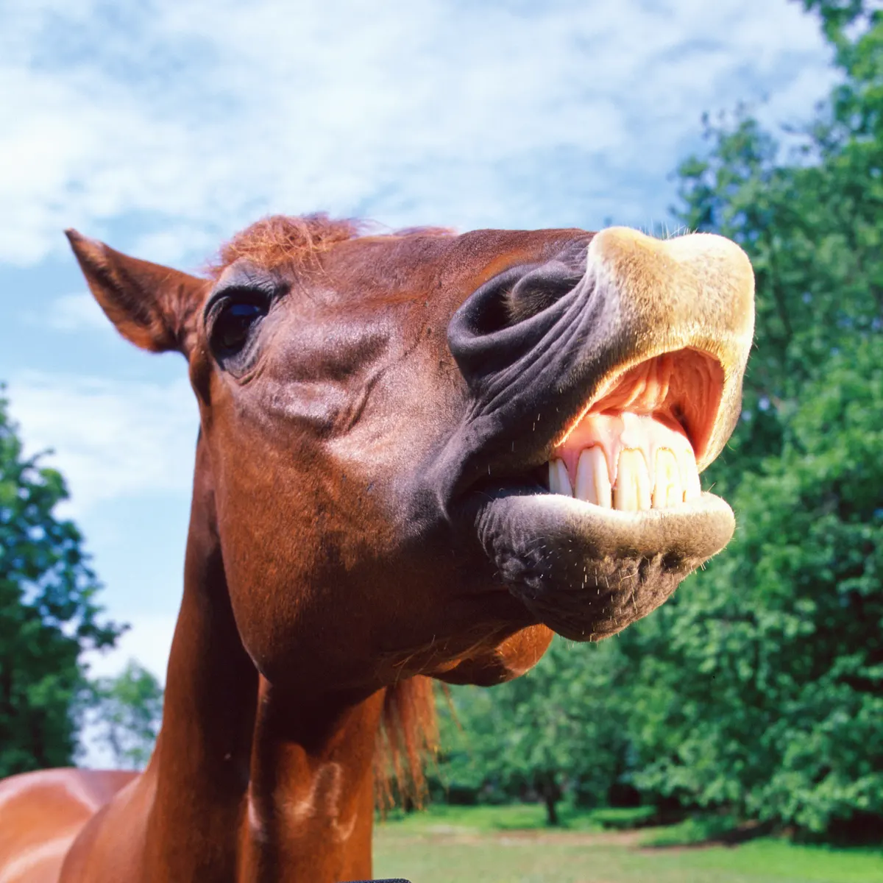
Straight from the horse’s mouth
“I heard straight from the horse’s mouth that there is going to be a pop quiz in chemistry today.”
Meaning: directly from the person who is the best source of information on that topic
Origin: You can tell the age of a horse very accurately by looking at its teeth. Someone who was trying to sell you the horse might lie about its age, but by looking at its teeth you’d learn the truth “straight from the horse’s mouth.”

Slide 5
Wear your heart on your sleeve
“It’s not hard to figure out how Chester is feeling because he always wears his heart on his sleeve.”
Meaning: to show one’s emotions openly
Origin: In the 1600s it was a custom for a girl to tie a ribbon around the arm of the guy she loved, and he’d wear it into a joust or battle as a symbol of his devotion. To wear your heart on your sleeve is like showing your feelings to everyone.

Slide 6
Toe the line
“The boss told Everett to toe the line, or he would lose his job.”
Meaning: do what you’re supposed to do
Origin: In a race, the runners line up with their toes touching the starting line. If a runner’s toe goes over that line, he is disqualified. So to “toe the line” means to keep your toes touching the line and follow the rules.

