Slide 1
Idioms
Year 8 Vocab
Term 2, Week 10

Slide 2
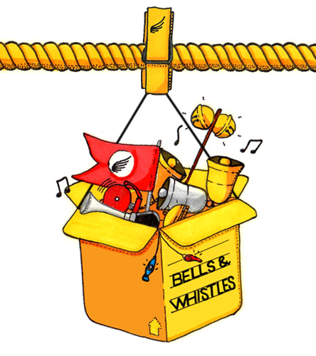
Bells and whistles
“Evie is getting an awesome new laptop with all the bells and whistles.”
Meaning: impressive accessories; flashy features
Origin: During the Industrial Revolution there were lots of new technologies being invented. Back then, machines with bells and whistles were really high-tech.

Slide 3
Out of the woods
“Dad’s condition has improved slightly, but the doctor said he’s not out of the woods yet.”
Meaning: safe from trouble or danger
Origin: Before people had effective portable lights, a wood or thick forest would have been quite a dark and dangerous place to be. Wolves, bears, or gangs of thieves often lurked there, and it was easy to get lost. So, coming out of the woods would mean getting safely out of a risky situation.

Slide 4
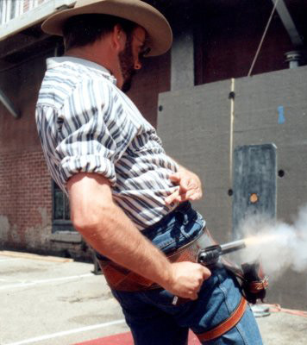
Shoot from the hip
“We’re going to think things through carefully this time, not just shot from the hip.”
Meaning: to talk or act without thinking first of the consequences
Origin: In gunfights, it was easier to shoot the gun from the holster on your hip than to go to the trouble of pulling it out to shoot. Shooting from the hip is something you would do very quickly without thinking first.

Slide 5
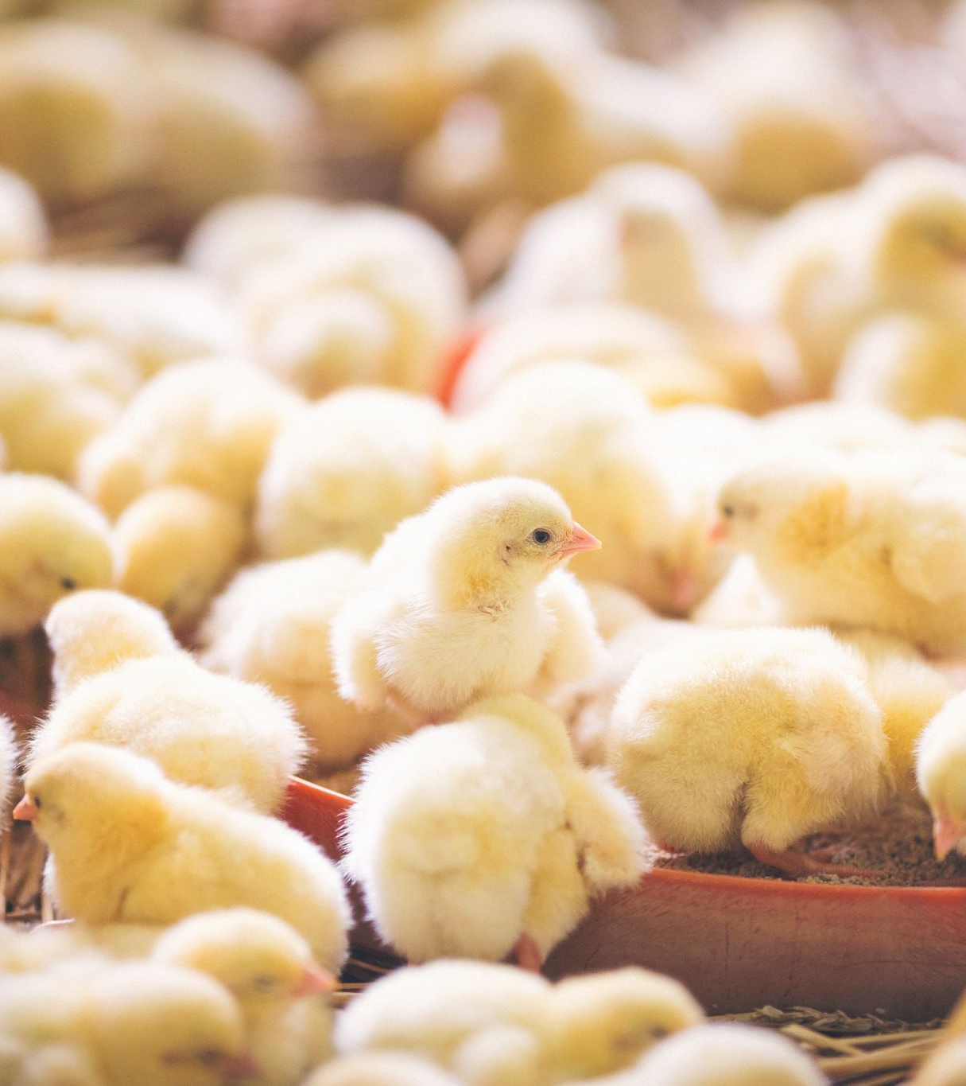
No spring chicken
“Grandma can’t play basketball the way she used to. She’s no spring chicken.”
Meaning: not young anymore
Origin: A spring chicken is a baby chick that’s only just hatched. If you’re getting older, you’re no longer like a spring chicken.

Slide 6
On the fritz
“The washing machine is on the fritz, so I have to take the washing to the Laundromat.”
Meaning: broken; not working
Origin: During WWI, British soldiers would often refer to any German as “Fritz” (a common German nickname). If something was broken or going wrong, the Germans must have had a hand in it!

