Slide 1
Year 8 Vocab
Term 1 Week 7

Slide 2
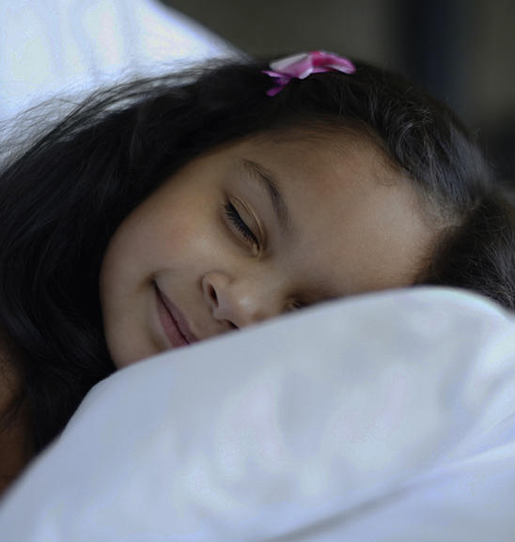
Feign
Part of speech: verb
Meaning: to pretend, to fake
Jack feigned illness to try and get out of doing his test.
The kids always feign sleep when I go in to check on them.

Slide 3
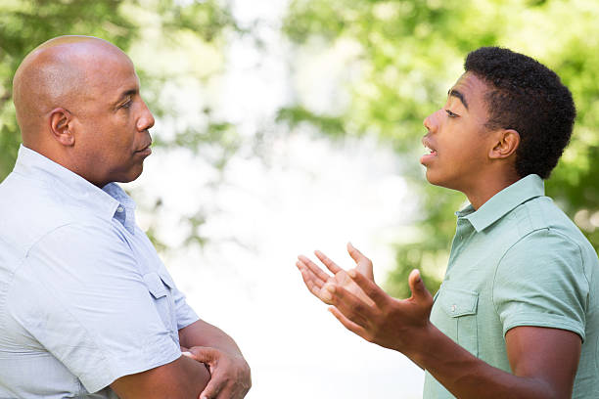
Beseech
Part of speech: verb
Meaning: to beg or plead
I beseech you, please give me another chance!
As soon as he got his license, he beseeched his parents to buy him a car.

Slide 4
Loathsome
Part of speech: adjective
Meaning: causing disgust or hatred
Carrie looked at him as though he were a particularly loathsome slug.
Smoking is a loathsome habit.

Slide 5
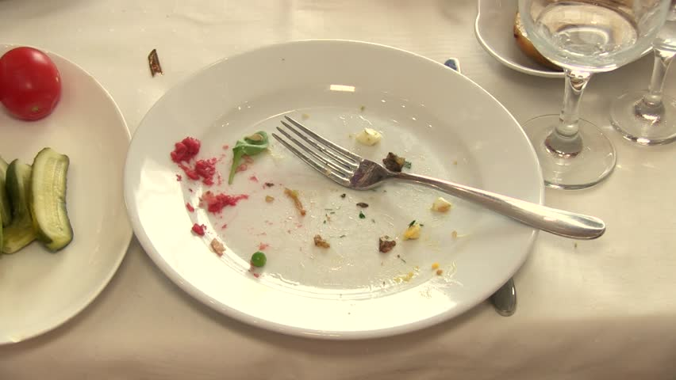
Morsel
Part of speech: noun
Meaning: a tiny amount
No thanks, I couldn’t eat another morsel!
He refused to give her the smallest morsel of attention.

Slide 6
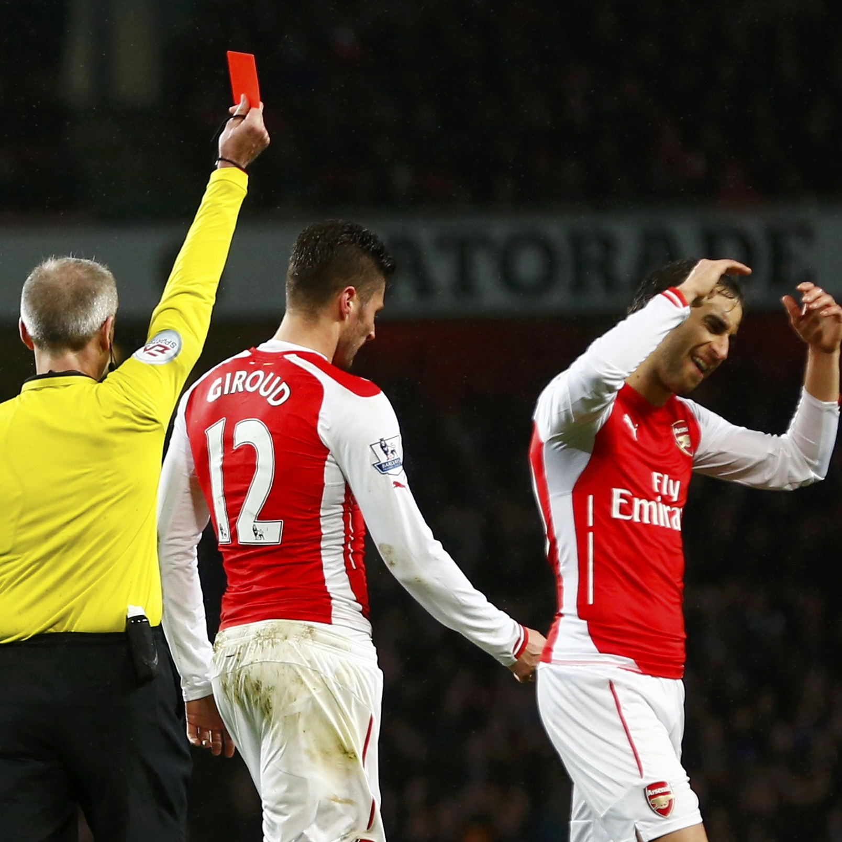
Grievance
Part of speech: noun
Meaning: a complaint about unfair treatment; a grudge
In her letter she listed many grievances.
It’s been years since they lost the game but he still has a grievance about the ref’s decision.

Slide 7
Labyrinth
Part of speech: noun
Meaning: a maze, or a route that is confusing and difficult to navigate
In Paris, we got lost in the labyrinth of narrow alleyways.
But first, you must find your way out of the Labyrinth of Doom!

Slide 8
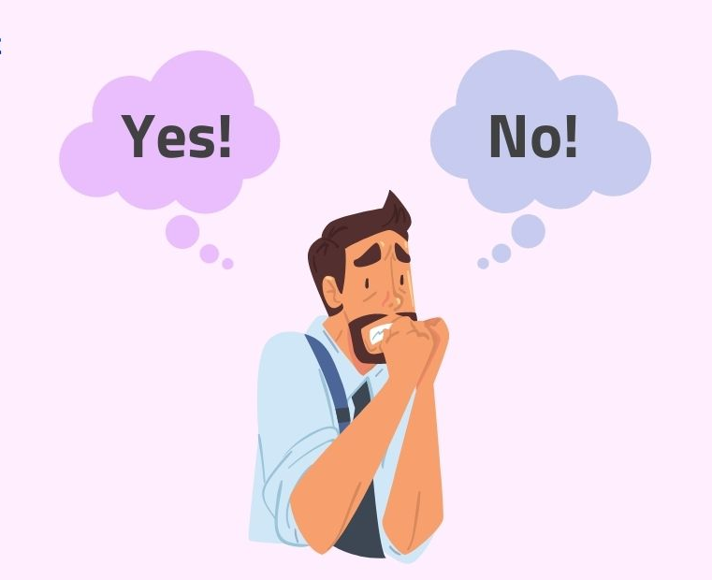
Quandary
Part of speech: noun
Meaning: a state of uncertainty about what to do in a difficult situation; a dilemma
Both places offered me the job, so now I’m in a quandary over which one to accept.
The situation posed a moral quandary.

Slide 9
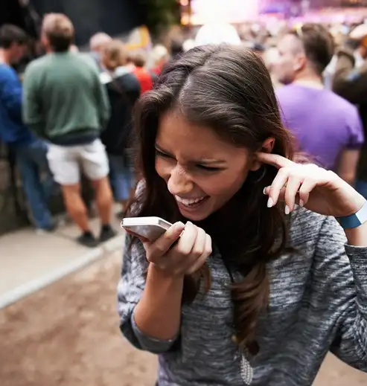
Tumult
Part of speech: noun
Meaning: a loud confused noise, especially caused by a crowd of people
We had to shout to be heard over the tumult.
Her mind was a tumult of worries and fears.

Slide 10
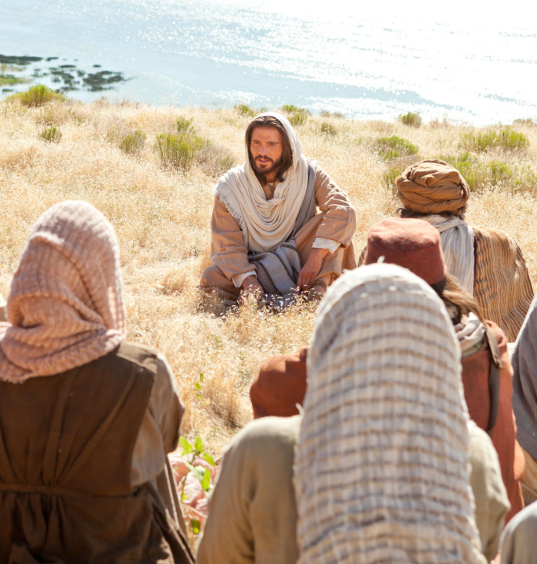
Discourse
Part of speech: noun
Meaning: written or spoken communication; a speech or debate
Christ’s discourse in Galilee is often referred to as the Sermon on the Mount.
The TV show host always engages his guests in a lively discourse.

Slide 11
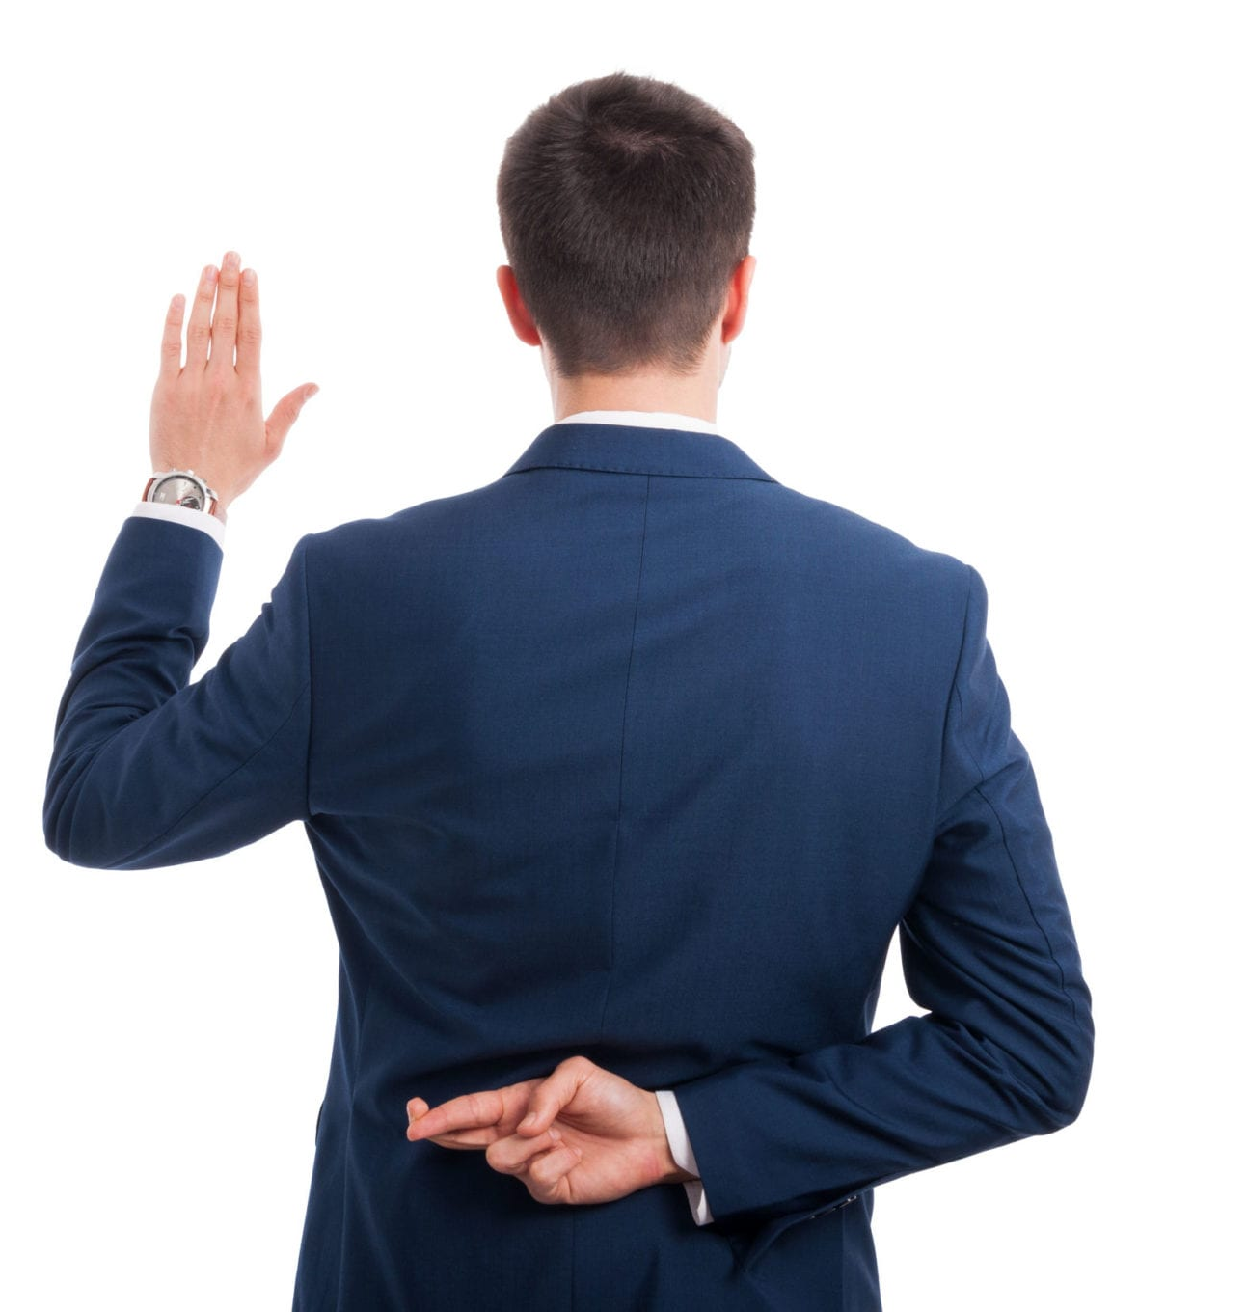
Perjury
Part of speech: noun
Meaning: the act of deliberately lying or giving false information in court
The thief committed perjury when he told the judge he was innocent.

