Slide 1
Year 8 Vocab
Term 1 Week 9

Slide 2
Impede
Part of speech: verb
Meaning: to block or slow down something by getting in the way
Loud music will impede your ability to concentrate.
Heavy rain impeded our journey.

Slide 3
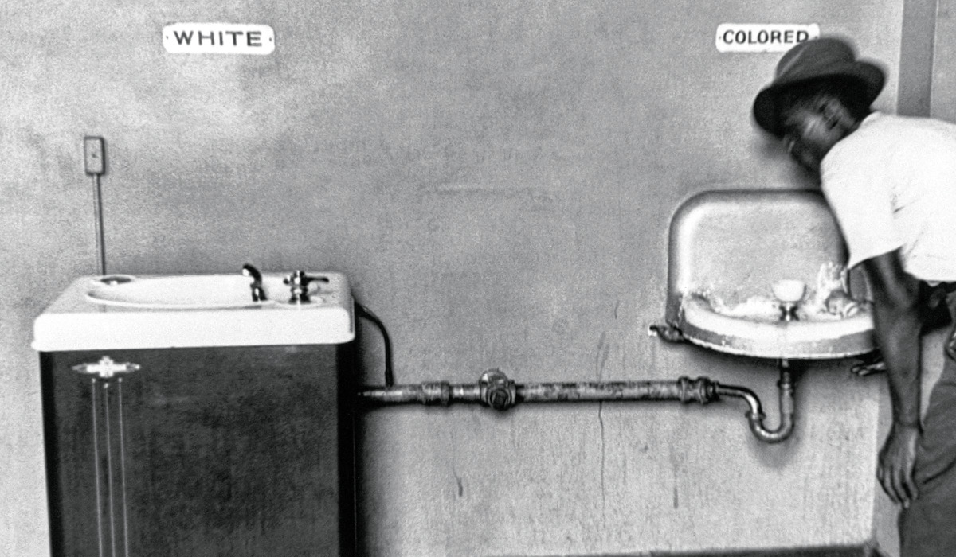
ostracism
Part of speech: noun
Meaning: exclusion; being rejected from a social group or a place
Children who are seen as ‘different’ can become victims of teasing or social ostracism.
Many black families suffered from ostracism and discrimination in America’s south.

Slide 4
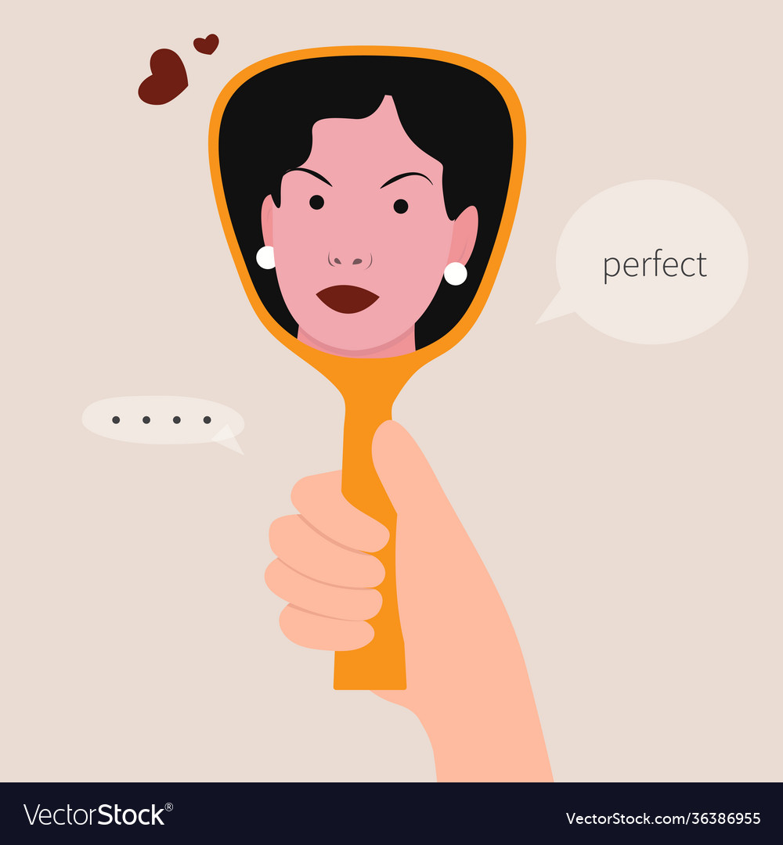
Narcissism
Part of speech: noun
Meaning: self-obsession; being in love with yourself or your appearance
Alice’s narcissism made her incredibly difficult to live with.

Slide 5
nostalgia
Part of speech: noun
Meaning: a feeling of longing for things of the past
Val was filled with nostalgia when she saw a photo of her childhood home.

Slide 6
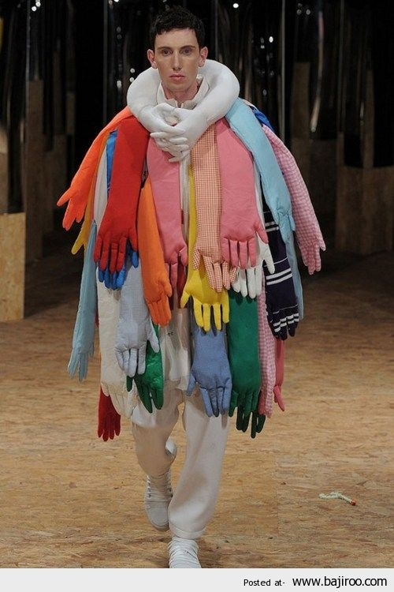
maverick
Part of speech: noun
Meaning: someone who thinks or acts independently, does things differently to everyone else
The fashion designer is a maverick and created some very strange outfits.

Slide 7
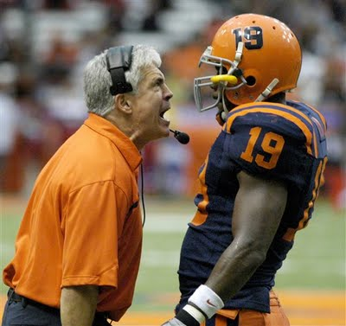
Lambast
Part of speech: verb
Meaning: to scold or criticize harshly, to attack verbally
The coach would lambast Terry whenever he made a mistake.
His first novel was lambasted by critics.

Slide 8
Incorrigible
Part of speech: adjective
Meaning: unable to change, unable to learn from mistakes – wild and uncontrolled
My hair is incorrigible!
His sister was an incorrigible liar.

Slide 9
Precocious
Part of speech: adjective
Meaning: showing unusually advanced skills or mature qualities at an early age.
Ted was a precocious child who could read well before he went to school.

Slide 10
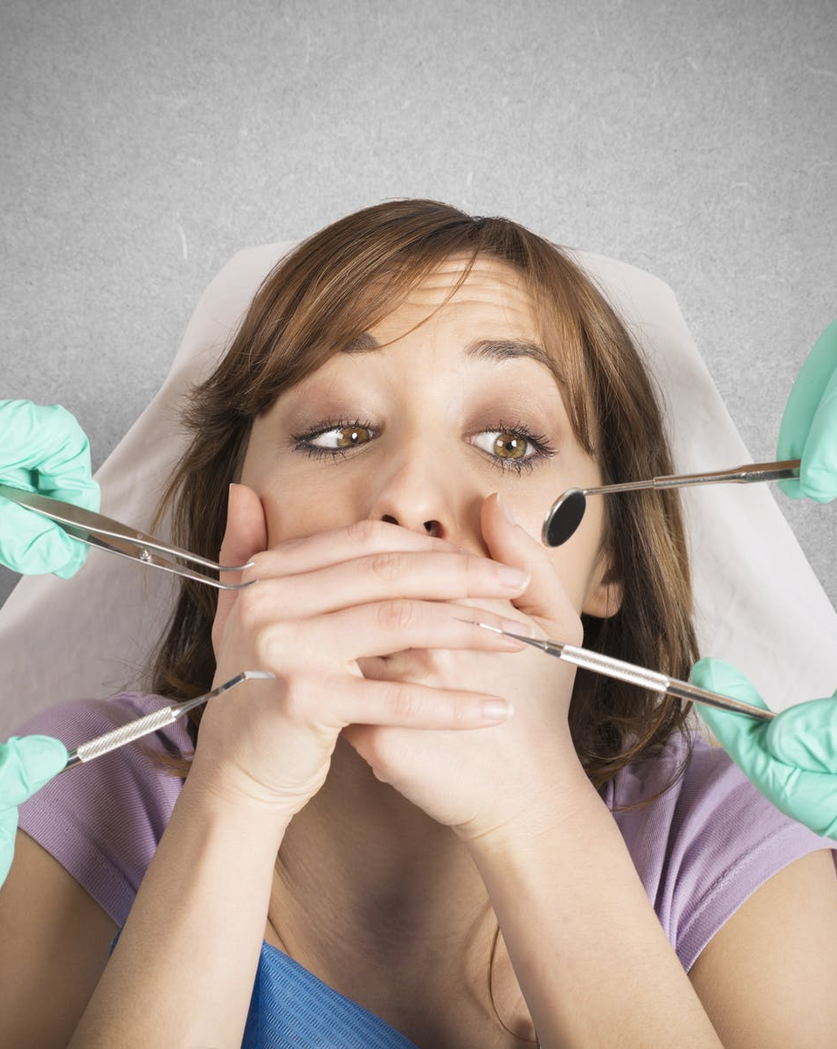
quell
Part of speech: verb
Meaning: to crush or subdue; to put an end to by force; to supress or quiet down
The police were called out to quell the riot.
It was a huge effort for Gemma to quell her fears and book a dentist appointment.

Slide 11
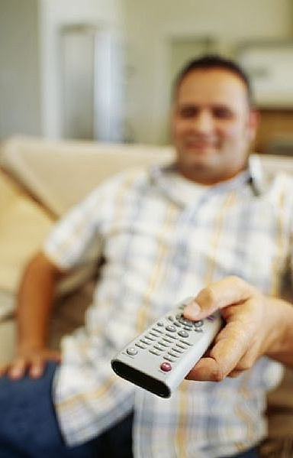
relinquish
Part of speech: verb
Meaning: to release hold of; to voluntarily give up or let go control of something
It’s very rare for Dad to relinquish the TV remote.
You can’t relinquish your dream of getting into med school!

