Slide 1
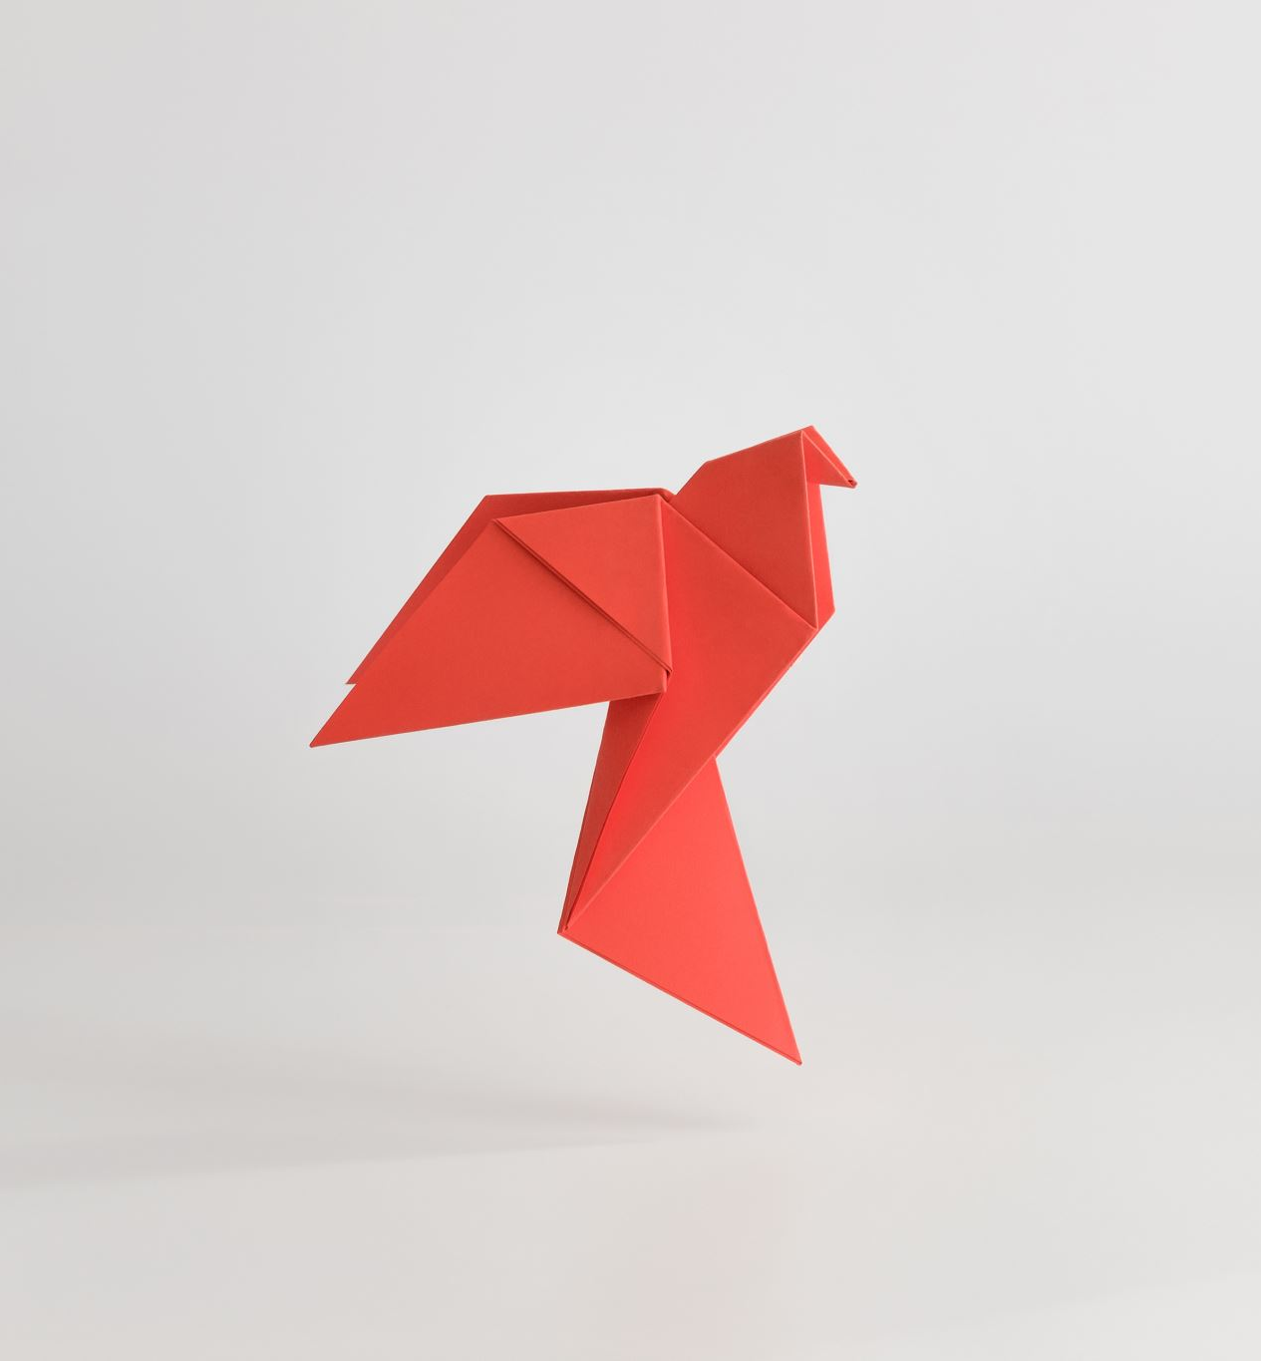
Year 8 Vocab
Term 1 Week 10

Slide 2
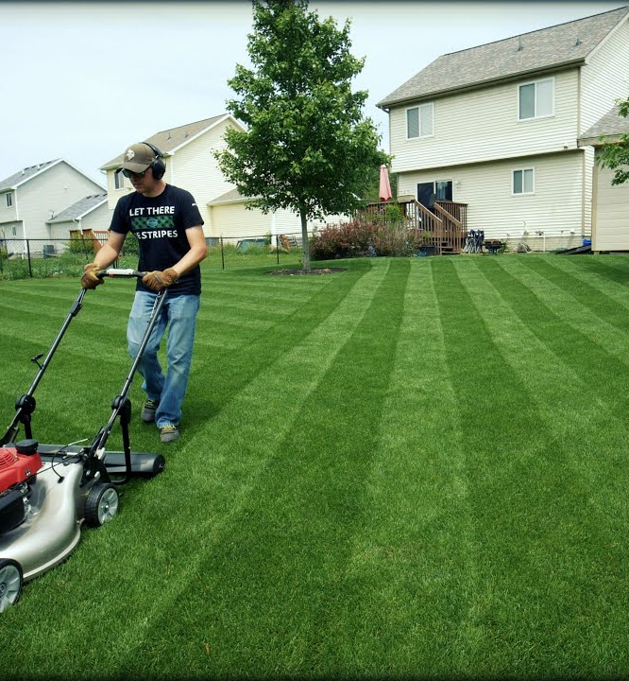
Scrupulous
Part of speech: adjective
Meaning: careful to do things correctly or morally; and/or with thorough attention to detail
John took scrupulous care of his back lawn.
He’s far too scrupulous to take advantage of his position.

Slide 3
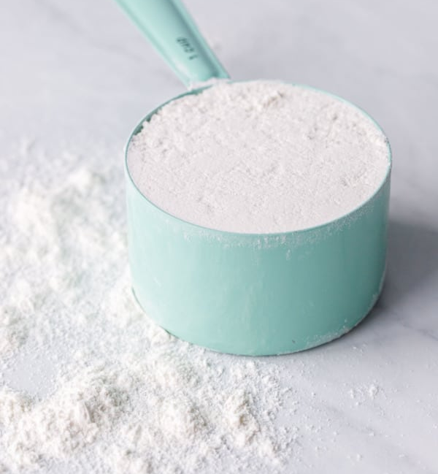
Suffice
Part of speech: verb
Meaning: to be enough, to be adequate
Half a cup of flour should suffice.
Suffice to say, he didn’t get the job.

Slide 4
Trepidation
Part of speech: noun
Meaning: a feeling of fearful uncertainty about the future
Shirley waited with trepidation to hear the results of her test.
I had no trepidation about being the first person to sign up.

Slide 5
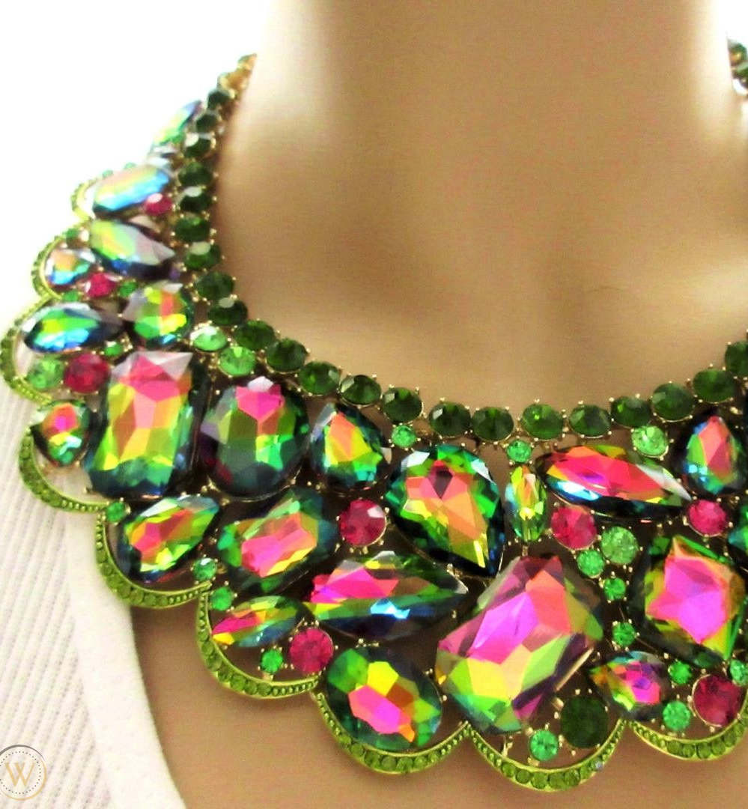
Tawdry
Part of speech: adjective
Meaning: showy but cheap and poor quality; unpleasant or immoral.
I thought that necklace she had on looked tawdry.
The tawdry details of the scandal shocked the nation.

Slide 6
Truncate
Part of speech: verb
Meaning: to cut short
Jim had to truncate his presentation because he ran out of time.
He was a sensational player but his career was truncated by an injury.

Slide 7
Vapid
Part of speech: adjective
Meaning: dull or bland; showing no intelligence or imagination
Bill’s new girlfriend is a bit vapid.
There was nothing on TV except vapid comedies.

Slide 8
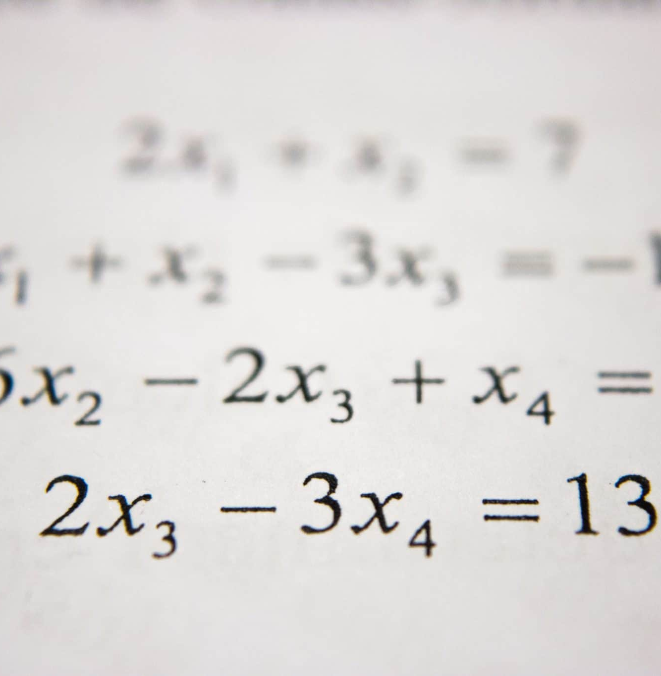
Adversary
Part of speech: noun
Meaning: an opponent or enemy
Ah, algebra, my old adversary!
Not only were they were surrounded by adversaries, but the freezing mountainous terrain made escape impossible.

Slide 9
Utilitarian
Part of speech: adjective
Meaning: designed to be useful rather than beautiful
The kitchen was decorated in a utilitarian style.
That restaurant’s dishes are too utilitarian for my tastes.

Slide 10
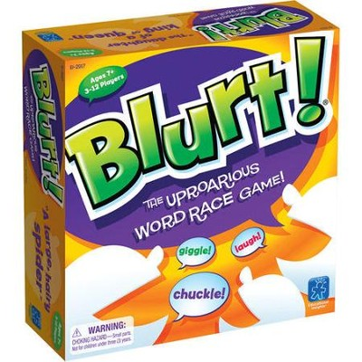
Uproarious
Part of speech: adjective
Meaning: causing a lot of noise and laughter
Blurt is an uproarious game where you shout out the answers.
His remarks were met with uproarious response from the crowd.

Slide 11
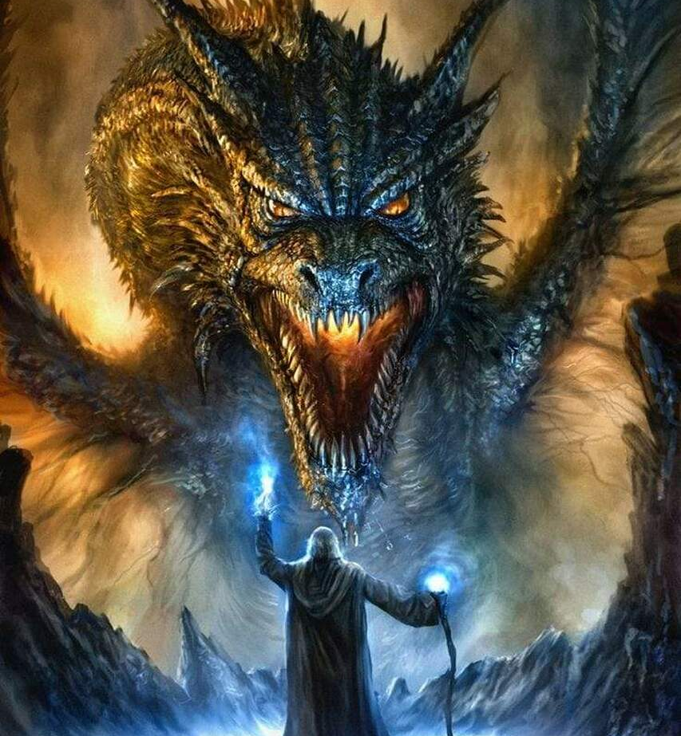
Wrath
Part of speech: noun
Meaning: anger, rage
Do not enter the cave or you will feel the wrath of the dragon!
The people saw the floods as a sign of divine wrath.

