Slide 1
Poetry Part 1
Form

Slide 2
What is Poetry?
Discuss with the person next to you:
What is a poem?
What’s the difference between poems and other types of writing?
How can you tell it’s a poem?

Slide 3
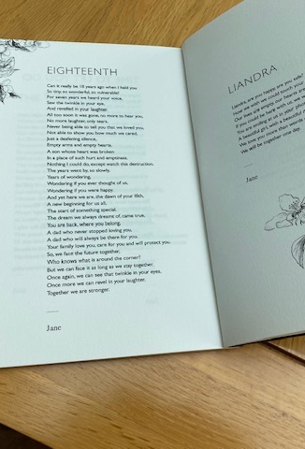
Are poems always…?
Short?
Rhyming?
In a particular shape:
Lots of short lines down one side of the page?
Arranged in verses?
Do they always have rules about how many lines or syllables?

Slide 4
Answer: Nope!
Sometimes have rules – but sometimes don’t
Sometimes rhyme – but sometimes don’t
Sometimes have a ‘shape’ on the page – but sometimes don’t
Sometimes have a meter/rhythm – but sometimes don’t
Often meant to be read aloud – but not always
Lots of different types, topics, formats
Written for lots of different reasons

Slide 5
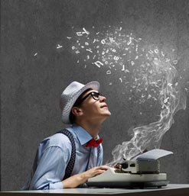
Message & Method
In poems, authors use lots of different techniques to convey (show, deliver) their message.
The two most important questions you need to ask about every text (film, novel, poem, play):
What is the writer’s message?
How is it conveyed?

Slide 6
FORM
We use the word ‘form’ to talk about the type of poem, the rules it has, the way it’s laid out.
Form can have an effect on the author’s message and how it’s conveyed.

Slide 7
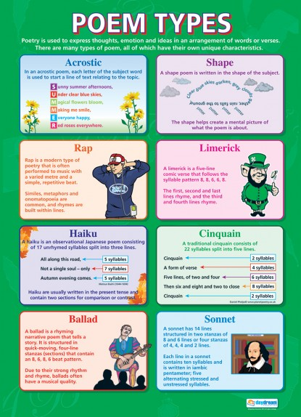
Examples of Poetry Forms
Haiku
Limerick
Narrative poem
Lyric poem
Ode
Free verse

Slide 8
Form & Meaning
The form of a poem often reflects or mirrors what the poem is about
A poem with very short choppy lines, all with exactly the same pattern or same number of syllables can give the impression of order, patterns, or restriction
Might work well for a poem about soldiers marching, an animal in a cage, a train rattling along, horses galloping, swinging back and forth

Slide 9
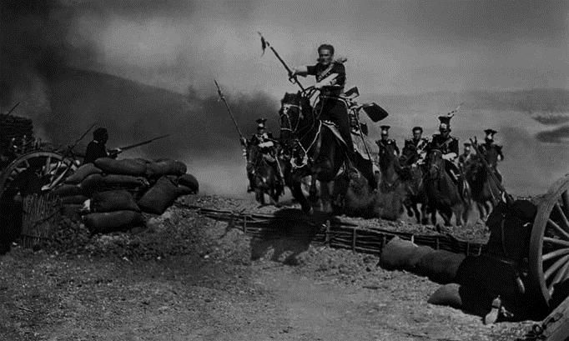
Cannon to right of them, Cannon to left of them, Cannon in front of them Volleyed and thundered; Stormed at with shot and shell, Boldly they rode and well, Into the jaws of Death, Into the mouth of hell

Slide 10
The bird that stalks
down his narrow cage
can seldom see
through his bars of rage
his wings are clipped
his feet are tied
so he opens his throat to sing.
The caged bird sings
with a fearful trill
of things unknown
but longed for still
and his tune is heard
on the distant hill
for the caged bird
sings of freedom.

Slide 11
Form & Meaning
A poem with long flowing lines, no rhyme or pattern can give the impression of freedom, creativity, flight, speed, movement
Might work well for a poem about a bike ride, the wind rippling through a field, wandering thoughts or imagination, a roller coaster

Slide 12
Skidding down the hill, bumping and jumping on the rocks
Picking up speed, zooming along the track, the breeze on my face feels cool and refreshing,
I'm traveling faster than the speed of light.
Wind funnels through my shirt as I sail between the trees.
I'm bent low, my torso poised over the handlebars, trees flash by but I don't notice.
I'm focused … trying to lose myself in the rhythm
The chug, chug, chug of my legs on the pedals
You race me to the bottom but I win!
Getting dark. Time to go back.
We skid on the dirt, turn around
and ride home.

Slide 13
Form & Meaning
Poets can choose a form based on what they want to express.
If they want to:
Tell a dramatic story – might choose a ballad or narrative poem
Show appreciation for a single moment in nature – might choose a haiku
Say how much they love & admire something – might choose a lyric poem, a sonnet or an ode

Slide 14
Looking at Form in Poetry
When you first read a poem, ask:
What is the form of this poem?
Why has the author used this form?
Does the form help show the message?

Slide 15
Activity
Handout 1: Poetry Forms sheet
Handout 2: example poems
Decide the form of each poem
Suggest why the poet used this form
Can work in pairs

