Slide 1
Poetry 2: Rhythm/Meter

Slide 2
Emphasis
In spoken English we give more weight or emphasis to some syllables in words
Dan-ger-ous (DAH da da)
Ca-tas-tro-phe (da DAH da da)
Un-a-void-a-ble (da da DAH da da)
Try saying them with the emphasis on the wrong syllables!
Dan-ger-OUS
Ca-tas-TRO-phe
Un-A-void-a-BLE

Slide 3
What is meter?
When words are arranged so that ‘stressed’ (emphasised) and ‘unstressed’ (non-emphasised) syllables form a pattern
Gives it a beat
Will there really be a morning
Is there such a thing as day?
Could I see it from the mountains
If I were as tall as they?

Slide 4
What is meter?
When words are arranged so that ‘stressed’ (emphasised) and ‘unstressed’ (non-emphasised) syllables form a pattern
Gives it a beat
Will there really be a morning
Is there such a thing as day?
Could I see it from the mountains
If I were as tall as they?

Slide 5
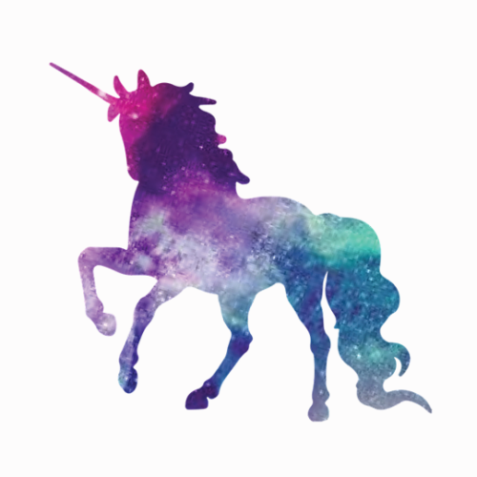
Syllables vs meter
Even if two lines have the same number of syllables, they won’t have the same ‘beat’ if the emphasis is different
Compare:
Will there really be a morning (8 syllables)
Is there such a thing as day? (7 syllables)
Will there really be a morning (8 syllables)
Are unicorns fictional? (7 syllables)

Slide 6
Syllables vs meter
Even if two lines have the same number of syllables, they won’t have the same ‘beat’ if the emphasis is different
Compare:
Will there really be a morning (DAH da DAH da DAH da DAH da)
Is there such a thing as day? (DAH da DAH da DAH da DAH)
Will there really be a morning (DAH da DAH da DAH da DAH da)
Are unicorns fictional? (da DAH da da DAH da da)

Slide 7
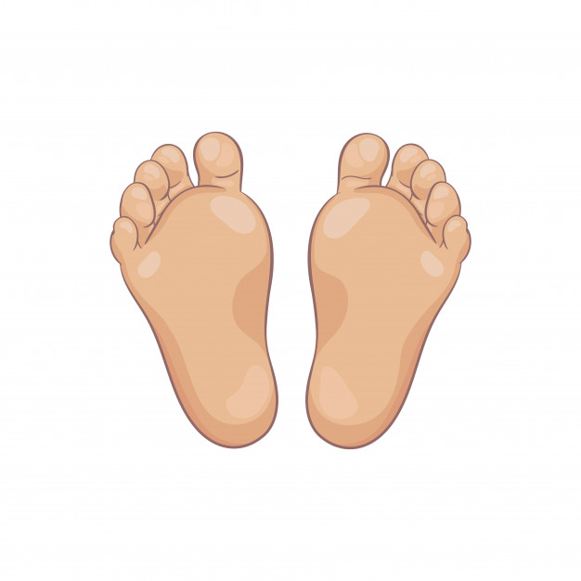
These are called… feet?
Trochee (DAH-da) e.g. TROphy
Iamb (da-DAH) e.g. inDEED
Spondee (DAH-DAH) e.g. TV
Dactyl (DAH-da-da) e.g. CERtainly
Anapest (da-da-DAH) e.g. interRUPT

Slide 8
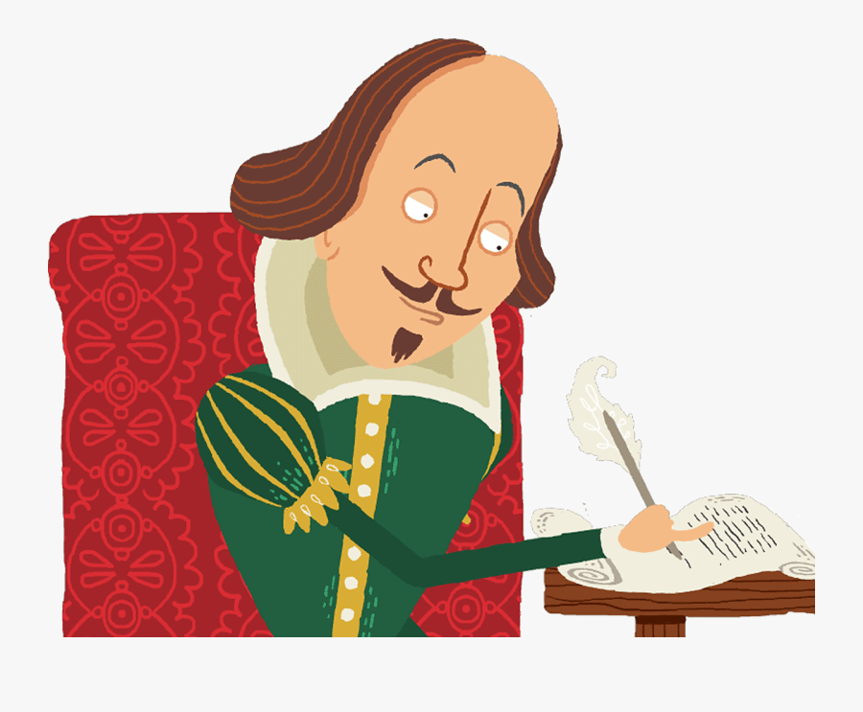
Meter = how many ‘feet’ per line
iambic pentameter = five iambs per line
(da DAH da DAH da DAH da DAH da DAH)
Sonnets are in iambic pentameter
Shall I compare thee to a summer’s day?
Thou art more lovely and more temperate
Rough winds do shake the darling buds of May
And summer’s lease hath all too short a date

Slide 9
Meter = how many ‘feet’ per line
Anapestic tetrameter = four anapests per line
(da da DAH da da DAH da da DAH da da DAH)
Dr Seuss often uses anapestic tetrameter
On the FIFteenth of MAY, in the JUNgle of NOOL,
In the HEAT of the DAY, in the COOL of the POOL,
He was SPLASHing, enJOYing the JUNgle's great JOYS…
When HORton the ELephant HEARD a small NOISE.

