Slide 1
Poetic Devices – why are they used?
Effect on Reader

Slide 2
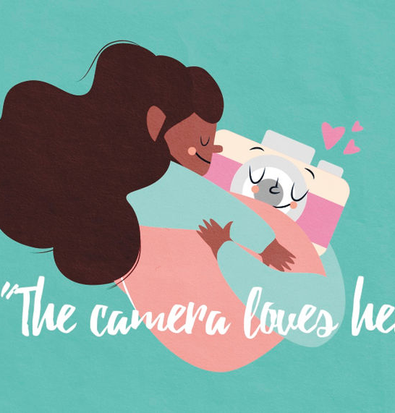
Figurative Language
The Camera Loves Her
Time Flies
Non-literal language

Slide 3
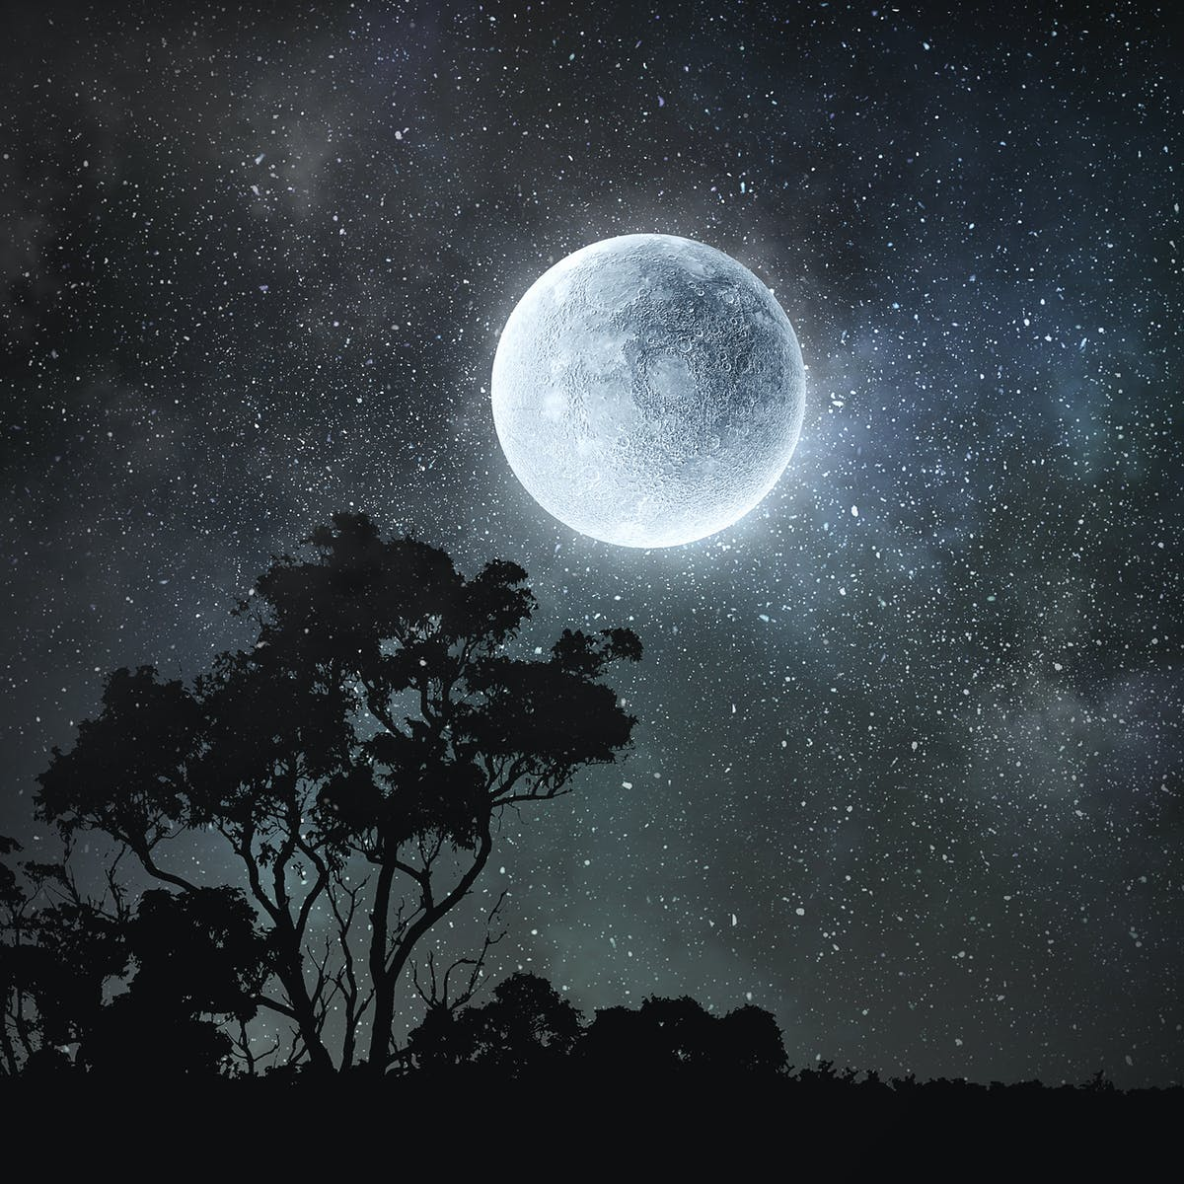
Similes & Metaphors
Simile: making a comparison using ‘like’ or ‘as’
The moon is like a silver penny
The moon is as shiny as a silver penny
Metaphor: making a direct comparison by saying something is something else
The moon is a silver penny
The moon, a bright silver penny in the sky, shone on us.

Slide 4
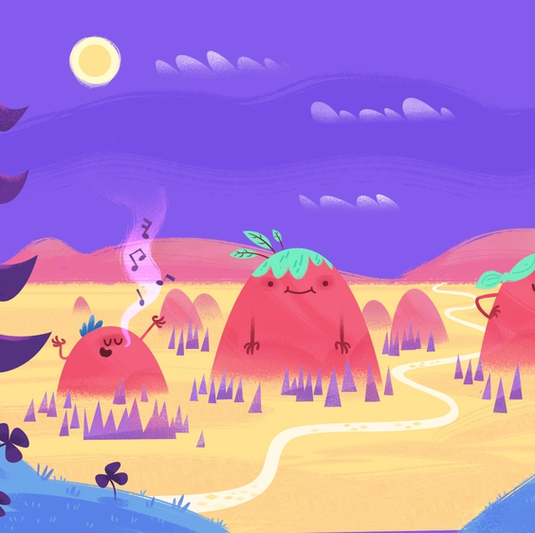
Personification
Giving human characteristics to inanimate objects.
The hills clap their hands and the mountains sing for joy.
The printer beeped irritably.
The old car was lonely and forgotten.

Slide 5
Imagery
Creating a picture in the reader’s mind, often by using language that describes the senses (sight, taste, smell, feel, sound) or appeals to feelings and emotions.
The sky turned a fiery orange
The flower had soft, velvety petals
The smoke burned my throat and made my eyes sting
Her words were sharper than a dagger in my heart

Slide 6
Hyperbole
Extreme exaggeration for effect.
He was light-years ahead of the rest of the class.
I’m so hungry I could eat a horse.
I’ve explained this a billion times already.

Slide 7
Why are they used?
When the Bible says God is a rock – what does this tell you about God?
Strong, steadfast
Unchanging, lasts for ever
A place to shelter
A solid foundation
Using figurative language does 2 things:
1. Communicates several ideas in one word.
2. Is interesting, sticks in your memory.

Slide 8
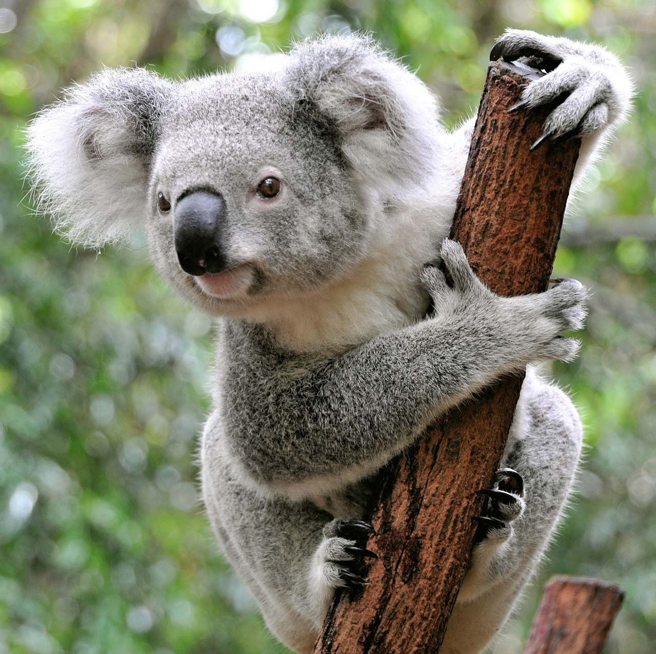
Comparisons
Imagine you’re trying to describe a koala to someone that’s never seen one. A good way to do that is to make COMPARISONS. What is it similar to?
Soft fur and big fluffy ears like a cuddly toy
Sharp black claws like an eagle’s talons
Sleepy all the time like a sloth
Grunting sounds like a cross between a pig and a donkey
Comparisons help you to imagine or visualise things. Links to your memories of past experiences.

Slide 9
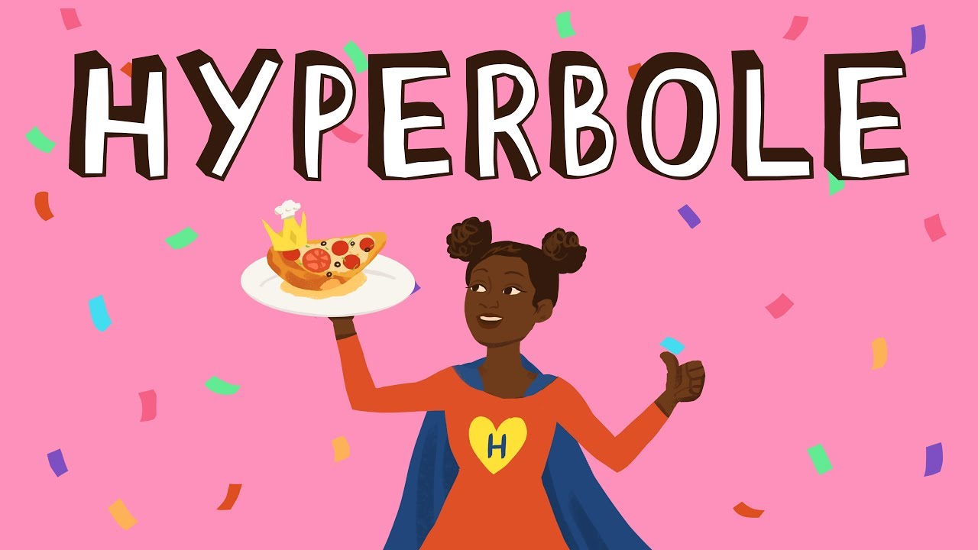
Other Effects
Hyperbole:
Expresses a strong emotion
Evoke humour (be funny)
Interesting/memorable
Personification:
Make the reader feel an emotional response.
Feel a connection to the object that you wouldn’t feel just by using an adjective.
E.g. might make you feel sorry for the car or annoyed with the wind.

Slide 10
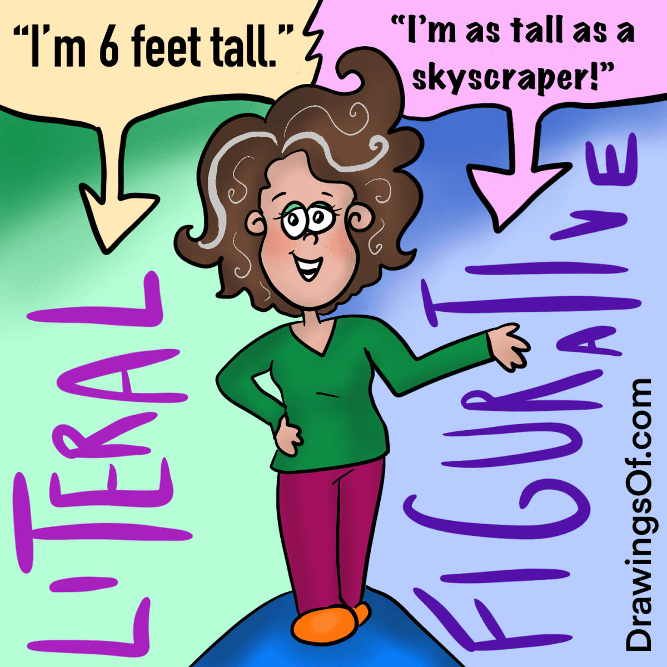
Figurative Language – effects
Helps you picture what the author is talking about.
Quick way to communicate complex ideas
Interesting and memorable – sticks in your head
Makes an emotional connection, makes you feel something
Links to memories of past experiences
Humour – amuses/entertains

Slide 11
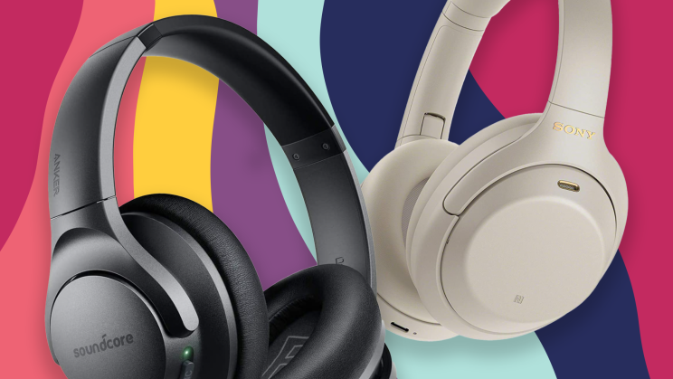
Sound Devices

Slide 12
Alliteration
A repeated sound at the start of several words
Wordlessly watching, he waits by the window
Upside-down under the umbrella with us

Slide 13
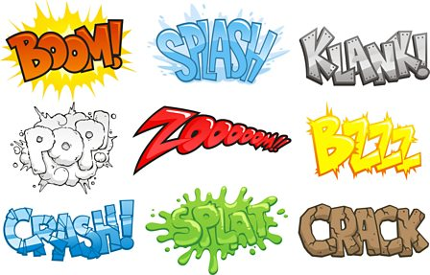
Onomatopoeia
Words that sound like what they are describing

Slide 14
Rhyme
When two words have the same or similar sound at the end.
Perfect rhyme (exactly the same sound)
Love, dove
Plunder, thunder
Imperfect rhyme, also called ‘slant rhyme’ or ‘half rhyme’ (sounds similar but not exactly the same)
Lake & fate (different consonant)
Sparring, caring (different vowel)

Slide 15
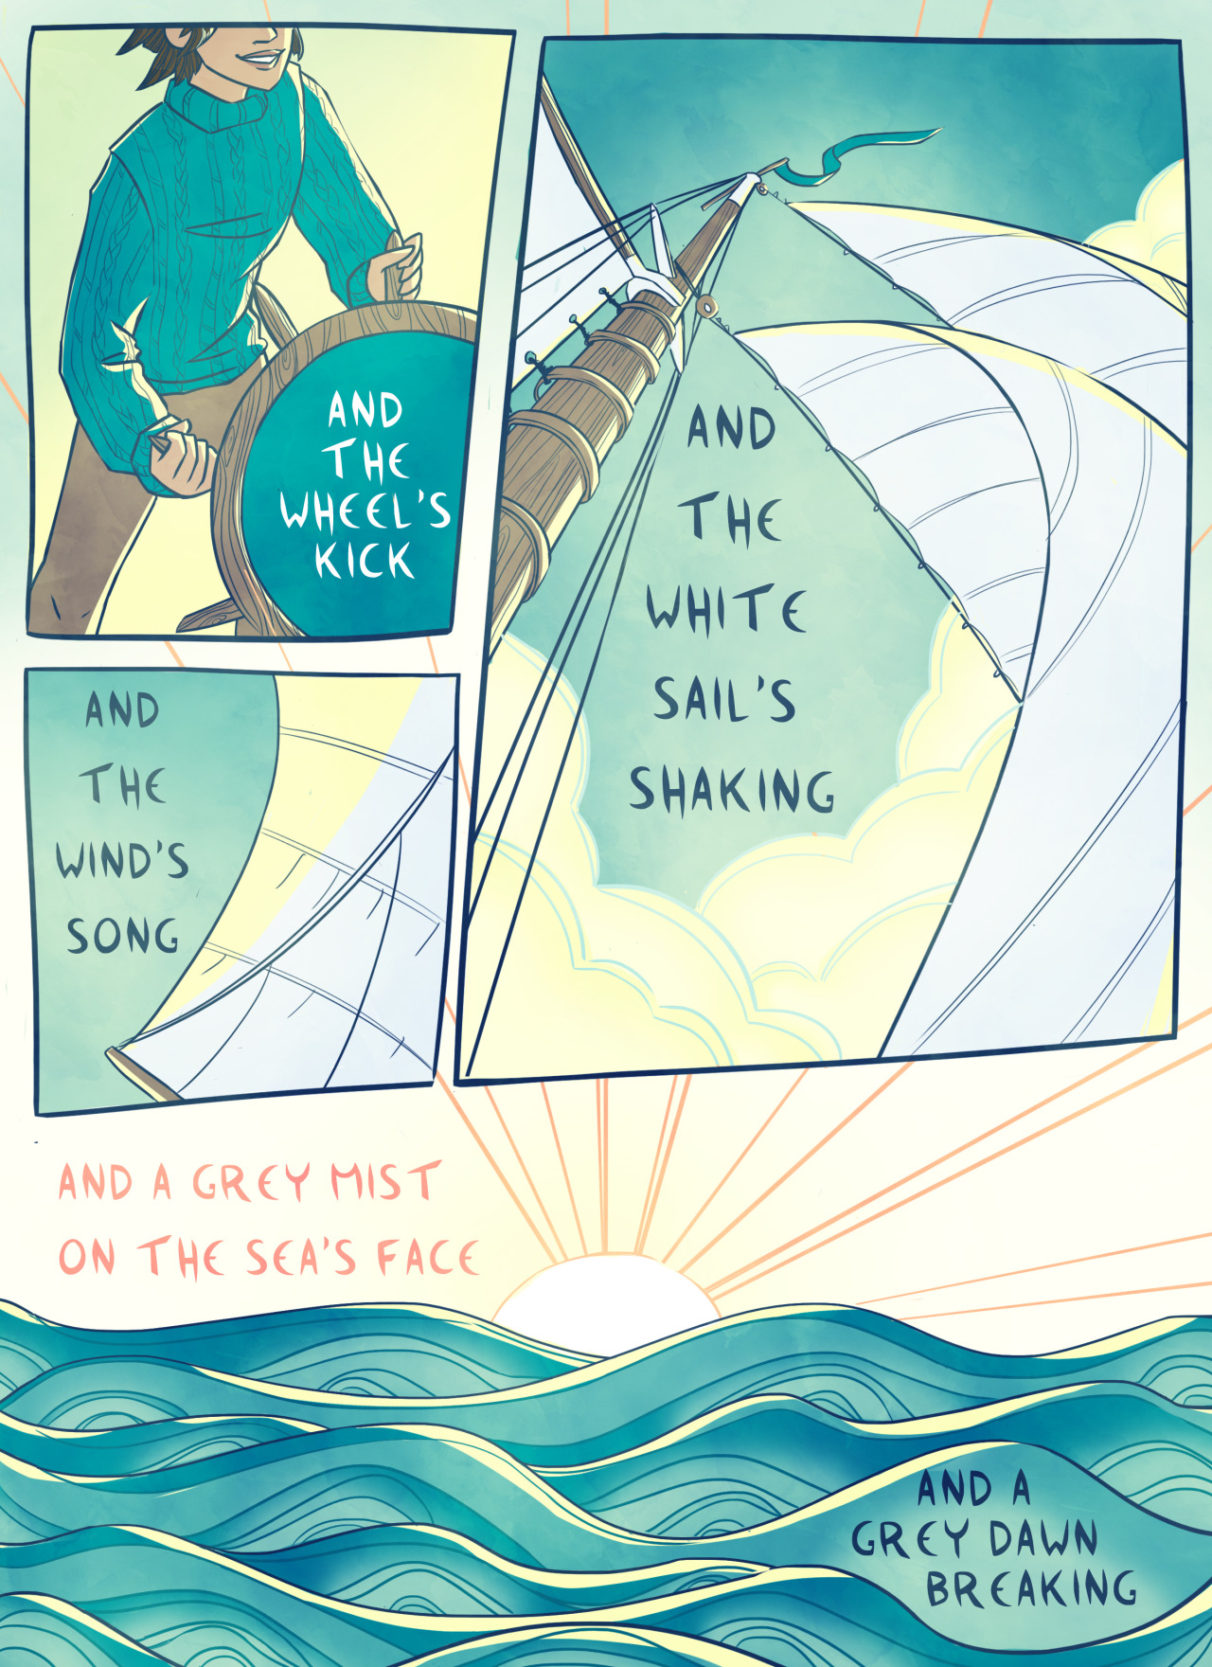
Rhythm or Meter
A regular pattern of stressed and unstressed beats in poetry
You have brains in your head. You have feet in your shoes. You can steer your-self a-ny di-rec-tion you choose.
I must go down to the seas a-gain, to the lone-ly sea and the sky…

Slide 16
Sound Devices: why are they used?
Help you ‘hear’ what the poem is describing
Sounds of words can mimic the sound of the thing in the poem
Repeated soft sounds like shhh or ffff can sound a bit like ocean waves or the wind in the trees
Repeated harsh sounds like kkkk or ggg can sound a bit like gunfire or machinery
Sounds of words can create an emotional response
Might use soft smooth sounds when talking about something beautiful and calm
Might use harsh guttural sounds when talking about something bad or painful

Slide 17
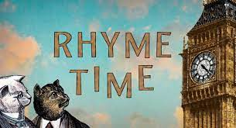
Sound Devices: why are they used?
Rhyme & rhythm emphasise certain words
Link them together and make them stand out
Create a sense of order & pattern which is pleasing to the ear
Human brain likes repetition
Creates expectation – when there is a pattern in the rhyme you can predict as you’re listening what the next word will sound like
Makes it easier to remember
Poetry is often intended to be memorised & read aloud

