Slide 1
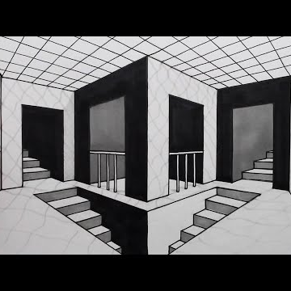
Point of View & Perspective
Who’s telling the story?

Slide 2
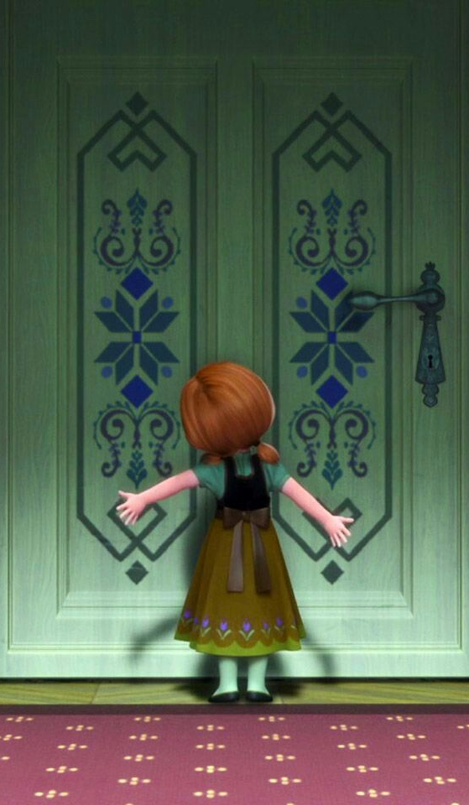
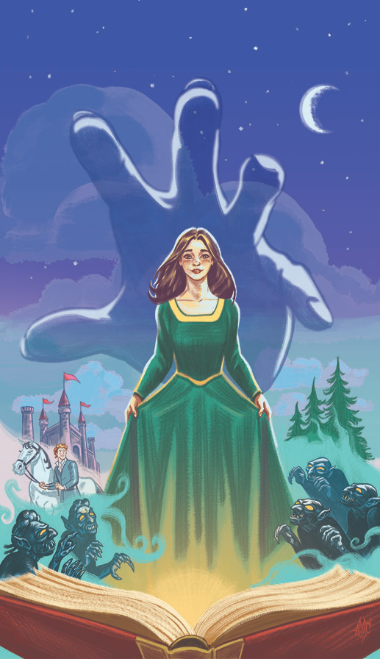
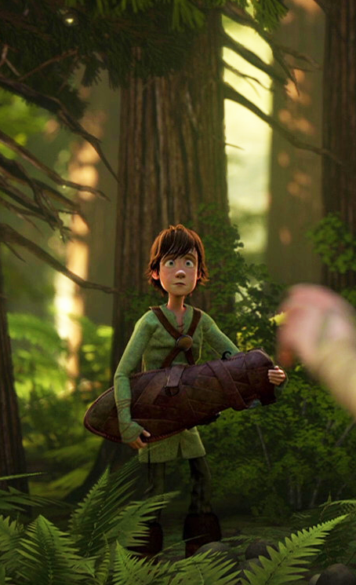
1st Person
I, me, my, we, us
If someone told me to hop on one foot all day, I'd have to do it. If you commanded me to cut off my own head, I'd have to do it. I am in danger at every moment.
3rd Person
He, him, his, she, her, hers, it, they, them, their
Hiccup had secretly befriended the Night Fury. He took the harness he had made back to the clearing.
2nd Person
You, your, yours
You want to build a snowman, but your sister does not want to play with you.

Slide 3
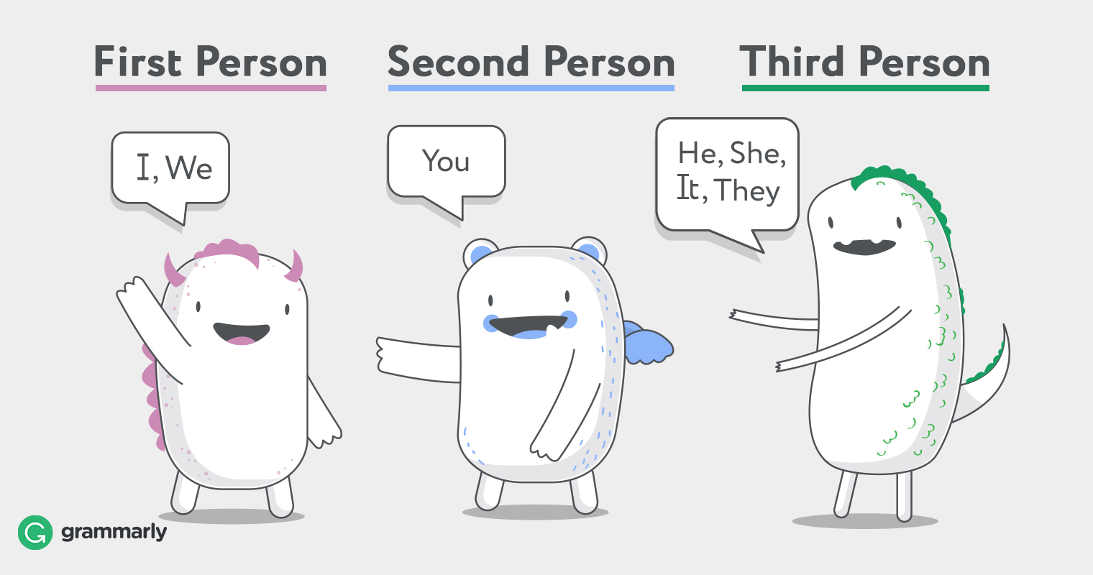
Point of View
Who’s telling the story?
Three most common points of view are:
First person
Second person
Third person

Slide 4
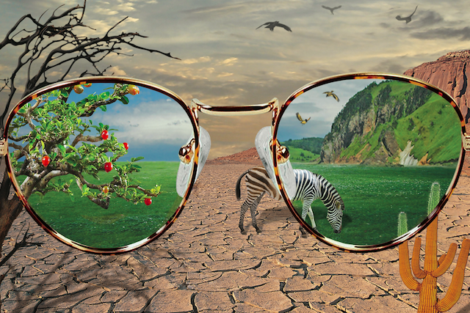
Perspective
Two different people can look at the same picture and see two different things.
Looking from a different perspective is like looking through different lenses in a pair of glasses
Your perspective is influenced by things like:
Past experiences
Culture & country
Parents and upbringing
Religious beliefs
Education
Character traits

Slide 6
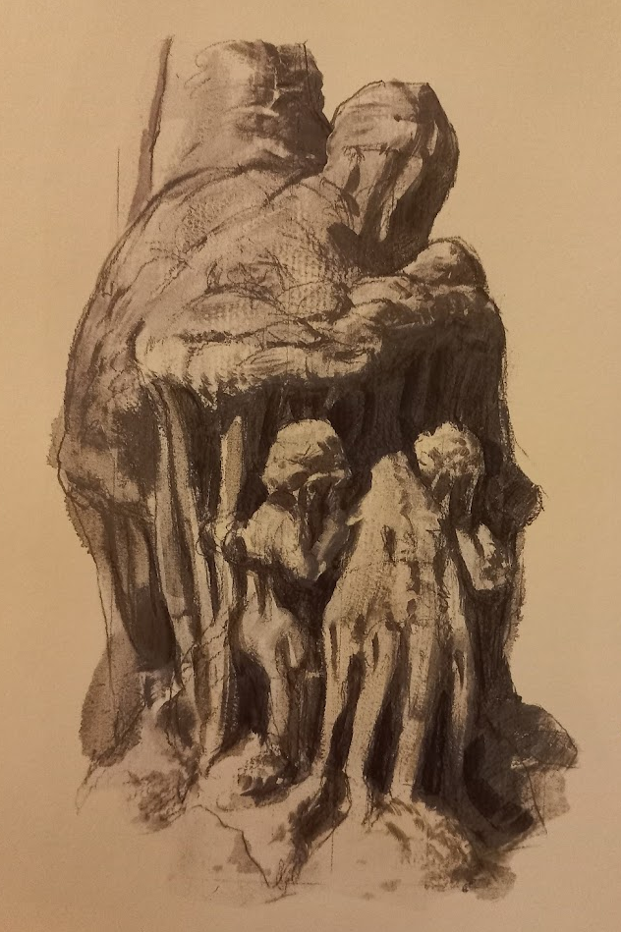
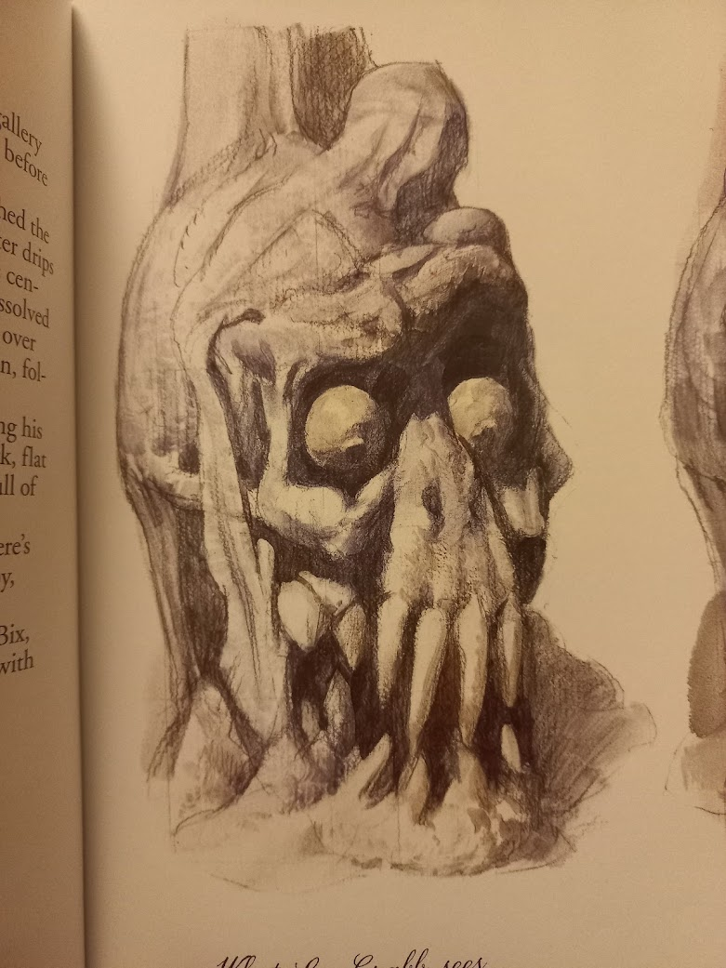
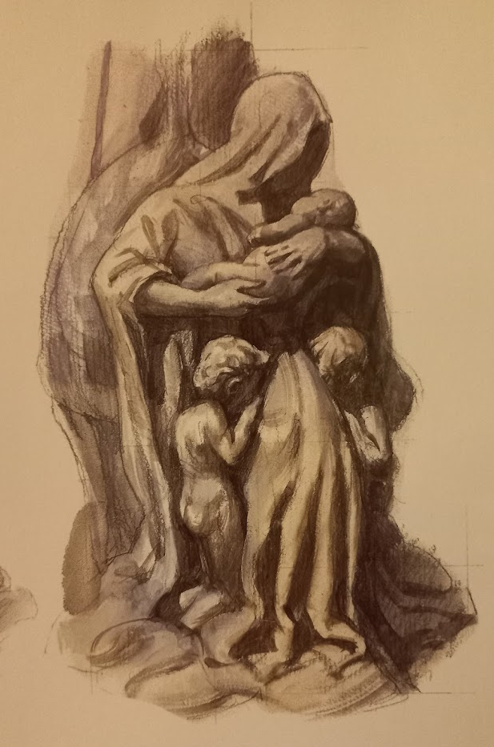
What Arthur saw…
What Lee Crab saw…
What Oriana saw…

Slide 7
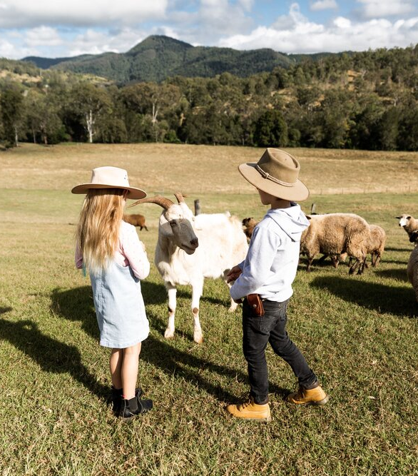
Perspective Example
A wealthy father took his son to visit a family who lived on a poor farm, to make him see how lucky he was.
Afterwards he asked the boy what differences he’d noticed.
His son said, “well, we only have dog – they had three dogs and lots of other animals too. We have a pretty big pool, but their creek stretches for miles. We have to buy our food, but they can go out and pick it from their garden whenever they want. The kids had so many brothers and sisters that they always had someone to play with. And our back yard is tiny compared to all those paddocks. They’re really lucky.”

Slide 8
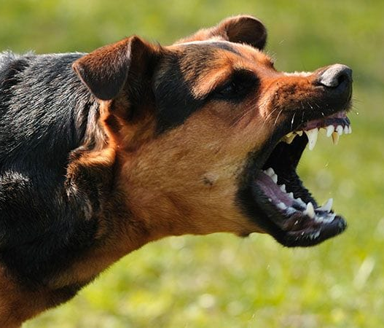
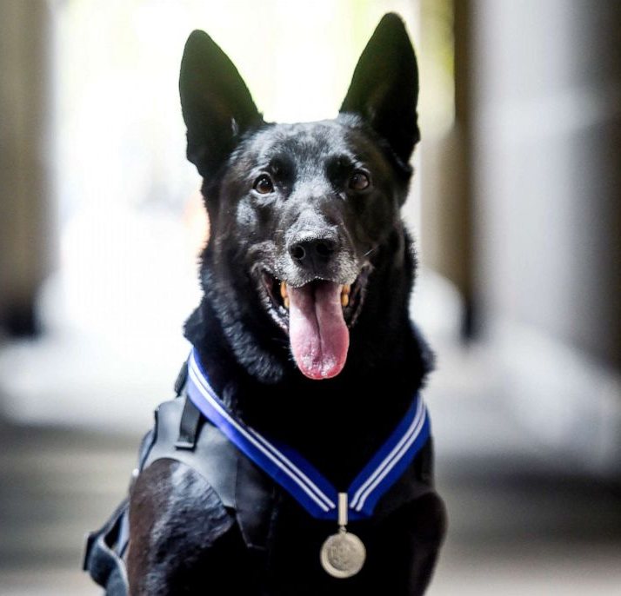
Two descriptions of the same scene
The attack was brutal. The victim was completely defenceless, but the vicious beast pursued him relentlessly. Blood splattered as the dog’s teeth slashed his arm.
The dog bravely chased the armed attacker and managed to make him drop the knife by seizing his wrist. The heroic and fast-acting animal stopped the criminal in his tracks.

Slide 9
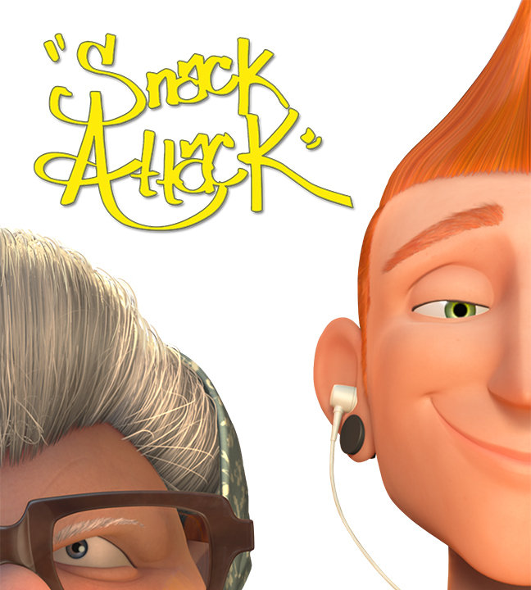
Activity
Watch the 3 short story clips
Work in pairs to fill out the sheets

Slide 10
Joy & Heron

Slide 12
Snack Attack

