Slide 1
Year 8 English: Vocab
Term 3, Week 2

Slide 2
Chide
Part of Speech: verb
Meaning: to scold or tell off; to express disapproval
The boss had to chide Andy when he was late for work three times in a row.

Slide 3
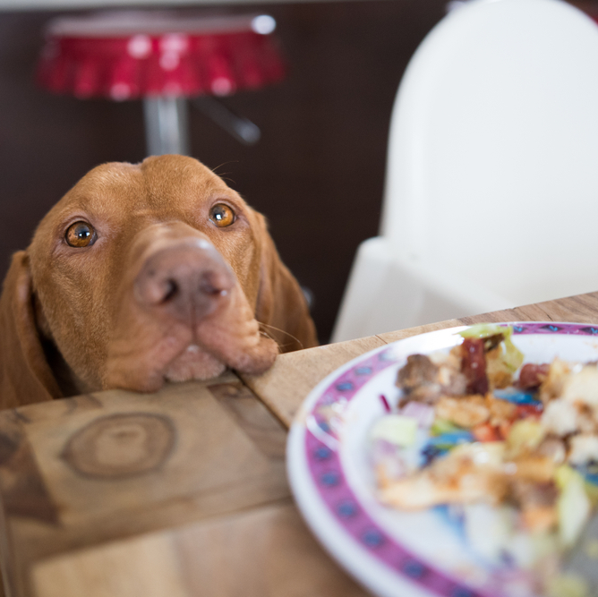
Importune
Part of Speech: verb
Meaning: to beg or pester someone by repeatedly asking
Bosco continued to importune me while I tried to eat dinner.

Slide 4
Condescend
Part of Speech: verb
Meaning: to act superior; to show that you think you’re better or smarter
You should never condescend to people while trying to teach them something.

Slide 5
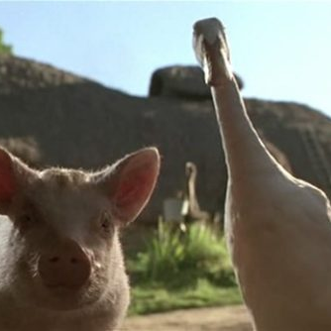
Audacious
Part of Speech: adjective
Meaning: extremely bold and daring; cheeky
When embarking on an audacious crime, a duck needs a willing accomplice.

Slide 6
Servile
Part of Speech: adjective
Meaning: too eager to serve or please others; overly submissive
The waiter acted so servile that it made me cringe.

Slide 7
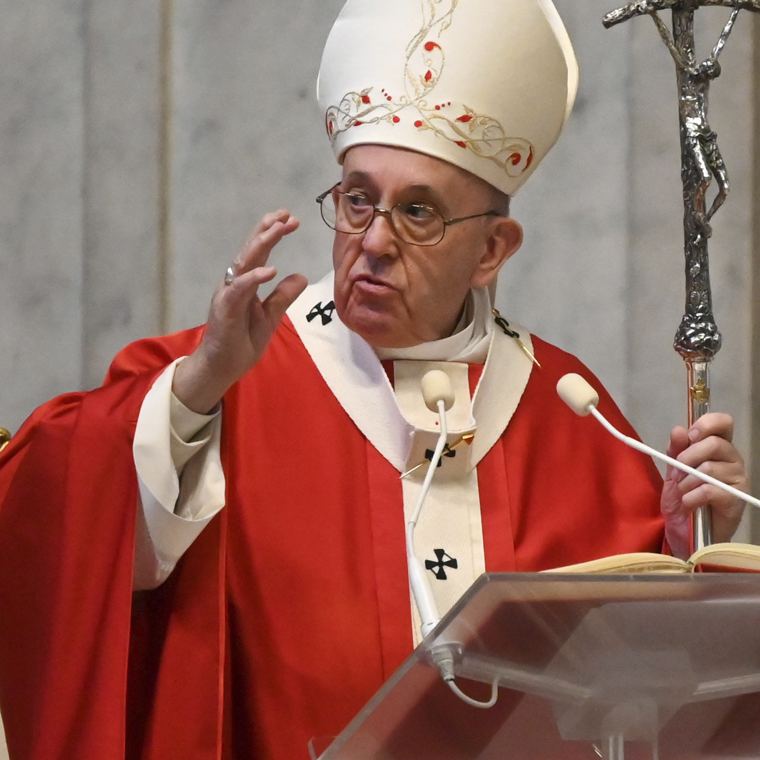
Infallible
Part of Speech: adjective
Meaning: unable to make mistakes or be wrong
Roman Catholics believe the Pope is infallible.

Slide 8
Prudent
Part of Speech: adjective
Meaning: wise; showing care or thought for the future; sensible in handling practical matters
If you have a family history of skin cancer, it would be prudent to wear a hat and sunscreen at the beach.

Slide 9
Venture
Part of Speech: verb
Meaning: to bravely begin something risky
We shall now venture into this enormous dark cave.

Slide 10
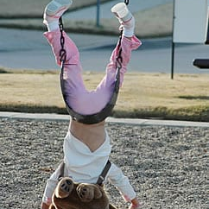
Allude
Part of Speech: verb
Meaning: to suggest or hint; to refer to something in an indirect way
I tried to allude to the incident at the playground without explaining exactly what happened.

Slide 11
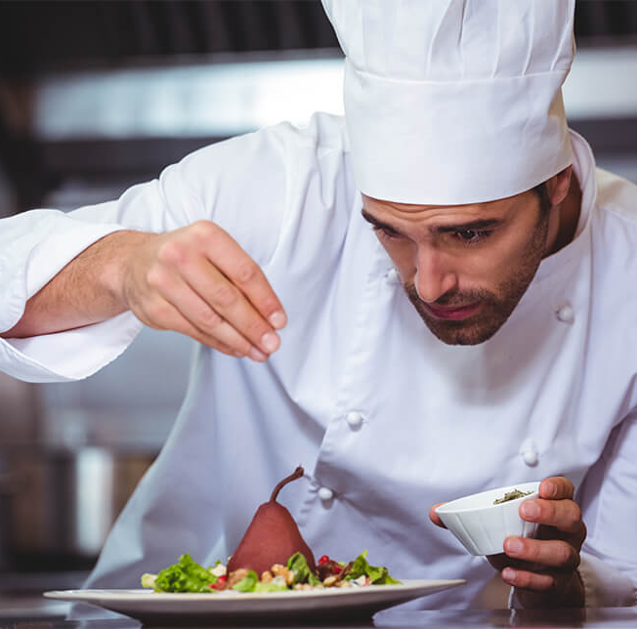
Nuance
Part of Speech: noun
Meaning: a tiny, subtle variation; a small difference that is hard to notice
Because he’s a chef, he obsesses over every nuance of flavour.

