Slide 1
Year 8 English: Vocab
Term 3, Week 3

Slide 2
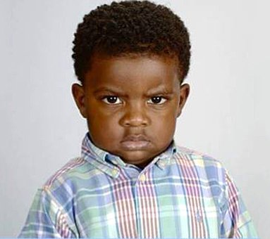
Construe
Part of Speech: verb
Meaning: to interpret; to read words or actions in a certain way
You could construe Timmy’s expression as grumpy, but he’s actually just shy.

Slide 3
taper
Part of Speech: verb
Meaning: to get smaller or thinner at one end
Her nails taper to a very sharp point.

Slide 4
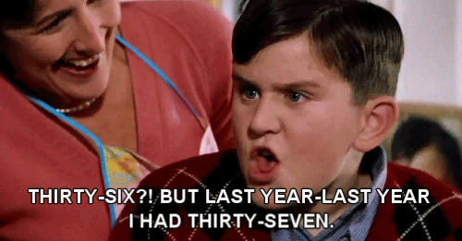
ingrate
Part of Speech: noun
Meaning: someone who is not thankful
I can’t believe that kid complained about his birthday party, the little ingrate.

Slide 5
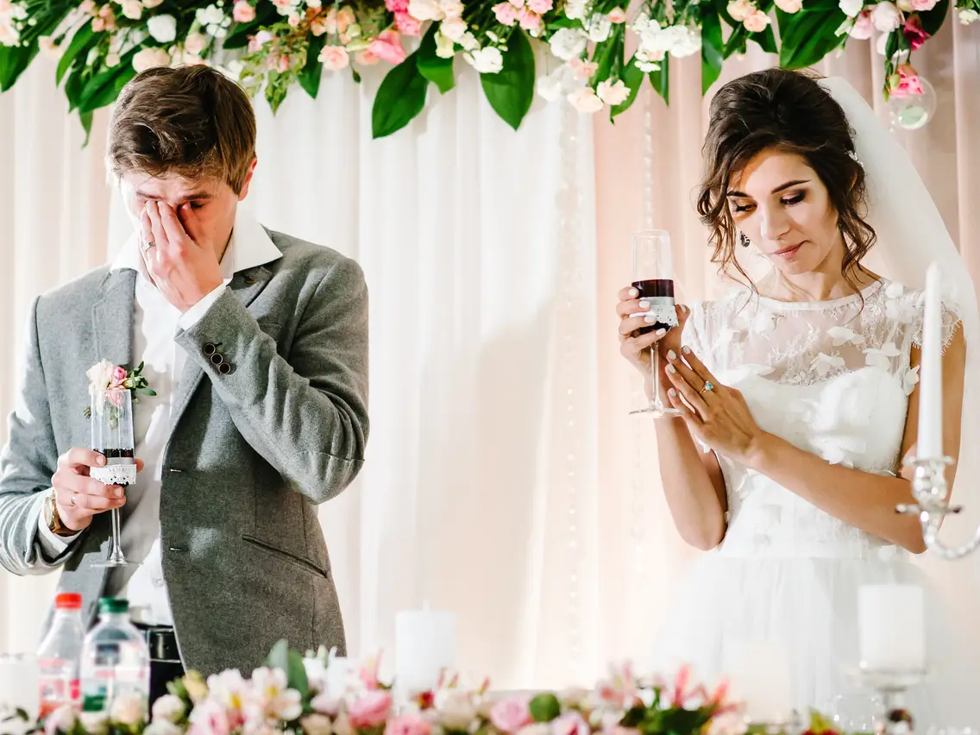
blunder
Part of Speech: noun
Meaning: a stupid or careless mistake
The groom made a terrible blunder when he called the bride the wrong name.

Slide 6
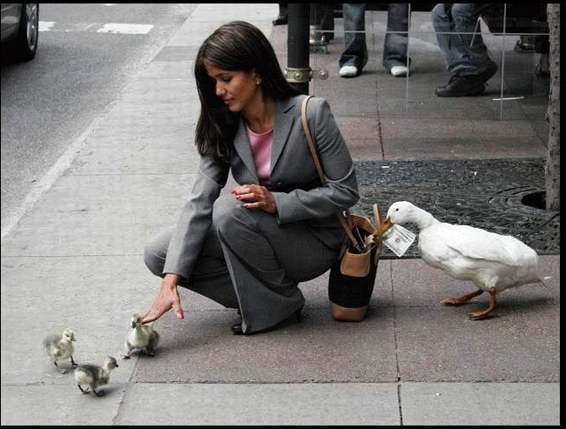
purloin
Part of Speech: verb
Meaning: to steal
While she was distracted, a duck purloined Jacinda’s cash.

Slide 7
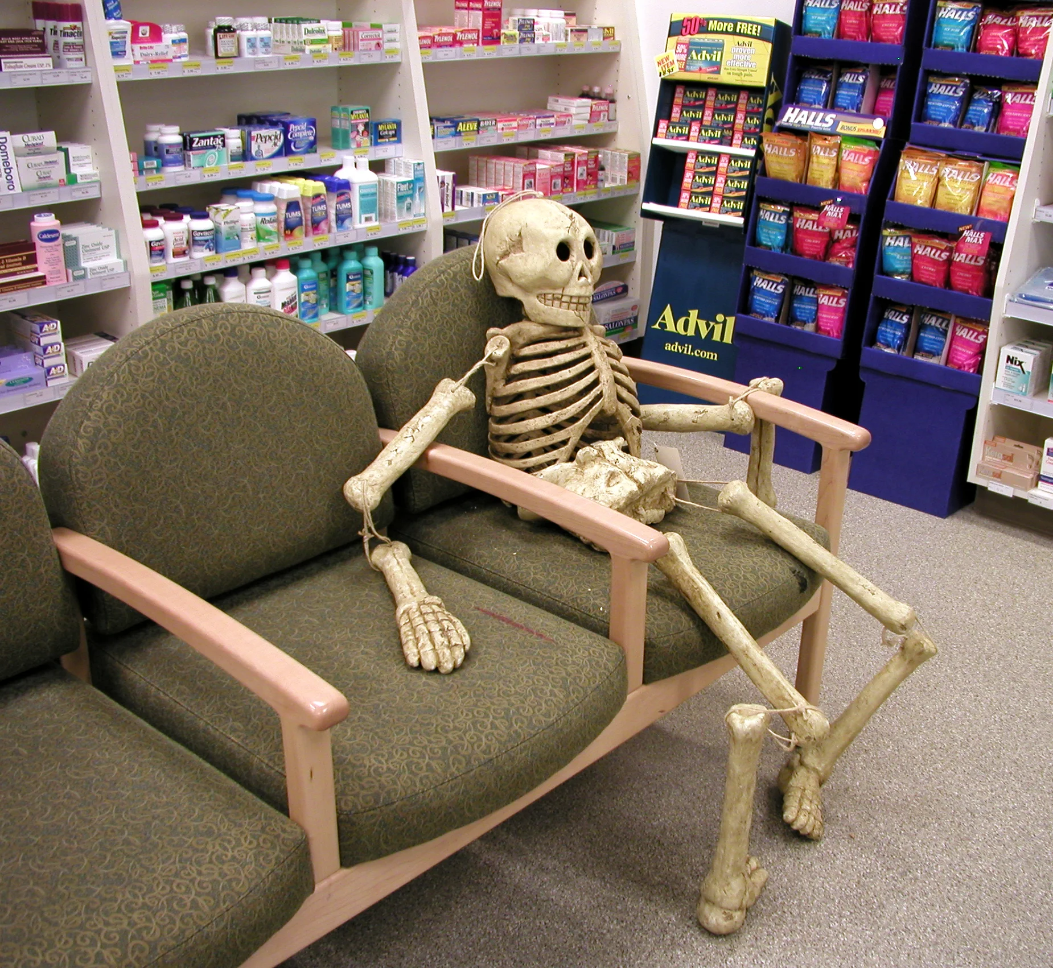
vexed
Part of Speech: adjective
Meaning: irritated or annoyed
Verna was vexed by the long waiting times at the chemist.

Slide 8
inquisitive
Part of Speech: adjective
Meaning: curious, interested to find things out
Ray’s inquisitive mind made him a great scientist.

Slide 9
congenial
Part of Speech: adjective
Definition: agreeable, suitable, or pleasing
A window seat is a congenial spot for reading.

Slide 10
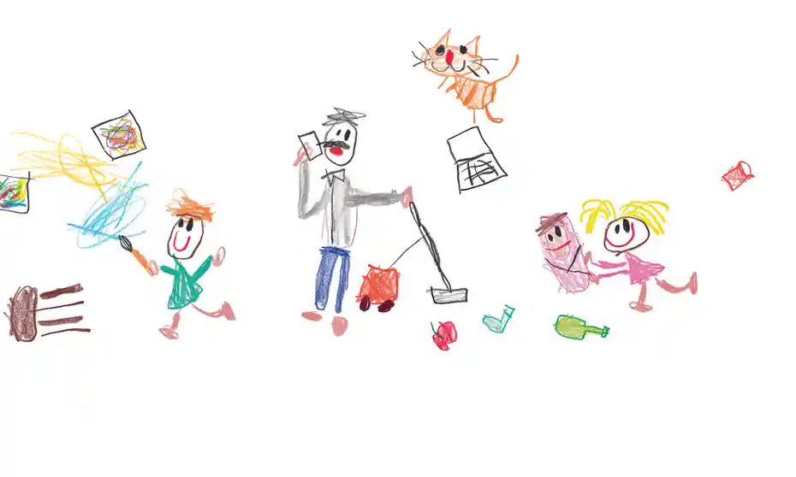
Boisterous
Part of Speech: adjective
Meaning: noisy and energetic; rowdy
It was a challenge keeping four boisterous children busy all day.

Slide 11
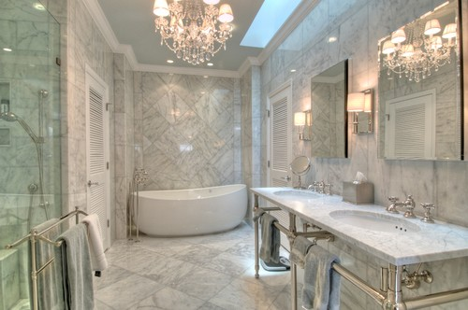
opulent
Part of Speech: adjective
Definition: very obviously expensive and luxurious
The bathroom was so opulent that I was afraid to use it.

