Slide 1
Year 8 English: Vocab
Term 3, Week 5

Slide 2
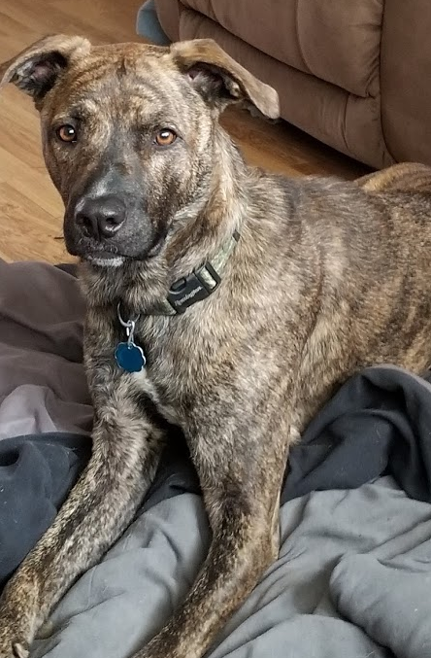
Cur
Part of Speech: noun
Meaning: an aggressive mongrel dog, or a mean and cowardly person
That mangy old cur next door can’t stand kids walking across his lawn.

Slide 3
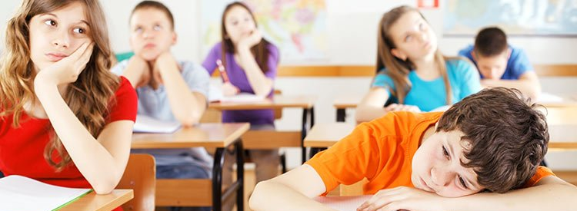
Drone
Part of Speech: verb
Meaning: to speak in a dull monotonous voice
The teacher continued to drone on and on, even though the class had stopped listening.

Slide 4
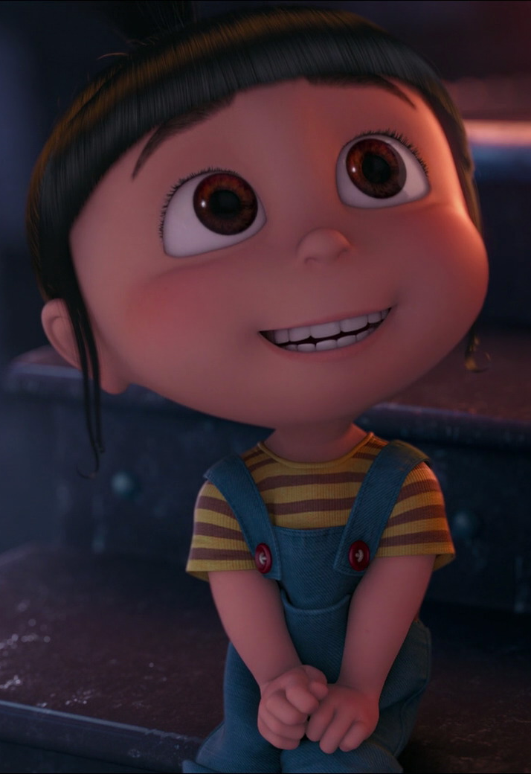
Visage
Part of Speech: noun
Meaning: the face or appearance of a person
Her visage might seem innocent, but she’s up to something.

Slide 5
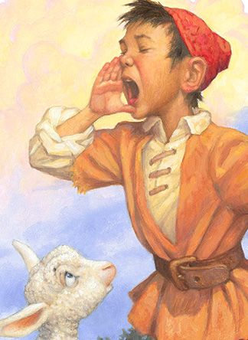
Credibility
Part of Speech: noun
Meaning: believability
The boy lost all credibility when he cried ‘wolf’ for the third time.

Slide 6
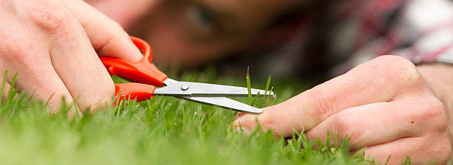
Scrupulous
Part of Speech: adjective
Meaning: careful, thorough and attentive to detail; being careful to be honest and correct
Dad has always been scrupulous about cutting the lawn.

Slide 7
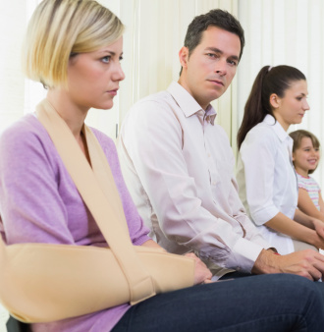
Peevish
Part of Speech: adjective
Meaning: irritable; easily annoyed
The patients in the waiting room became peevish after two hours had passed.

Slide 8
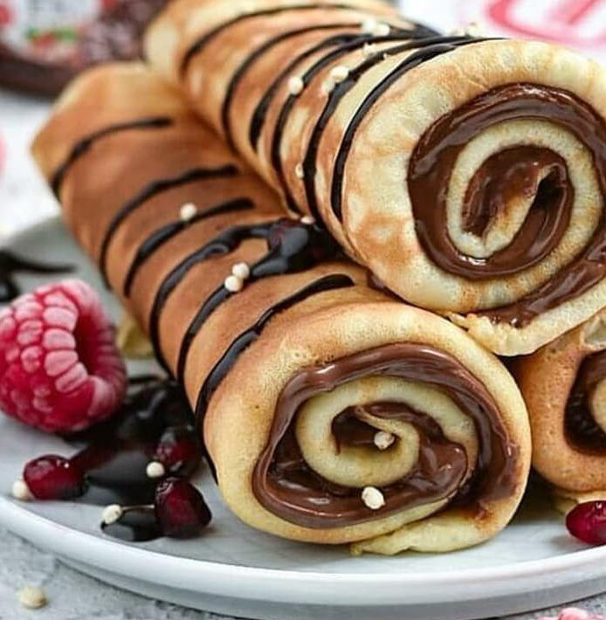
Scrumptious
Part of Speech: adjective
Meaning: delicious
Those chocolate pancakes look absolutely scrumptious!

Slide 9
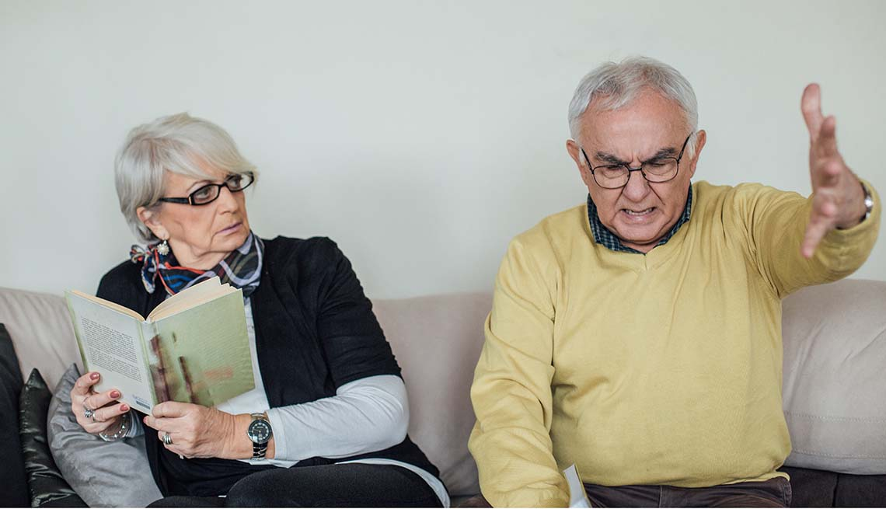
Yammer
Part of Speech: verb
Meaning: to talk on and on in an annoying way, especially about something unimportant
Uncle Fred always has to yammer on about the way things were back in his day.

Slide 10
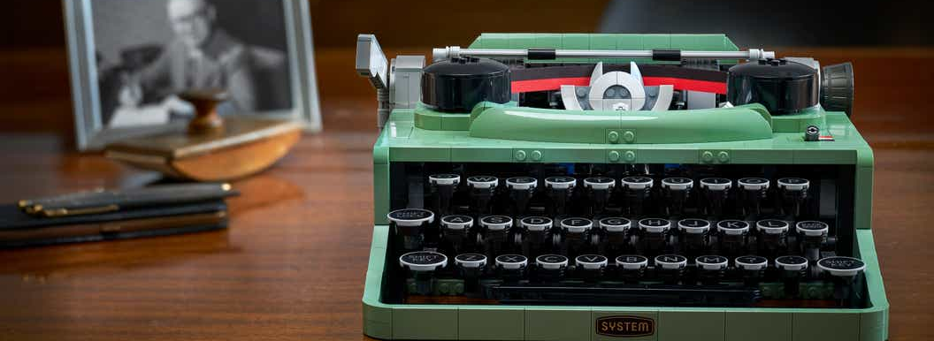
Defunct
Part of Speech: adjective
Meaning: no longer in use; no longer existing or functioning
I found Granny’s defunct typewriter in the attic.

Slide 11
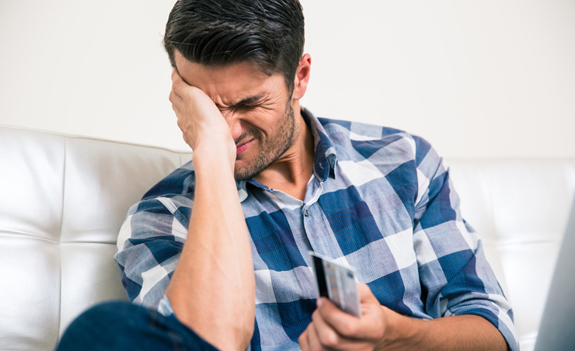
Remorse
Part of Speech: noun
Meaning: deep and painful regret
Gary was full of remorse after maxing out his credit card.

