Slide 1
Year 8 English: Vocab
Term 3, Week 6

Slide 2
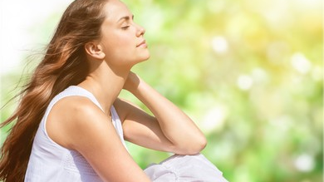
Demeanour
Part of Speech: noun
Meaning: outward behaviour; way of looking or acting
Anne’s calm demeanour put me at ease.

Slide 3
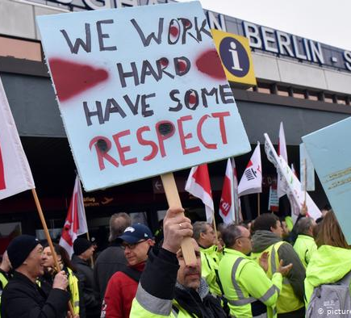
Clamorous
Part of Speech: adjective
Meaning: making a loud and confused noise; making noisy complaints or demands
The angry workers were very clamorous in their protest.

Slide 4
peruse
Part of Speech: verb
Meaning: to read or examine something in a relaxed way; to browse through
While we wait for a table, we should peruse the menu.

Slide 5
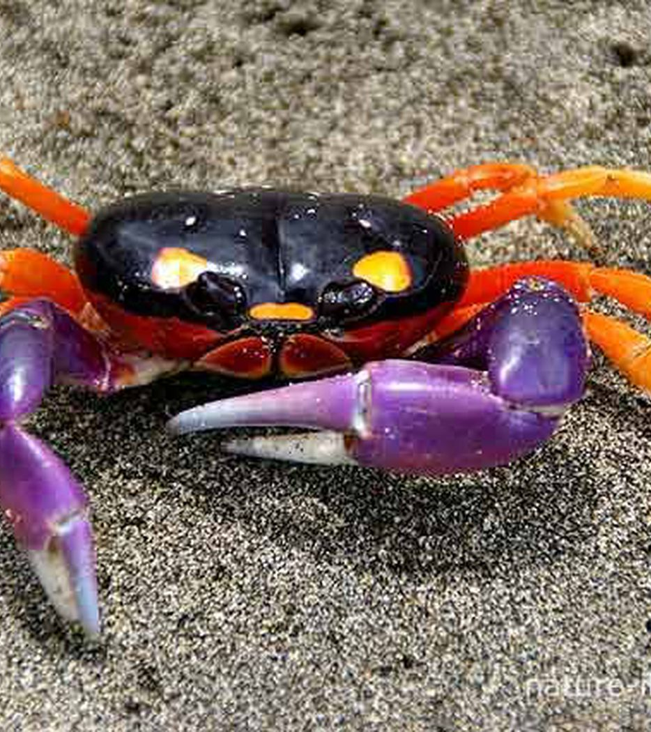
Scuttle
Part of Speech: verb
Meaning: to run with quick, hasty steps
The crab will scuttle away if I try to take a picture.

Slide 6
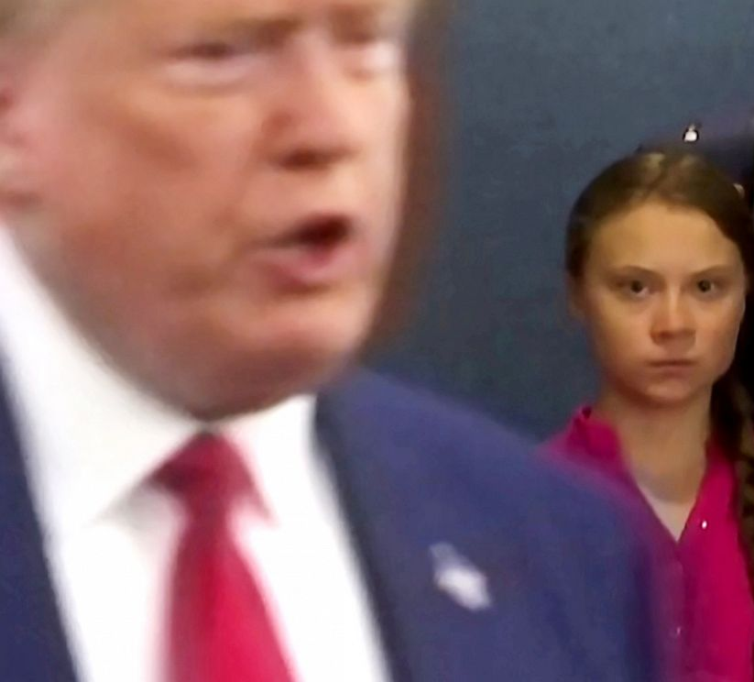
glower
Part of Speech: verb
Meaning: to stare angrily; to glare
Greta took the opportunity to glower at Donald Trump.

Slide 7
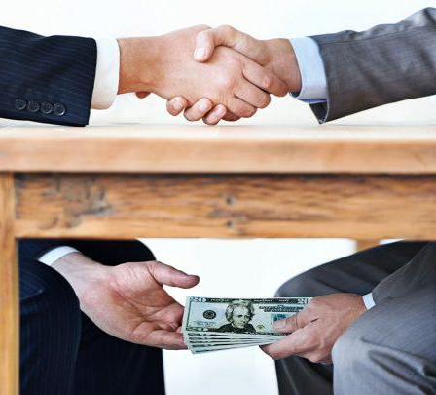
Acquit
Part of Speech: verb
Meaning: to free from legal charges; to declare not guilty
The judge’s decision to acquit the billionaire of all charges made many people suspect he had accepted a bribe.

Slide 8
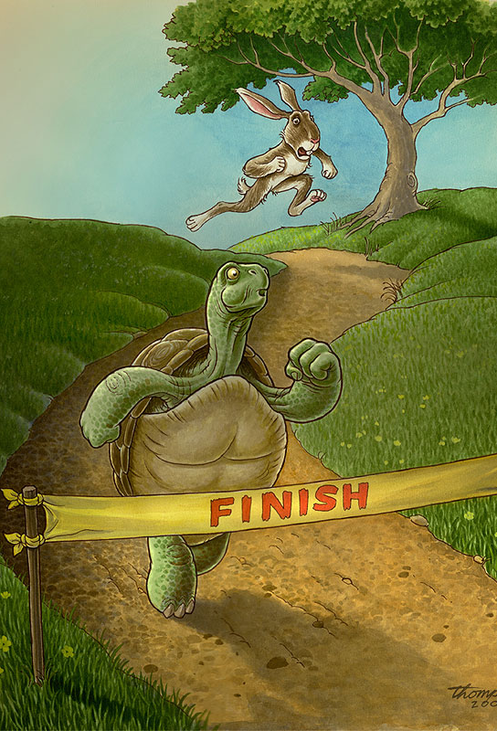
edification
Part of Speech: noun
Meaning: education or enlightenment; improvement, building up
Aesop’s fables were written for the edification of children.

Slide 9
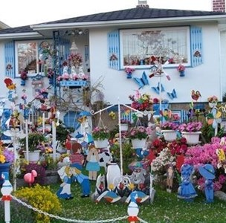
tawdry
Part of Speech: adjective
Meaning: cheap and showy; tacky or tasteless
The Jones’s tawdry lawn ornaments fail to reflect the image of this village.

Slide 10
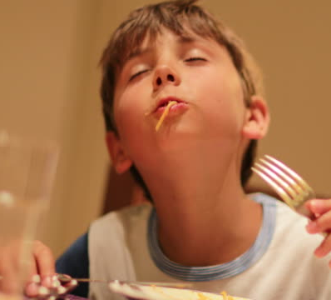
savour
Part of Speech: verb
Meaning: to taste or experience something slowly and thoroughly in order to enjoy it as much as possible
The spaghetti was so delicious that Lachlan wanted to savour every bite.

Slide 11
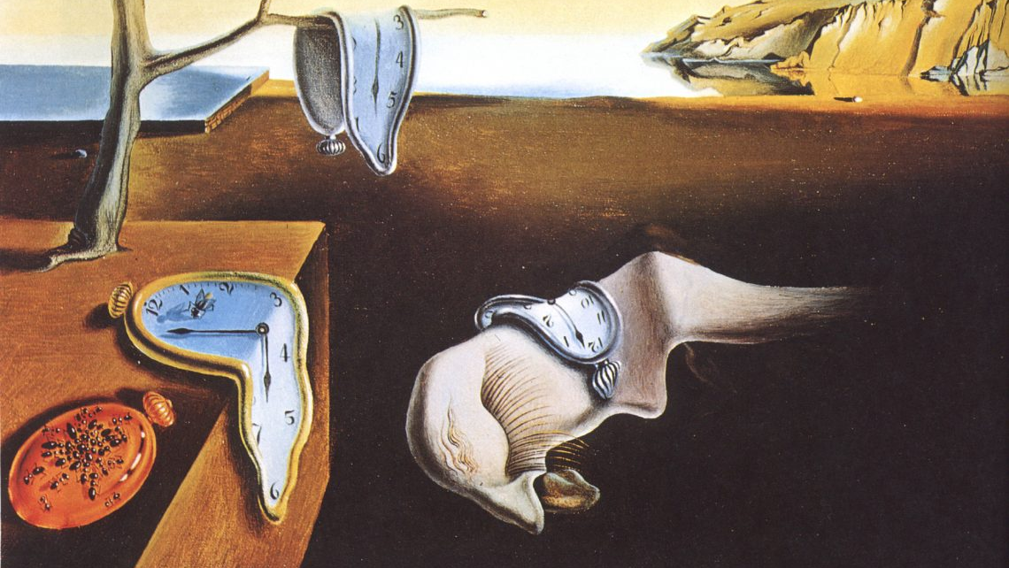
enigma
Part of Speech: noun
Meaning: something that is mysterious and impossible to understand
Many have pondered the enigma of Salvador Dali’s paintings.

