Slide 1
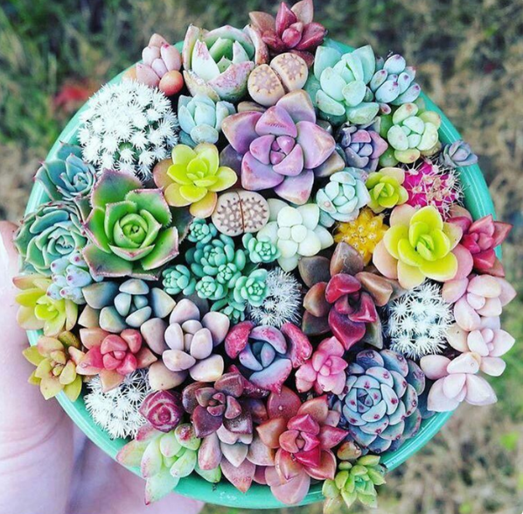
Year 8 English: Vocab
Term 3, Week 8

Slide 2
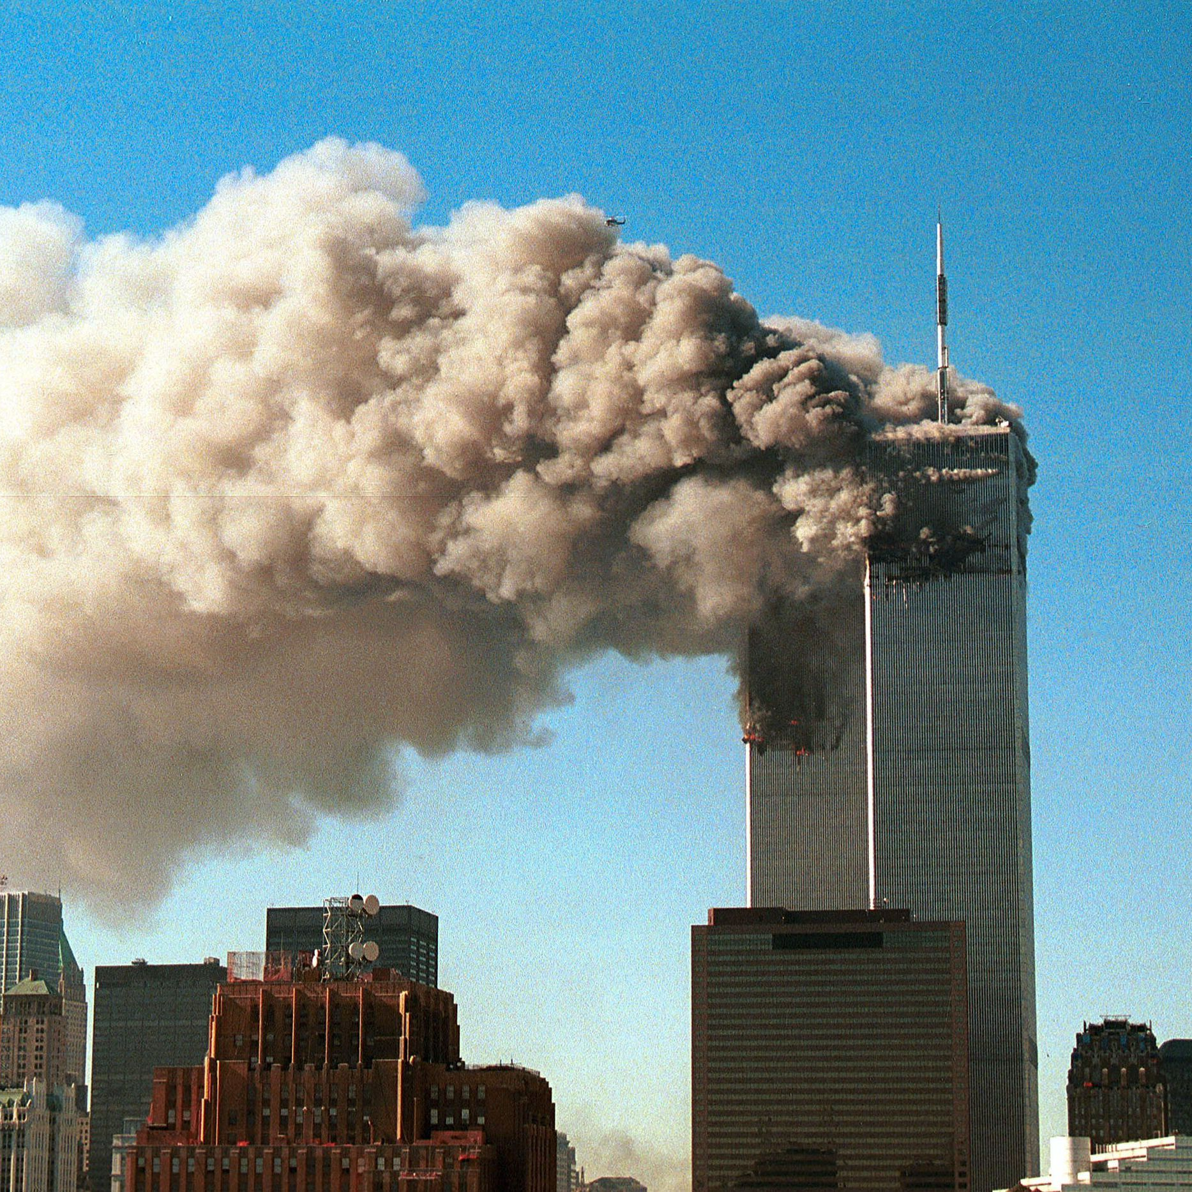
Grievous
Part of Speech: adjective
Meaning: very bad or serious; causing great sadness or pain
I was shocked when I heard the grievous news about the twin towers.

Slide 3
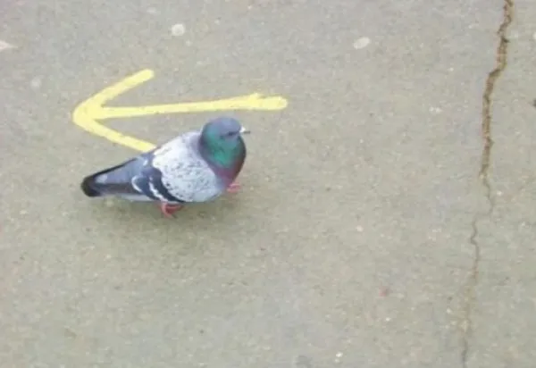
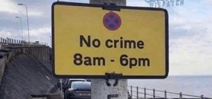
Prerogative
Part of Speech: noun
Meaning: privilege; right
Just because you’re rich, you don’t have the prerogative to break the law.

Slide 4
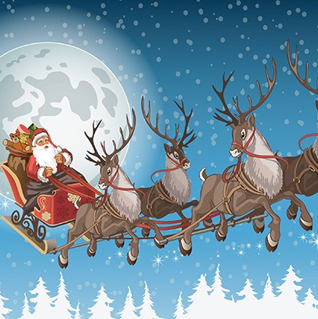
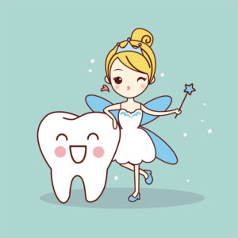
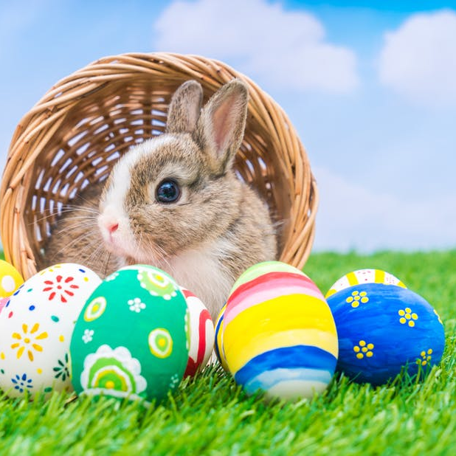
Credulous
Part of Speech: adjective
Meaning: trusting; believing
Children are so credulous, they believe any story you tell them.

Slide 5
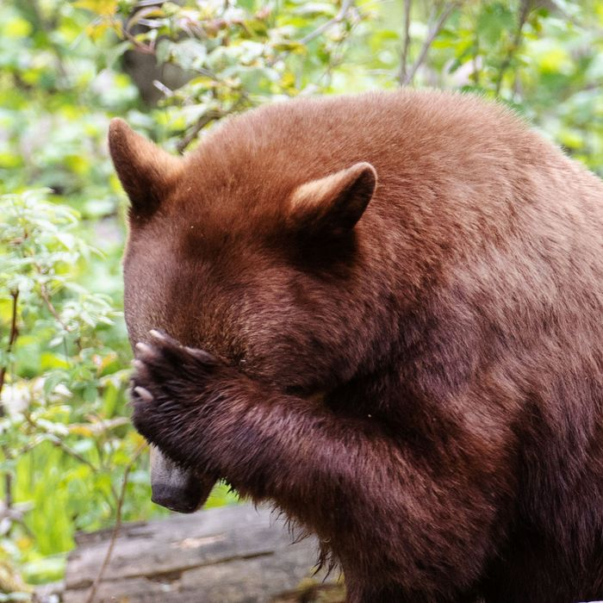
Expunge
Part of Speech: verb
Meaning: to wipe out; erase; obliterate
It was years ago, but I can never expunge that incident from my memory.

Slide 6
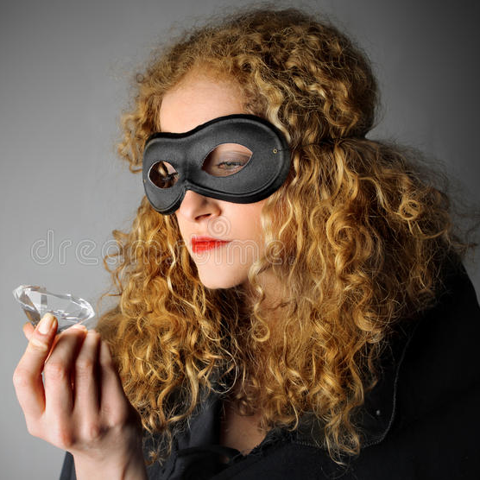
Smote
Part of Speech: verb
Meaning: struck or hit (past tense of smite)
After stealing the diamond, her conscience smote her, so she went and put it back.

Slide 7
Turmoil
Part of Speech: noun
Meaning: a state of confusion, disorder or uncertainty
Her mind was in turmoil over the difficult decision.

Slide 8
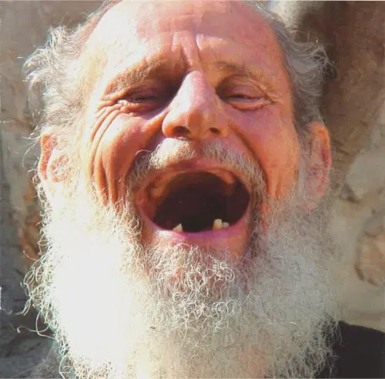
Guffaw
Part of Speech: noun
Meaning: a loud, unrestrained burst of laughter
The toothless old man let out a huge guffaw when I told a joke.

Slide 9
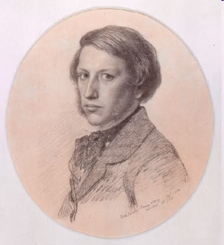
Austere (oss-TEER)
Part of Speech: adjective
Meaning: stern and severe
The man was so austere that he would not smile for his portrait.

Slide 10
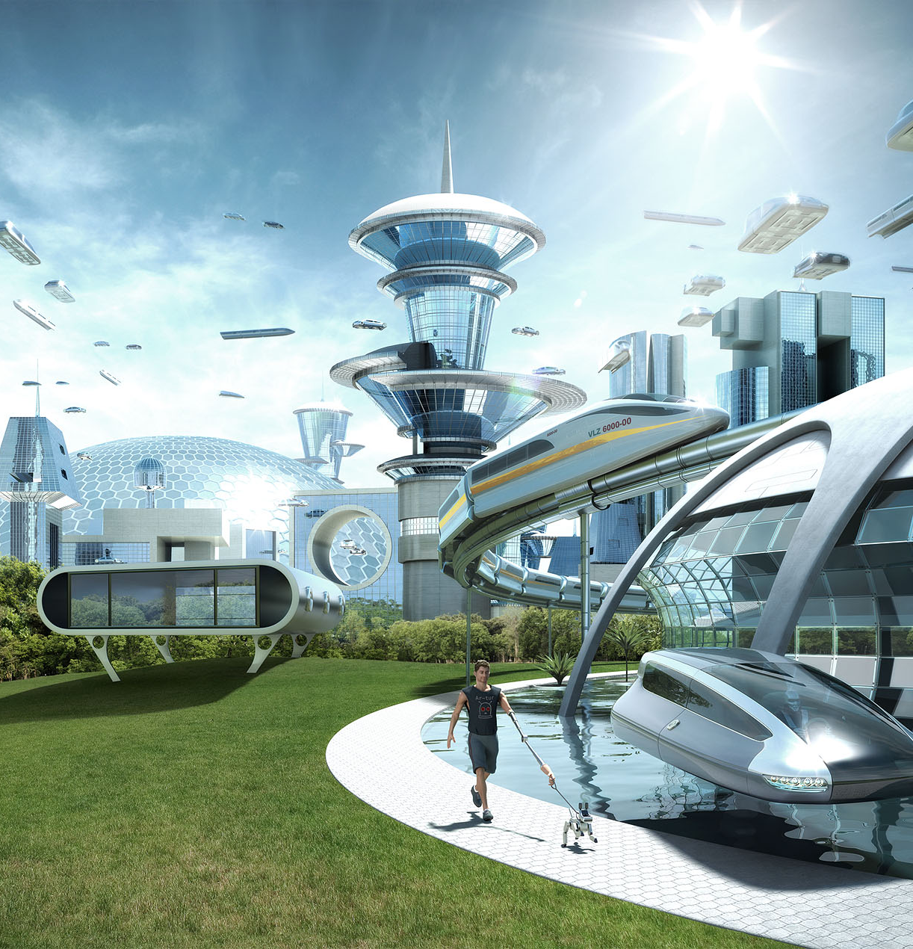
Utopia
Part of Speech: noun
Meaning: a perfect, idealised society free from fear or suffering
Science fiction movies often present the future as a peaceful utopia.

Slide 11
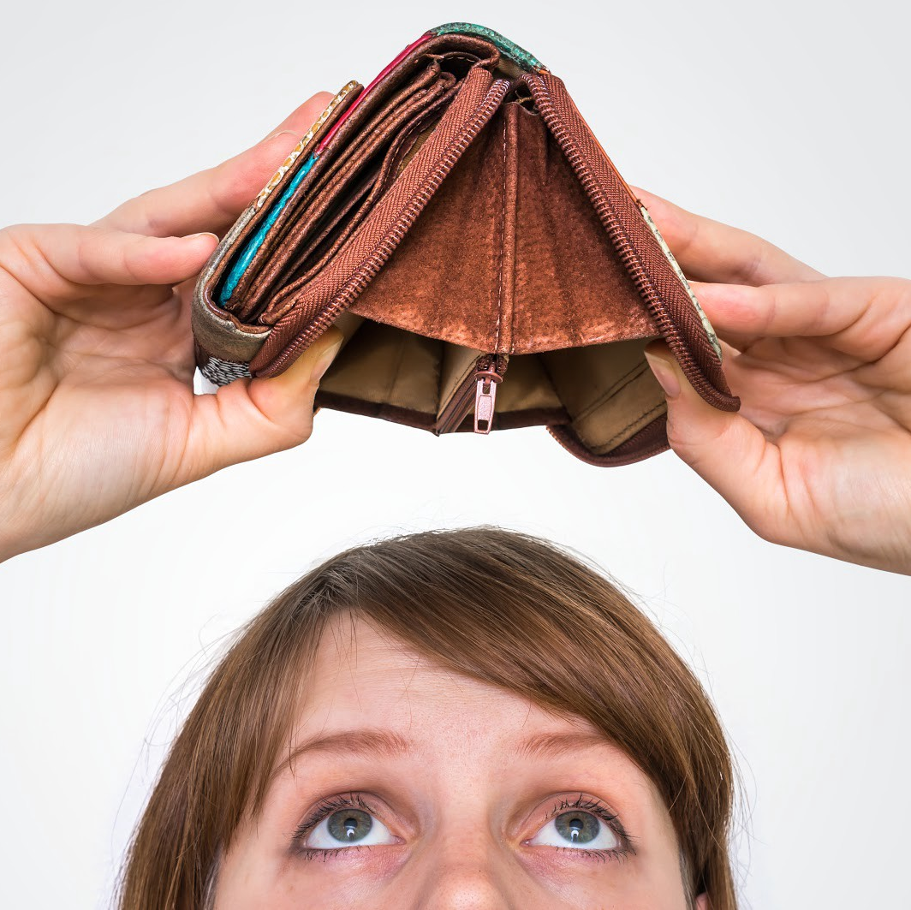
Heed
Part of Speech: verb
Meaning: pay attention; take notice of
My sister is always broke, but she still refuses to heed my sensible financial advice.

