Slide 1
Year 8 English: Vocab
Term 3, Week 9

Slide 2
Instigation
Part of Speech: noun
Meaning: urging or pushing; causing someone to act or making something happen
He only does his homework at his mother’s instigation.

Slide 3
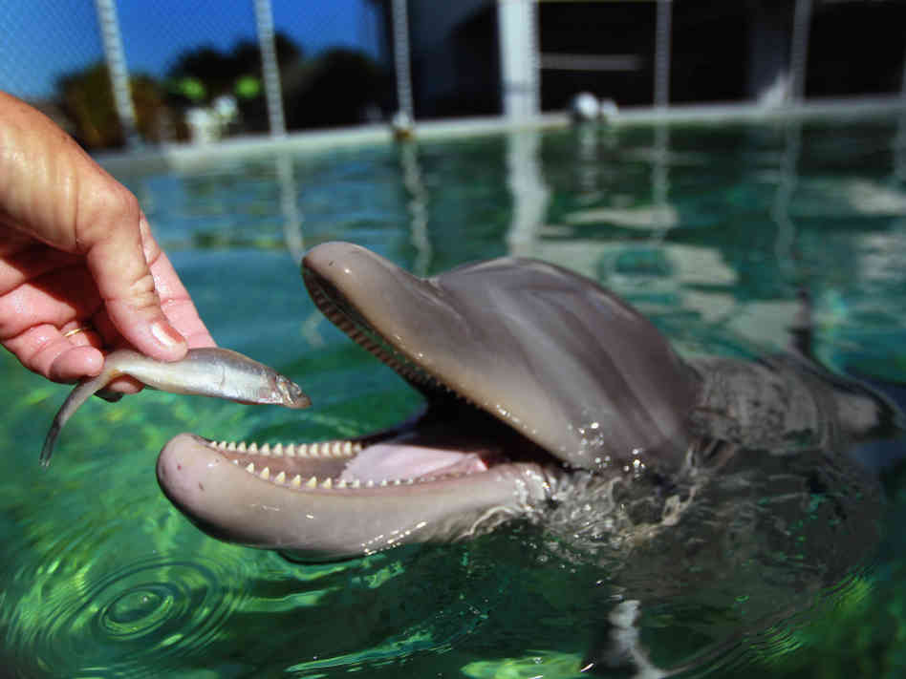
Voracious
Part of Speech: adjective
Meaning: greedy and never satisfied
Dolphins are voracious eaters and can consume up to 14kg of fish per day.

Slide 4
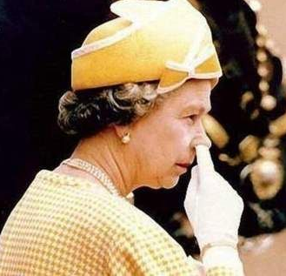
Uncouth
Part of Speech: adjective
Meaning: bad-mannered, embarrassing or rude
I never dreamed that the Queen could do something so uncouth.

Slide 5
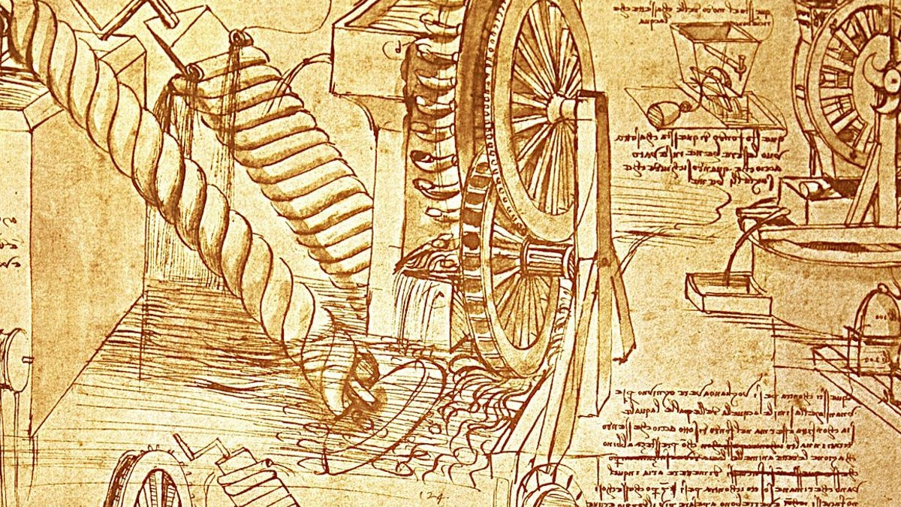
Renowned
Part of Speech: adjective
Meaning: famous, well known
Leonardo Da Vinci is renowned for his many wonderful paintings and inventions.

Slide 6
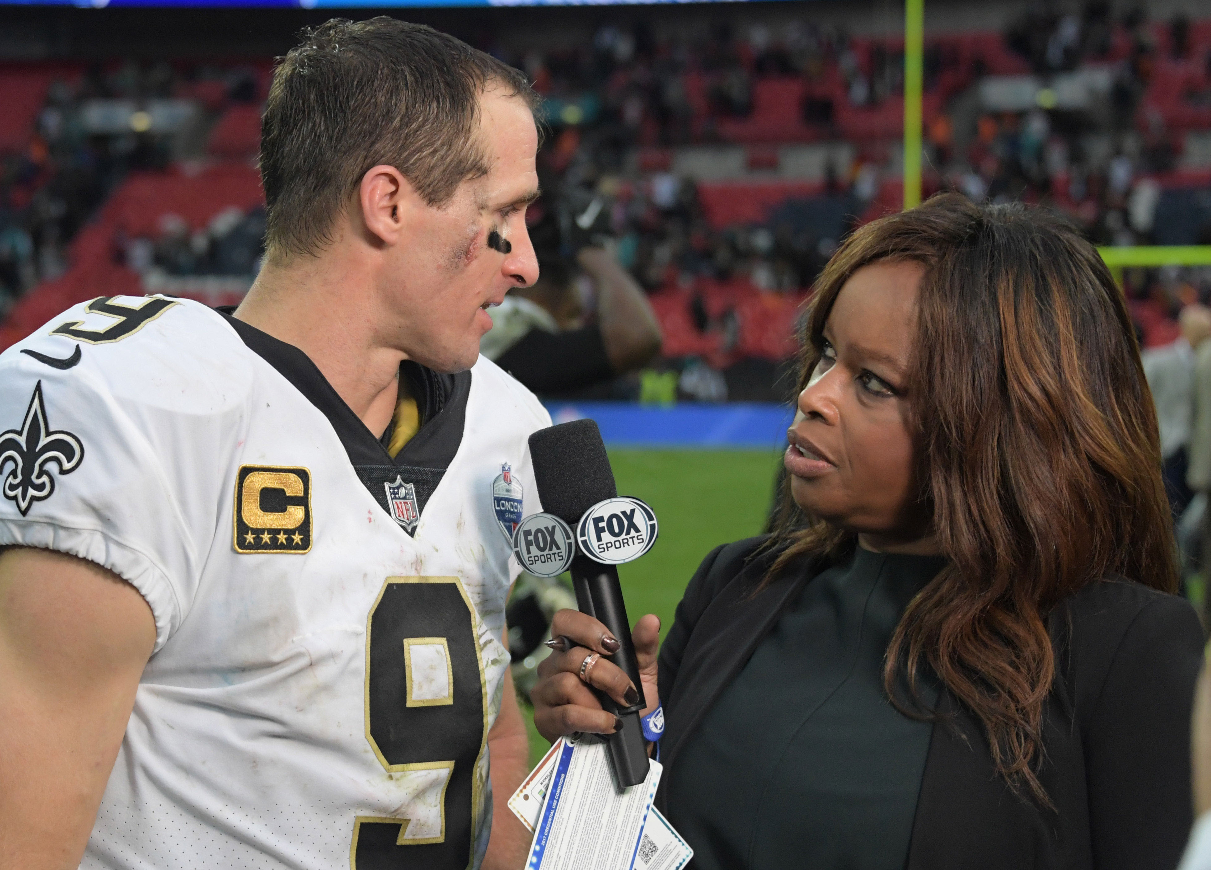
Discomfited
Part of Speech: adjective
Meaning: uneasy or embarrassed
Public figures must learn not to act discomfited when they are asked tricky questions.

Slide 7
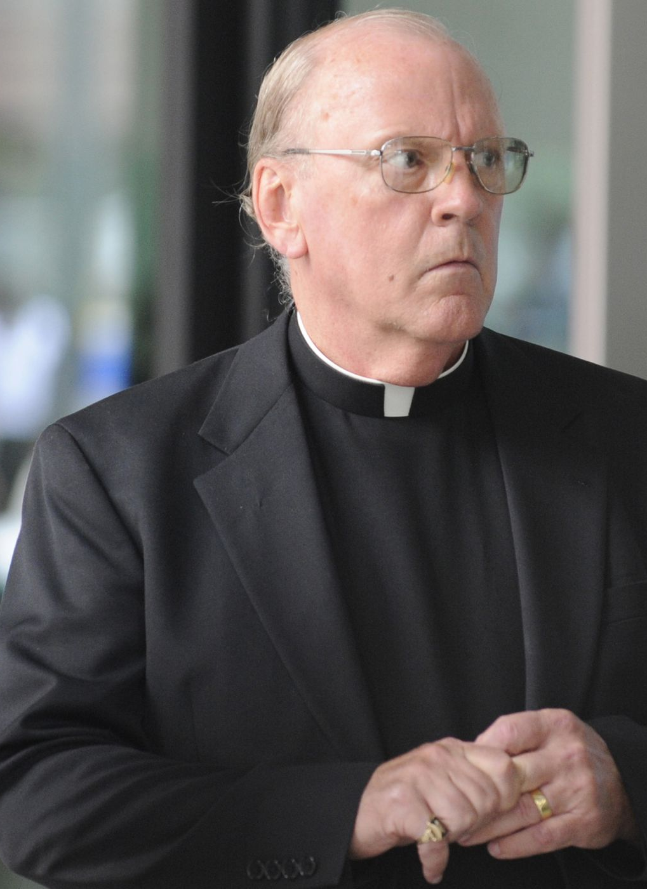
Infamy
Part of Speech: adjective
Meaning: fame for something bad
The vicar’s theft of the collection money brought infamy to his name and the church.

Slide 8
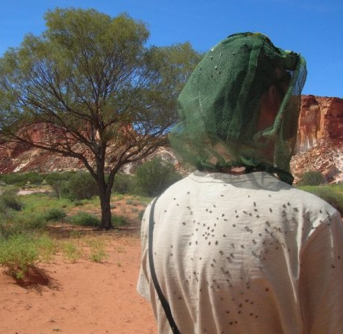
Onslaught
Part of Speech: noun
Meaning: a violent attack
When we reached the campsite, the onslaught of flies almost made us pack up and go home.

Slide 9
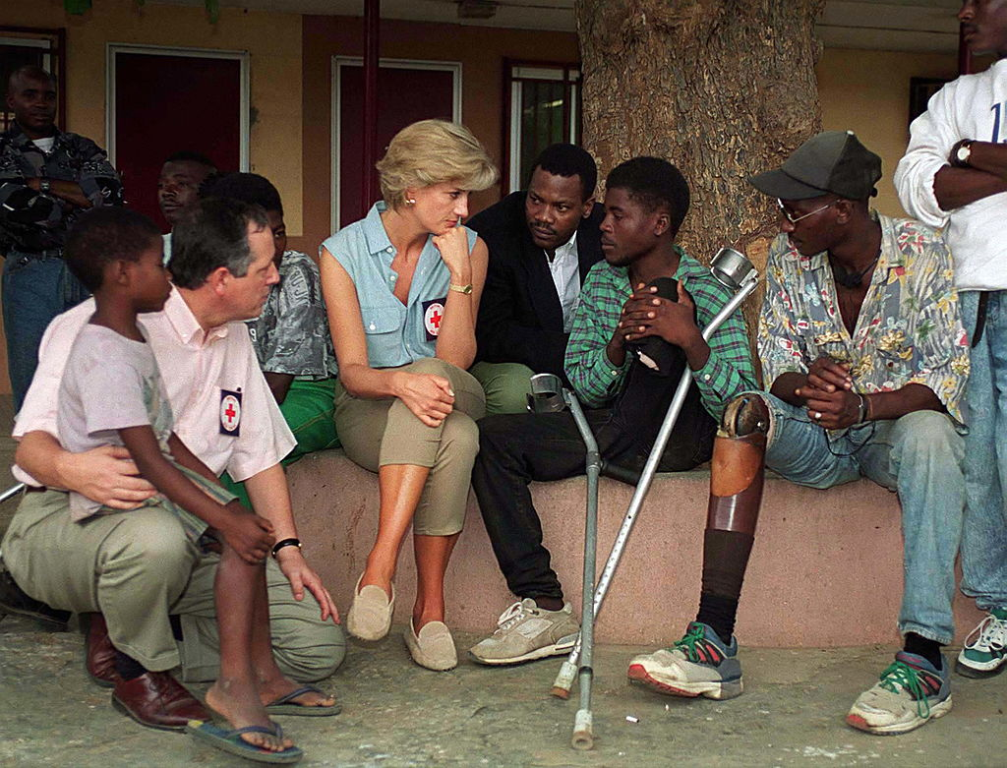
Benevolence
Part of Speech: noun
Meaning: kindness; generosity; desire to do good to others
Princess Diana was known for her benevolence to the poor and needy.

Slide 10
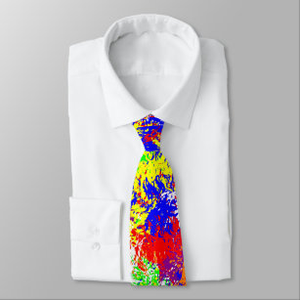
Garish
Part of Speech: adjective
Meaning: very bright, colourful or showy; tacky and tasteless
That tie is much too garish for a job interview.

Slide 11
Stealthily
Part of Speech: adverb
Meaning: secretively; sneakily
The tiger stealthily crept towards its prey.

